Slide 1

Employee Induction/ Awareness Advice and Guidance

Slide 2

Introduction
The COVID-19 pandemic has impacted severely on every part of our society and our economy.
Some have been working through this already and as we begin to gradually re-open all of our services in line with the Roadmap for Reopening Society and Business, we need to make sure that we adhere to the rules of this new way of living and working and continue to suppress the spread of the virus.
Work is a key part of life and it is important that we can work safely. This Awareness briefing is designed to provide information on the measures implemented by the Council and our responsibilities that will prevent the spread of COVID-19.
It aims to inform and advise all staff on how we can protect ourselves and our colleagues against the spread of COVID-19 in the working environment and to ensure your safety and that of our colleagues. We are asking that you to go through this presentation which will inform you how we will operate, what measures have been introduced and most importantly what is expected from you.
Please go through this presentation at your own pace and familiarise yourself with the measures required to ensure your safety and that of your colleagues.

Slide 3


Coronavirus (COVID-19)
To combat COVID-19, we must understand how it is spread and how to protect ourselves, our families, our colleagues and our community.
COVID-19 is a new illness that can affect your lungs and airways. It is caused by a new (novel) virus called Coronavirus.
As such we must all follow the public health advice and guidance, as well as any specific measures in place to help prevent the spread of COVID-19 in the work environment.
How the virus is spread COVID-19 is spread in sneeze or cough droplets.
 | You could get the virus if you: Come into close contact with someone who has the virus and is coughing or sneezing Touch surfaces that someone who has the virus has coughed and sneezed on and bring your unwashed hands to your face (eyes, nose or mouth)

Slide 4



COVID-19 symptoms
The most common symptoms are:
Cough: any kind of cough, usually dry but not always | Fever: High Temperature over 38º C | Shortness of Breath | Difficulty Breathing
It can take up to 14 days for symptoms to appear. If you are felling unwell or displaying symptoms, immediately self isolate and make phone contact with your GP and line manager / supervisor. Persons displaying symptoms must telephone their GP and follow advice received.

Slide 5


COVID-19 symptoms, Self-Isolation and Close Contact
To protect you, your colleagues and family, it is essential that if you:
Have any symptoms of COVID-19 or if you feel unwell before or
during work
0r
2. Have been in close contact with a confirmed COVID-19 case
You should immediately self-isolate at home, make phone contact with your GP and line manager / supervisor and follow advice issued.

Slide 6
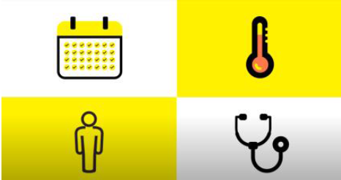
COVID-19 symptoms, Self-Isolation and Close Contact
Close Contact is defined as:
Spending more than 15 minutes within 2 metres of an infected person.
Living in the same house or shared accommodation as an infected person.
It is advised you do not return to work after isolation unless:
It has been 14 days since your first symptoms
5 days have passed without a temperature
You have no symptoms
Unless your doctor recommends otherwise.
If you are in an at risk / vulnerable group, as advised by the HSE, or have any concerns contact your GP.

Slide 7



protection against getting COVID-19
One of the best ways to prevent person to person spread of respiratory viruses, including COVID-19 is to follow proper hand hygiene and respiratory etiquette. Follow this advice as strictly as possible and encourage others to follow it too.
 | Hand Hygiene - Wash hands regularly and avoid touching your face and eyes with your hands. Use hand sanitiser where soap and water is not available. If hands are visibly dirty, wash hands with soap and water prior to using the sanitiser. Remember this should be for at least 20 seconds. Click Here for Posters & Videos
 | Cough Etiquette - when coughing / sneezing, cover your mouth and nose with your bent elbow or a tissue. Place used tissues into a closed bin and wash hands.
 | Clean and disinfect frequently touched objects and surfaces. Keep your environment clean.

Slide 8



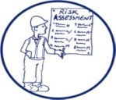
protection against getting COVID-19
 | Unnecessary Contact - Do not shake hands or make unnecessary contacts.
 | Physical Distancing - (also known as social distancing) aims, through a variety of means, to decrease or interrupt the spread of COVID-19. It does this by minimising contact between potentially infected individuals and healthy individuals. The current recommended distance to be maintained between people to minimise risk of transmission is 2 metres. If your work activity is going to require close contact within 2 metres, STOP and ask your line manager / supervisor for advice. This will require a risk assessment resulting in additional protection measures.

Slide 9
protection against getting COVID-19
 | Physical Distancing - (continued) Recommendations for physical distancing may include: Avoiding any crowded places When in public areas be respectful of the local community. Avoid gathering in groups and follow physical distancing. Organising office space in such a way that physical distances are maintained. Organising teams /crews to consistently work and take breaks together. The teams should be as small as is reasonably practicable in the context of the work to be done. Organising breaks to facilitate maintenance of physical distancing. Conducting meetings using online remote means as much as possible. Where face to face meetings are necessary, the length of the meeting and the numbers attending should be kept to a minimum and participants must maintain physical distancing at all times. Reorganising and rearranging working and break areas e.g. placing tables and chairs far enough apart in canteens. Providing one-way systems for access/egress routes where practicable. Implementing physical distancing during outdoor work activity.

Slide 10







protection against getting COVID-19
 | Travelling to work - Where possible, walk or cycle, to and from work. Where possible, travel alone in your private vehicle. Parking arrangements for additional cars and bicycles may need to be considered for employees during this time. If availing of public transport, follow physical distancing guidelines provided by operators. Minimise contact with frequently touched surfaces, e.g. handles, roof straps, isolation bars. Sanitise hands on arrival at work location.

Slide 11


protection against getting COVID-19
 | Travelling for work and mobile plant - The occupancy level of vehicles is to be minimised and single occupancy for vehicles is preferable. If more than one per person per vehicle, the following measures should be followed: Sit as far apart as the vehicle allows. Passenger to travel in the back of the vehicle at left passenger side. Keep windows of vehicles open, at least partially. Practice good respiratory hygiene. Key touch points in vehicles / mobile plant are to be wiped regularly (e.g. door handles, steering wheel, handbrake, gear stick, radio controls). Hand Hygiene - hands sanitised before and after entering / exiting the vehicle. Hygienic wipes and hand sanitiser must be available for this purpose. Cough Etiquette - when coughing / sneezing, cover your mouth and nose with your bent elbow or a tissue.

Slide 12



protection against getting COVID-19
 | Welfare Facilities - When using welfare facilities such as canteen, toilets, drying rooms allow appropriate time and space to facilitate the correct levels of hygiene and physical distancing. Be respectful of these boundaries. Toilets: You must respect the space available to ensure physical distancing. This may require a longer wait. Canteen: Break times should be staggered to reduce congestion and contact Cleaning materials will be provided, please clean area when finished break/s and dispose of rubbish appropriately Do not share objects that touch your mouth e.g. bottles, cups Always be vigilant of sources of contamination. Drying Rooms: You must respect the space available to ensure physical distancing while you change. Report any concerns to the line manager or supervisor.

Slide 13


protection against getting COVID-19
 | Work Environment - We must all work as a team. Throughout your day you should: Continue to maintain hygiene by washing your hands regularly. Keep your workspace clean and disinfected. Regularly clean high touch surfaces e.g. Handrails, Tables, desks, chairs, doorknobs, light switches, handles, phones, keyboards, toilets, taps and sinks. Be mindful of distractions.
 | Equipment, tools and plant - Equipment, tools and plant should not be shared where possible. Keep equipment, tools and plant clean and don’t share unless sanitised. Keep hands sanitised before and after use.

Slide 14


protection against getting COVID-19
 | When going home - When going home: PPE must remain at the depot / drying room / store. It is recommended that clothes are washed daily. Wash your hands before you leave. Travel alone if possible by walking, cycling, using a private vehicle. If availing of public transport, follow physical distancing guidelines provided by operators. Minimise contact with frequently touched surfaces, e.g. handles, roof straps, isolation bars. Keep contact points on your vehicle clean. Wash your hands when you return home, change your clothes and leave your boots outside.

Slide 15
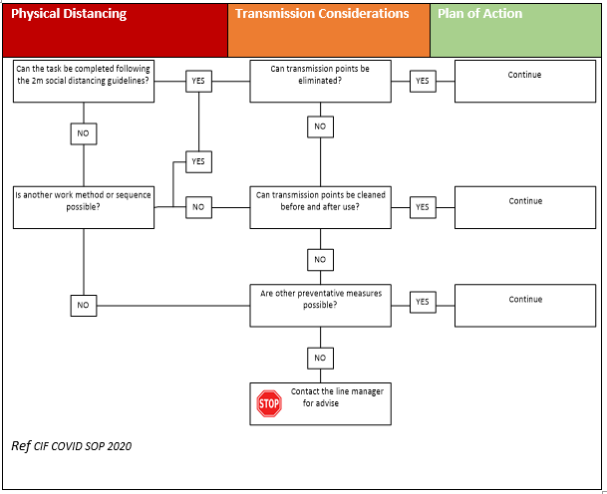
Work Processes and Risk Assessment
All work processes will have to be risk assessed, this process has been designed to protect you and your colleagues.
If you are in any doubt speak to your line manager / supervisor for guidance.

Slide 16
General Principle to be applied during covid-19
Reduce - the number of persons in any work area to comply with the 2-metre physical distancing guideline recommended by the HSE.
Review - work practices, mindful of close working arrangements. Employees should be encouraged to self-assess their task for physical distancing and transmission points.
Supervise – monitoring compliance to ensure physical distancing, hygiene rules and COVID –19 control measures are being adhered to and maintained in order to reduce the risk of the spread of COVID-19.

Slide 17
Health and Safety Documentation
Kilkenny County Council has a Covid 19 Working Safely Response Plan detailing how we are implementing the Government Return to Work Safely Protocol. This takes account of:
  “High Level LA COVID-19 Work Safely Health and Safety Guidance” (LGMA)
  Posters/ Videos
  Risk Assessments
  Safe Operating Procedures (SOPs)
  Memos
The risk assessment is the most important process for ensuring specific requirements have been assessed AND identified for YOUR workplace/ work activity and are put in place.
Each Line Manager should go through their Covid 19 risk assessment and any relevant SOPs with their staff
It is important to note that all existing Health and Safety provisions continue to apply during this time.

Slide 18
Compliance and Monitoring
Monitoring compliance will require ensuring that physical distancing, hygiene rules and COVID–19 control measures are being adhered to and maintained in order to reduce the risk of the spread of COVID-19.
It is important to note that compliance with COVID-19 control measures is the responsibility of everyone and must be supported by all in order to protect health and reduce the spread of COVID-19. Compliance checks with COVID-19 may include checking the following measures are in place and being adhered to:
Adequate signage Physical Distancing Hand Washing Cough/Sneeze Etiquette Safety Documentation | Risk Assessment Increased cleaning regimes where required Staggering breaks, lunch times, etc Correct use and disposal of PPE

Slide 19
Wellbeing

Infectious disease outbreaks like coronavirus (COVID-19), can be
worrying and can affect your mental health. As well as the Employee Assistance Programme, there are many public resources available which can be accessed at the links below:
Minding your Mental Health
https://www2.hse.ie/wellbeing/mental-health/minding-your-mental-health-during-the-coronavirus-outbreak.html
https://www.gov.ie/en/campaigns/together/?referrer=/together/
Mental Health Supports & Services
https://www.hse.ie/eng/services/list/4/mental-health-services/connecting-for-life/news/supports-and-services-during-covid-19.html
In This Together – Help & Advice to Protect your Mental Health
https://www.gov.ie/en/campaigns/together/?referrer=/together/

Slide 20
PEOPLE TO CONTACT in Kilkenny County Council for COVID-19 issues
We are here to help and advise with physical distancing and hygiene maintenance during this period.
Contact any of the following for advice and guidance:
Line Manager
Health and Safety Officer
Covid 19 Compliance Officer
Safety Representative
HR Officer
Your local trade union reps

Slide 21
Final Note
We must all depend on each other to protect ourselves, our families, our colleagues and our community.
It is essential that we follow the Government and HSE guidelines at home and at work.
Take ownership of yours and others safety
Maintain physical distancing
Limit physical contact
Wash your hands and practice good respiratory etiquette
If in doubt STOP and ask your line manager / supervisor
THANK YOU

