Slide 1
Butts Area Regeneration Framework Plan

Slide 2
Engagement with Residents etc.
Public Consultations
Consultations | Number attended | Number of surveys
Initial Consultation - 29th Feb 2024 | 38
1st consultation (Nov 6th 2024) | 70 | 50
2nd consultation (Feb 17th 2025) | 50 | 51
3rd consultation (Apr 30th 2025) | 47 | 40
4th consultation (June 25th 2025) | 52 | 45

Slide 3
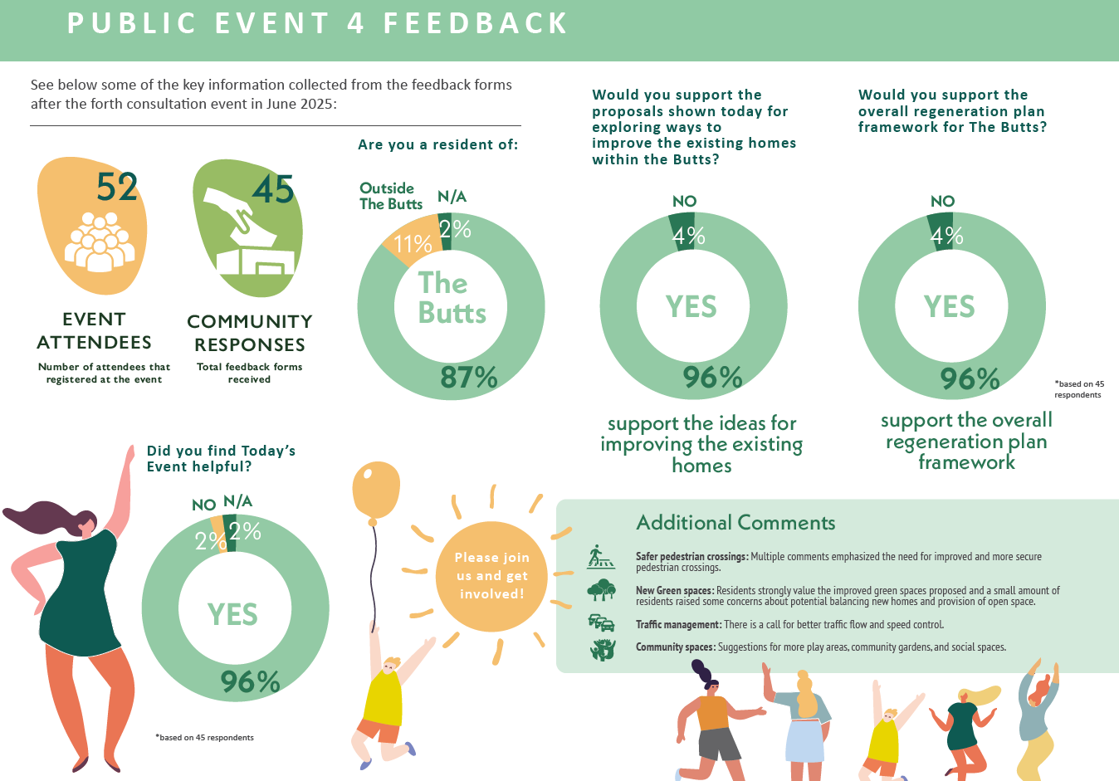

Slide 4
Engagement with Residents etc.
Selection of Additional Comments
Generally, people found the event very helpful, with a lot of information provided on the plans for the Butts
Traffic issues prevalent, with improved pedestrian crossings and other measures requested
Concerns were raised by a small number about the footbridge at Kennyswell, houses in the back field and in the KCC yard

Slide 5
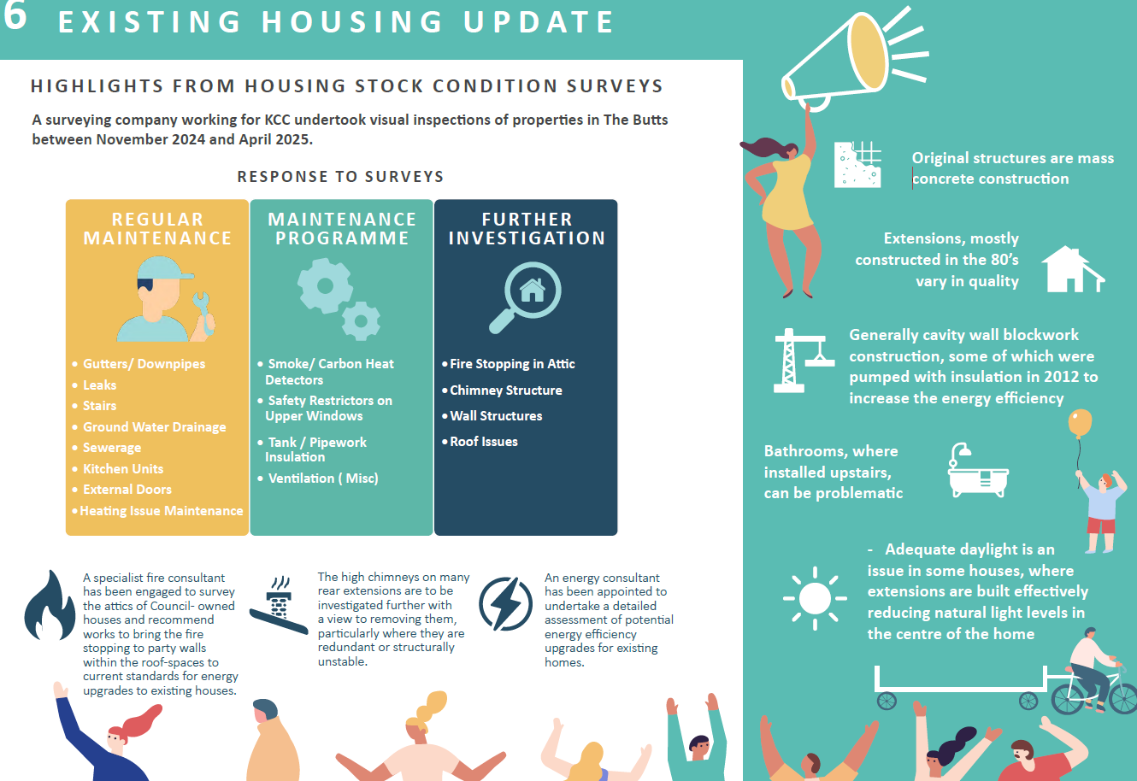
Existing Housing Stock

Slide 6
Existing Housing Stock (Contd.)
Pilot houses at Pearse Street & Connolly Street
Explore potential redesign solutions
Engage with tenants
Align units to current space standards, where possible
Improve energy efficiency
Decanting of residents, depending on extent of work

Slide 7
Green Field to Rear Connolly Street
Proposals:
Playing pitch
Dressing Rooms
Overlooked by new
housing

Slide 8
St. Joseph’s Road Site
Proposals:
Widen St. Joseph’s Road
to provide tree lined avenue
Includes housing along
St. Joseph’s Road, with a
Green space and play area
(age friendly & family units)

Slide 9
Sr. Anthony’s, Lord Edward Street
Proposals:
Age friendly housing
Family housing
Green space/food
growing area
Landscaping

Slide 10
Roads/Traffic within the Butts
“Rat run” from Tullaroan
Road
Support for changing
traffic movement/explore
1-way system
Traffic sub-committee
Prohibit right turn from
Tullaroan Road

Slide 11
Waterbarrack
Develop as a general
amenity area
Footbridge to Kennyswell
to improve accessibility
Basketball court/boules area
Handball alley – PS –
requires work

Slide 12
Next Steps:
City MD for approval
Costing of identified Projects
Submit Framework to Department for approval
Implementation Plan
Part 8’s/Planning for projects

Slide 13
Link to webpage below (notices/newsletters):
https://kilkennycoco.ie/eng/services/planning/town-regeneration/butts-area-regeneration.html

