Slide 1


Slide 2

Regional Cultural Strategy

Slide 3
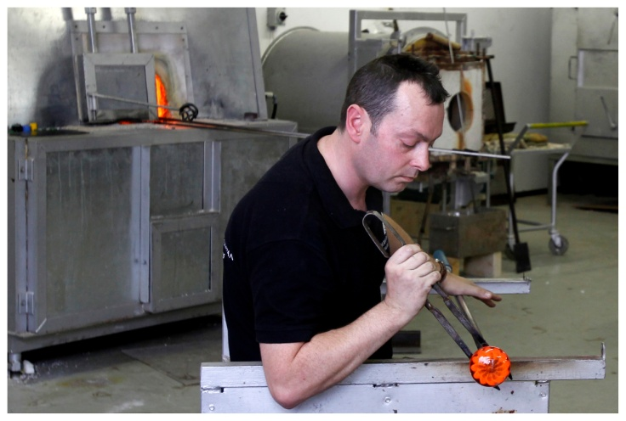
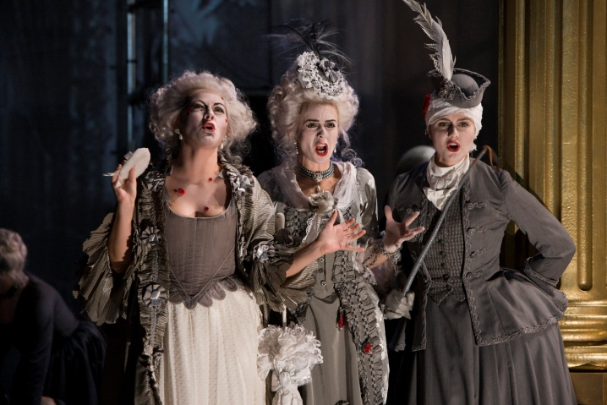
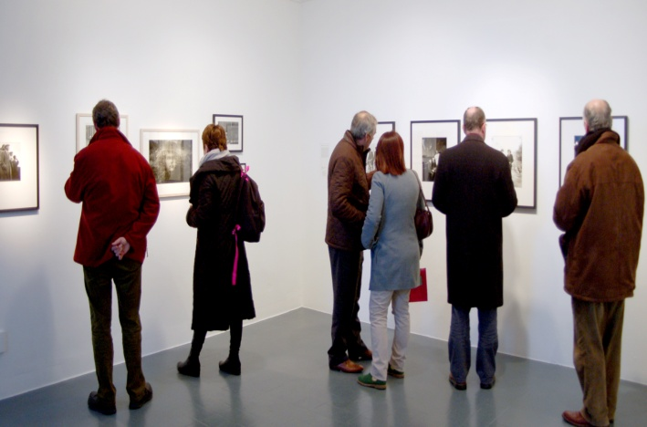
Regional Cultural Strategy 2016-2025
Vision
A region where the intrinsic value of culture is understood, appreciated and resourced to deliver excellence, innovation, accessibility and engagement for all who live, work and visit the Three Sisters.

Slide 4
Regional Cultural Strategy 2016-2025
Four Strategic Priorities
A Regional Model for Partnership
The Creative and Cultural Economy
Culture Led Social development
Urban and Rural Regeneration
Mission
To transform the Three Sisters region through culture-led partnership and investment to enhance the lives of our citizens

Slide 5
Ask of Kilkenny County Council:
To Adopt the Regional Cultural Strategy 2016-2025 for the Three Sisters region.

Slide 6
European Capital of Culture Bid
Three Sisters 2020

Slide 7
Introduction
The European Union designates one or more cities as a European Capital of Culture each year since 1985.
The title celebrates the richness and diversity of cultures throughout Europe and aims to bring the peoples of Europe closer together and improve our mutual understanding.
Waterford, Kilkenny and Wexford are bidding as the Three Sister Region against Limerick and Galway (Dublin was eliminated at the short-listing stage).
The Region has formed a unique partnership of the three LAs and the Cultural Sector. A partnership approach with a single cultural programme is a first for the ECoC and offers the opportunity to broaden the concept.

Slide 8
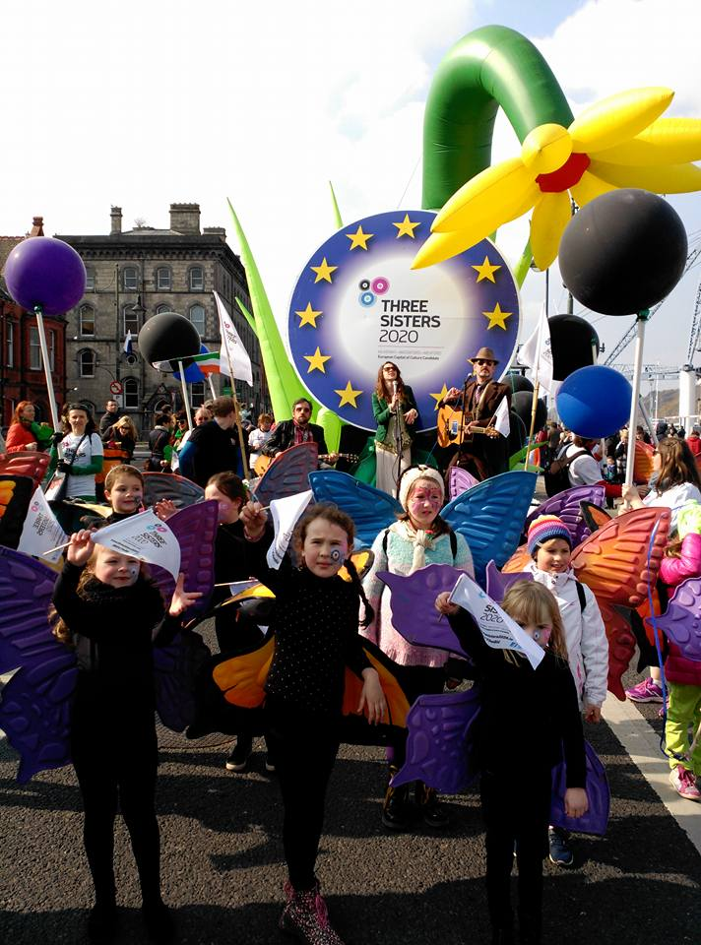
Benefits
We will automatically become “the place to visit” in Europe with an immediate increase in visitor numbers
We will be able to create a more sustainable future for our artists and creative people.
There will be improvements in investment opportunities, enterprise creation
and a greater appreciation for the value which creativity can bring
Improved image is a key impact indicator for many ECoCs

Slide 9

Benefits
Experience of Liverpool ECoC – 2008
  Awareness increased from 46% to 65%
  Tourism in the city grew by 34%
  The additional spending was £754m
Experience in Cork ECoC - 2005
  Increase in visitor numbers of 38%
  Increase in tourism income of 28%

Slide 10
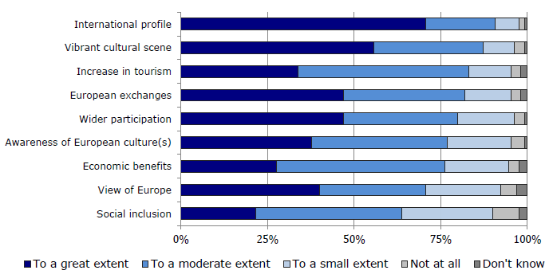
European Parliament Report on ECoCs Impact

Slide 11

The Bid Book
  Six equally weighted areas with over 50 questions
  1.Contribution to the long-term strategy
  2. European dimension
  3. Cultural and artistic content
  4. Capacity to deliver
  5. Outreach
  6. Management

Slide 12

Key Issues Raised by the Jury
  Reflect the cultures in Europe
  Strong commitment from the region
  What is the legacy, for the Region and for Europe
  Ambitious & innovative Cultural Programme
  Our capacity to deliver
  European audience

Slide 13
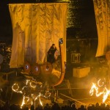
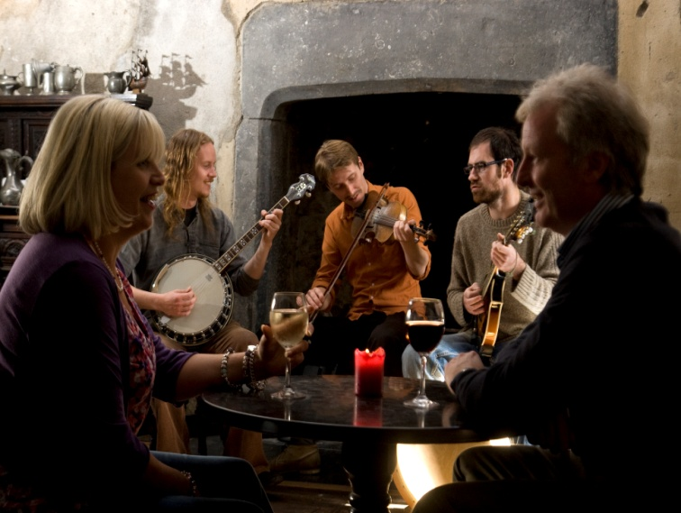
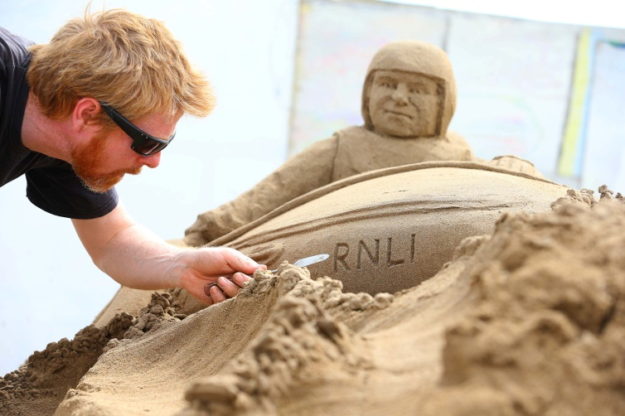
The Cultural Programme
The programme will have between 300 and 500 events.
There will be a wide range of scale and type

Slide 14
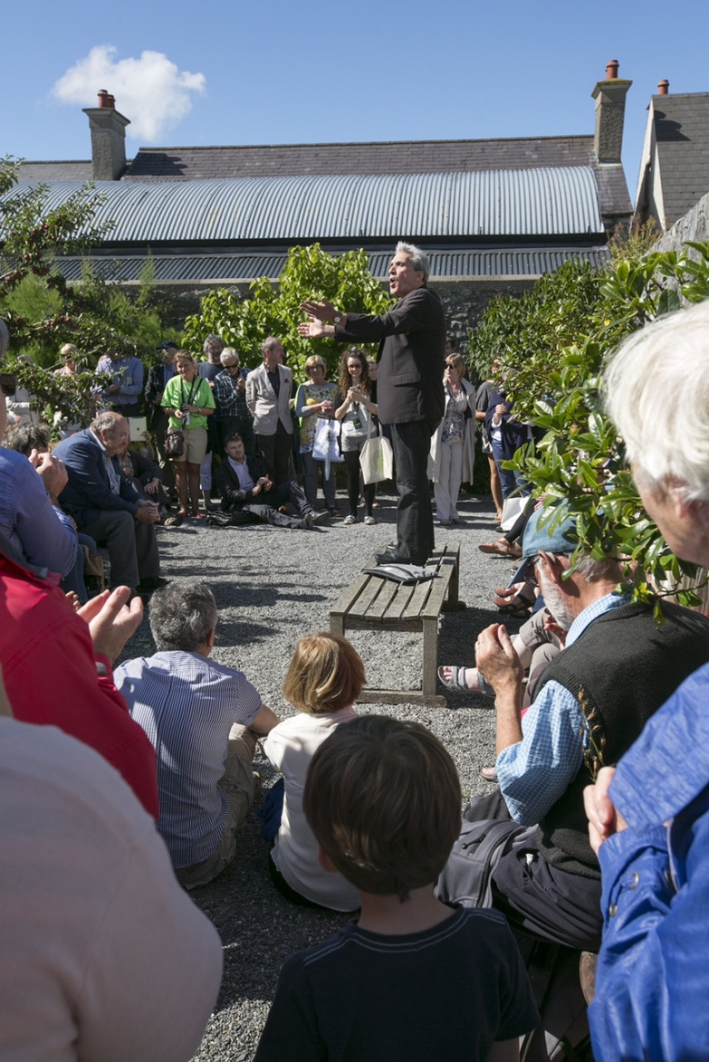
The Cultural Programme
The programme will be spread across the whole region
The programme will have a significant European element
The 2020 programme will begin building from 2016
It will leave a legacy of
  Partnership
  Collaboration
  International reputation

Slide 15
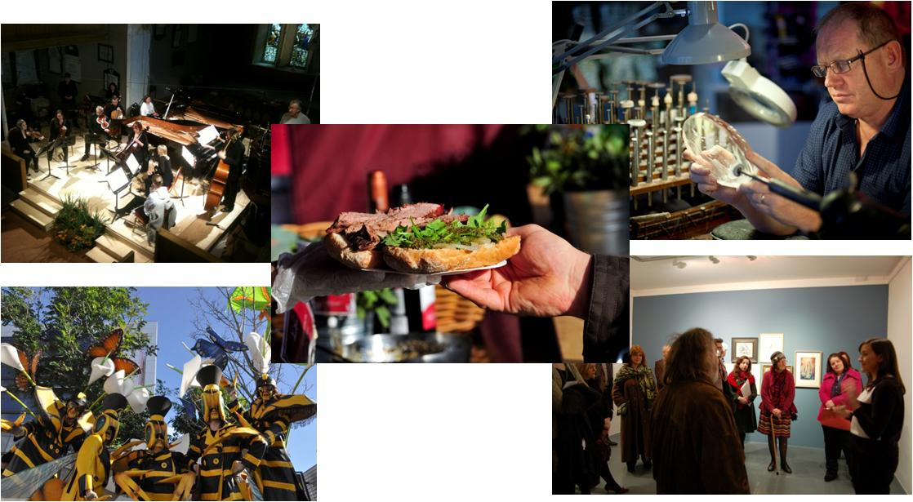
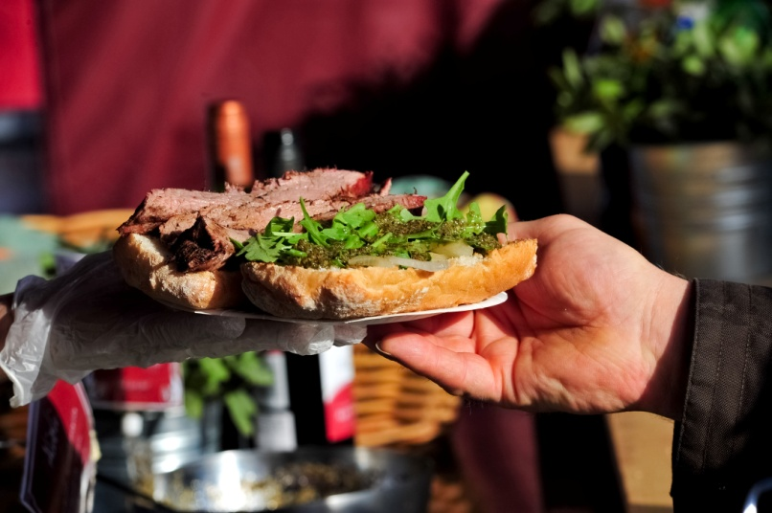
The Cultural Programme
The Bid Book programme will have over 30 large scale innovative cultural projects

Slide 16
Budget

Slide 17
Financial Impact
  The knock-on impact of expenditure of €31m in the region will be significant
  The expenditure of €4m on Marketing will generate national and international coverage to the value of €24m
  The return on investment of the total program expenditure is estimated at €170m for the region

Slide 18
Budget
*Subject to final programming

Slide 19
Key dates
  June 17th: Bid Book deadline
  July 13th: Jury visit the region
  July 14th: Jury interview
  July 15th: Announcement of Irish European Capital of Culture 2020

Slide 20
Ask of Kilkenny County Council:
1. Approve Contribution to the European Capital of Culture Budget
2. Endorse the Three Sisters Bid to host European Capital of Culture in 2020

Slide 21
Thank you
  Questions
  Further comments or questions can be sent to me at emma@threesisters2020.ie
  Programming ideas can be submitted on our website www.threesisters2020.ie
  Follow us on twitter @3sisters2020 and on facebook threesisters2020

