Slide 1
Hebron Road Urban Design Strategy April 2017

Slide 2
Study Area

Slide 3
Development Plan context:
It is an objective of the Kilkenny City and Environs Development Plan 2014 - 2020, to prepare an Urban Design Framework Strategy.
Z3 – Hebron Road:
To prepare an Urban Design Framework Plan for the Hebron Road.
Zoning change to mixed use
In place since 2008 Development Plan

Slide 4
Development Activity
Development Proposal have come forward.
Have been refused
No framework in Place
Design

Slide 5
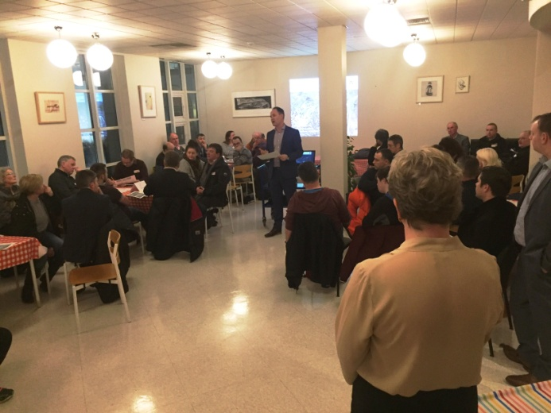
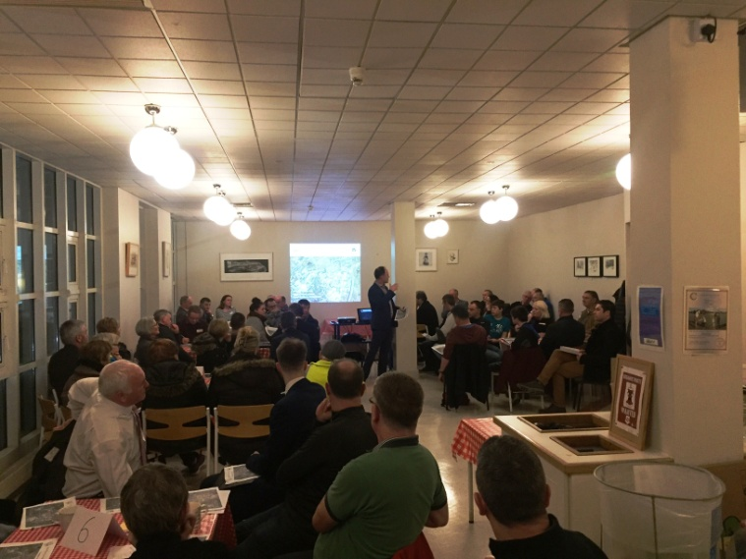
Public Consultation
1st Feb 2017
About 60 people attended
Youth consultation
Comhairle Na nOg

Slide 6
Main Issues
HGV traffic access arrangments
Landscaping
Lack of trees and landscaping
Poor pedestrian and cycle facilities
Traffic speed
Funeral & match day parking
Not to be a primary route to city

Slide 7
Main Issues

Slide 8
Proposals
Mixed use corridor
Incrementally improved
Priority Development Sites
Strong building lines
Hebron Road cycle land & pedestrian
Release development potential of sites
While achieving other objectives

Slide 9
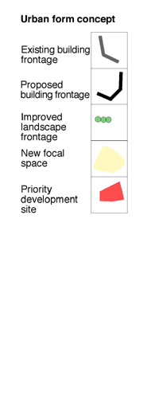
Proposals

Slide 10
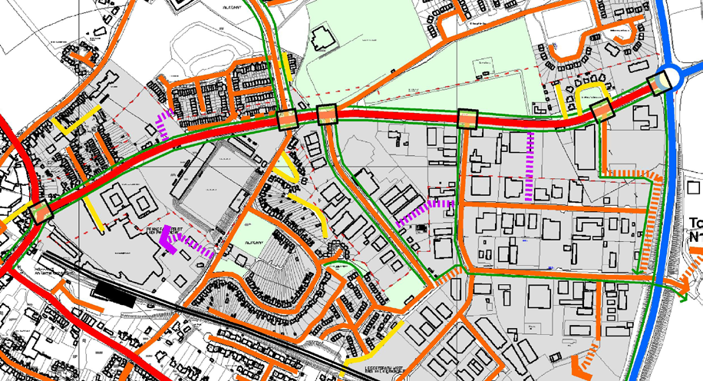
Traffic & Junctions
Traffic Issues : moving to signal junctions
subject to Transport Impact Assessment
Improved Cycle and Pedestrian facilities
Hebron Road – small land take/ realignment
In discussion with Road Design and Area Engineer to finalise recommendations before public display.

