Slide 1
GRANT SCHEMES

Slide 2
Grant Schemes covered include:
Outdoor Recreation Infrastructure Scheme
CLAR Scheme
Town & Village Scheme
Rural Regeneration & Development Fund

Slide 3
Funding for the development of new facilities, and for the maintenance, enhancement or promotion of existing outdoor recreational infrastructure in rural areas across Ireland.
The Scheme is administered and funded by the Department of Rural and Community Development with additional funding being provided by Fáilte Ireland.

Slide 4
The 2019 Outdoor Recreation Infrastructure Scheme (ORIS)
Measure 1: Small maintenance/promotion of existing infrastructure (maximum grant €20,000)
Measure 2:
Medium scale repair/upgrade and development of new small/medium infrastructure (grant of between €20,000 and €200,000)
Measure 3:
Repair/upgrade and development of larger more strategic projects (grant of between €200,000 and €500,000).
Local authorities are the applicant bodies under Measures 1 and 2, with Local Development Companies invited to participate under Measure 1 as partners or co-applicants.
Measure 3 open to local authorities and State Agencies, with collaborative approaches welcomed under this Measure in particular. Funding for all three measures will be provided to a maximum of 80% of total project costs, with the balance to be provided from local authority or other sources.

Slide 5
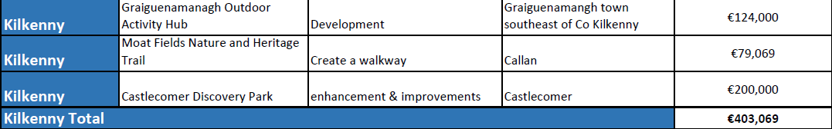
2018

Slide 6
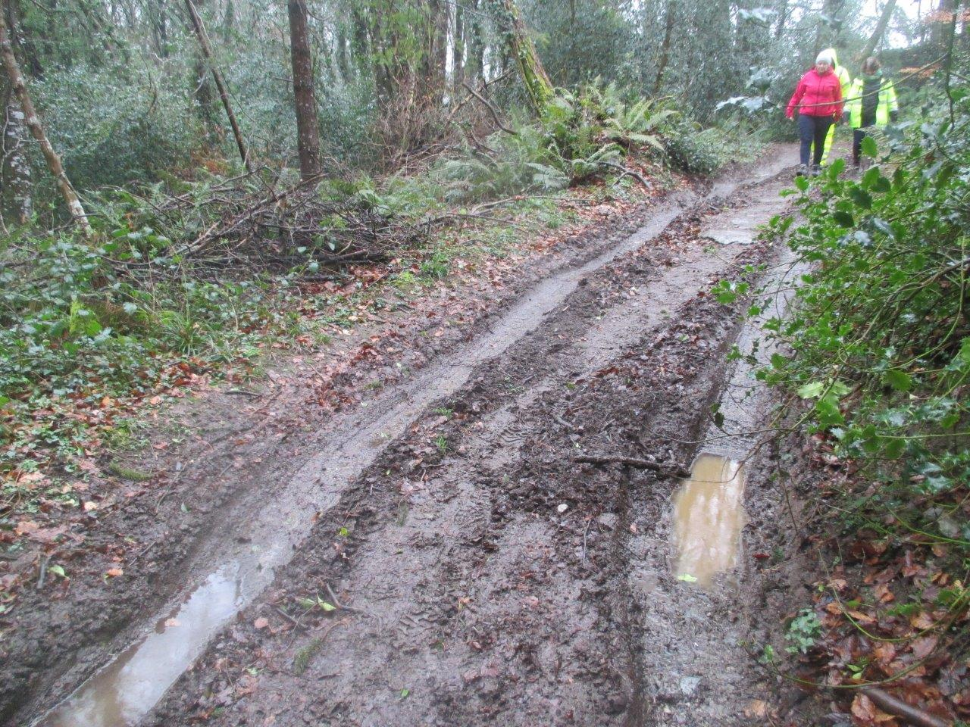
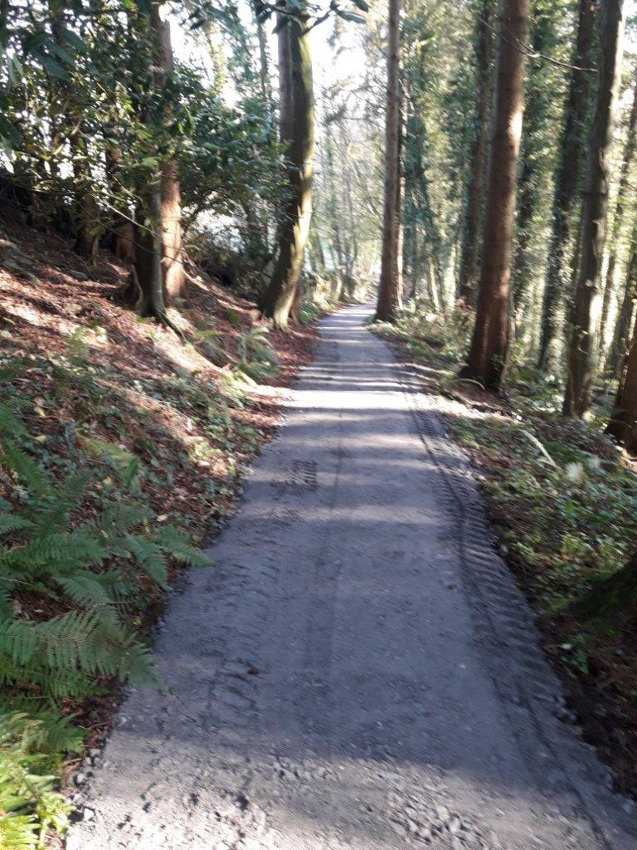
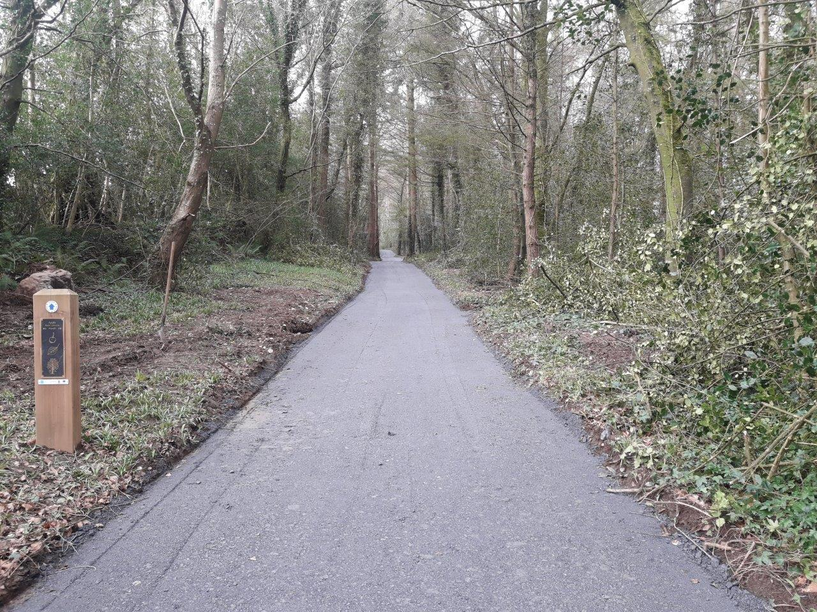
€337,553

Slide 7
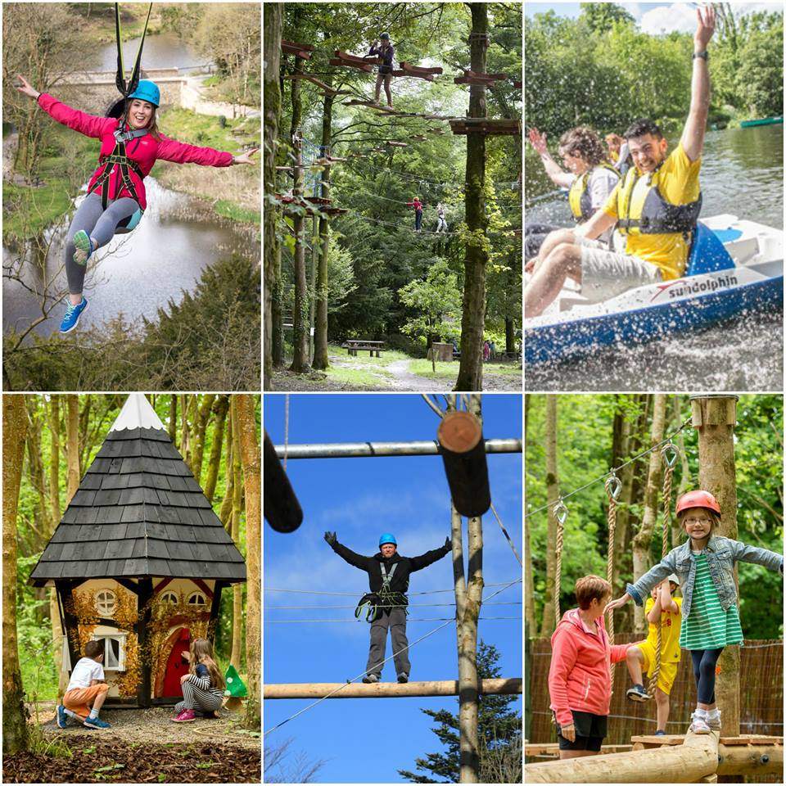
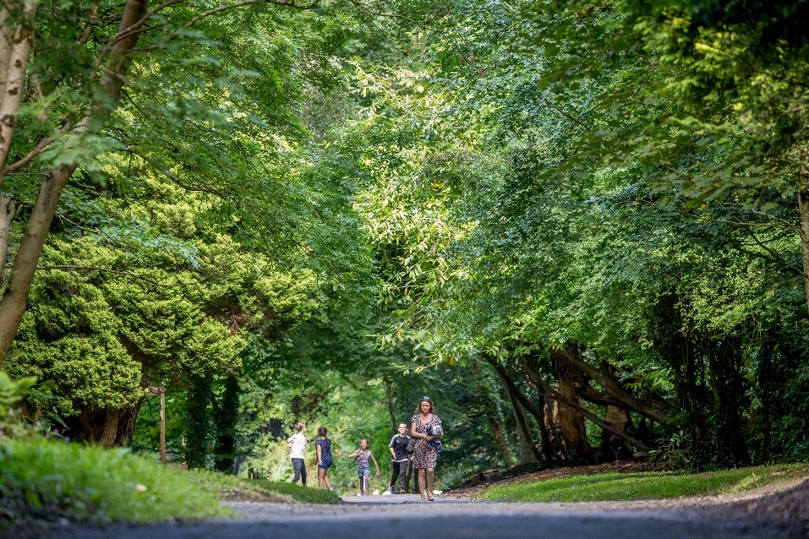
Castlecomer Discovery Park €200,000

Slide 8
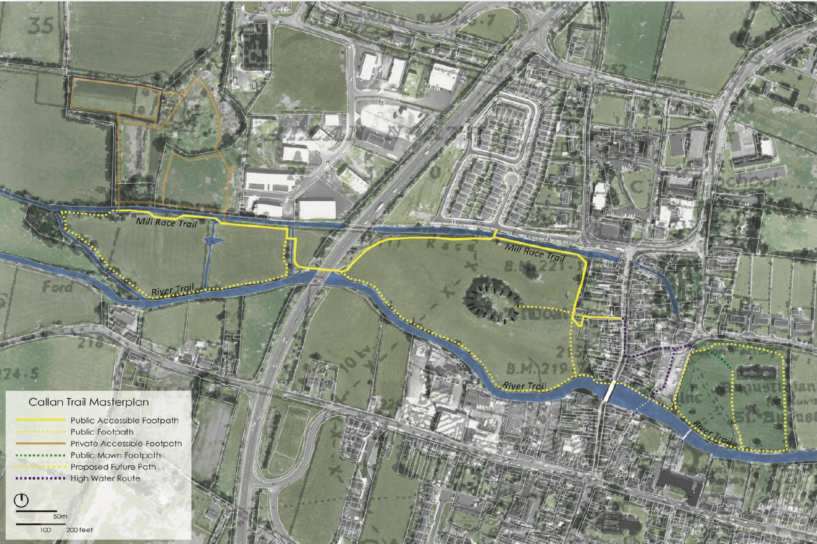
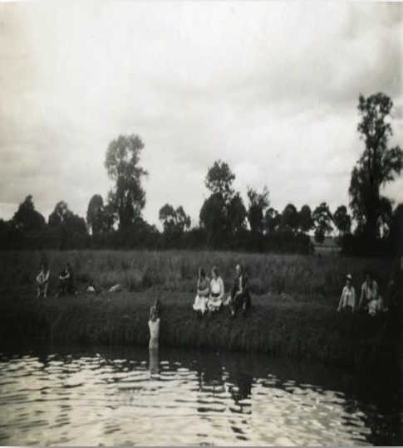
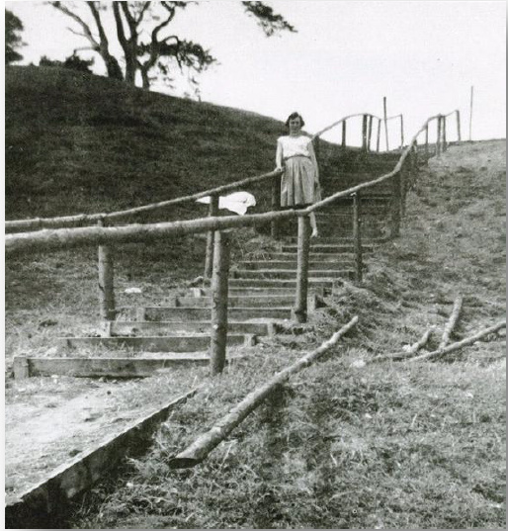
Callan – Moate Fields €79,069

Slide 9
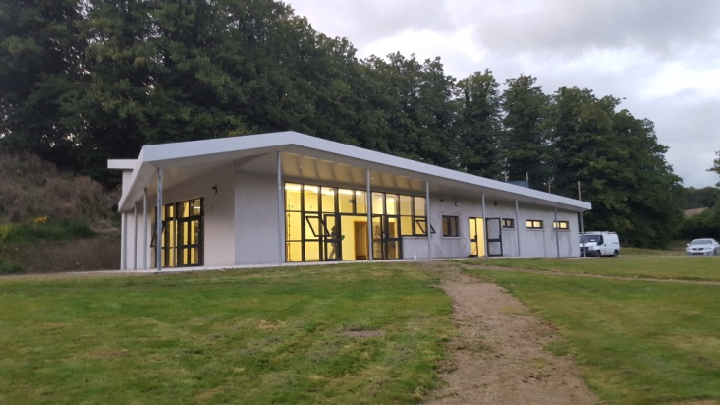
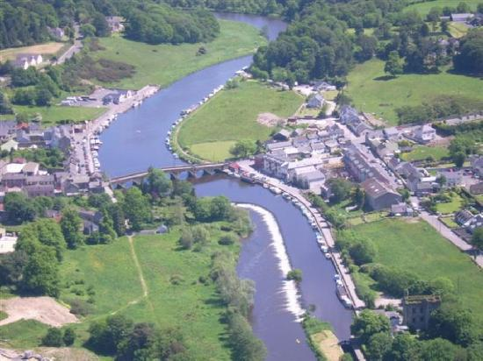
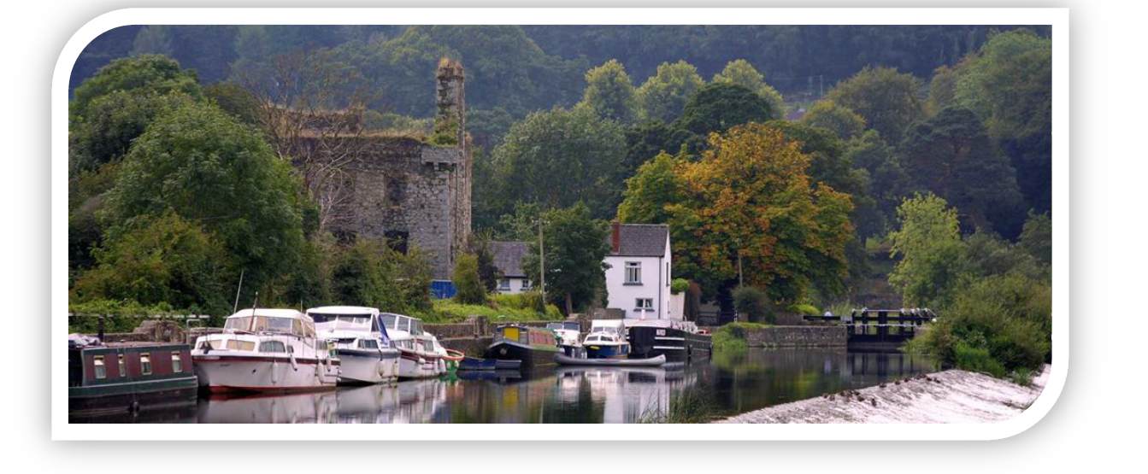
Graiguenamanagh Hub: €124,000

Slide 10
ORIS APPLICATIONS 2019:
Woodstock House Gardens and Arboretum | € 625,000 | € 500,000
Poulanassey Waterfall and Trail | € 217,000 | € 173,600
Silaire Wood Walk | € 257,513 | € 200,000
Paulstown Community Park | € 211,500 | € 169,200

Slide 11
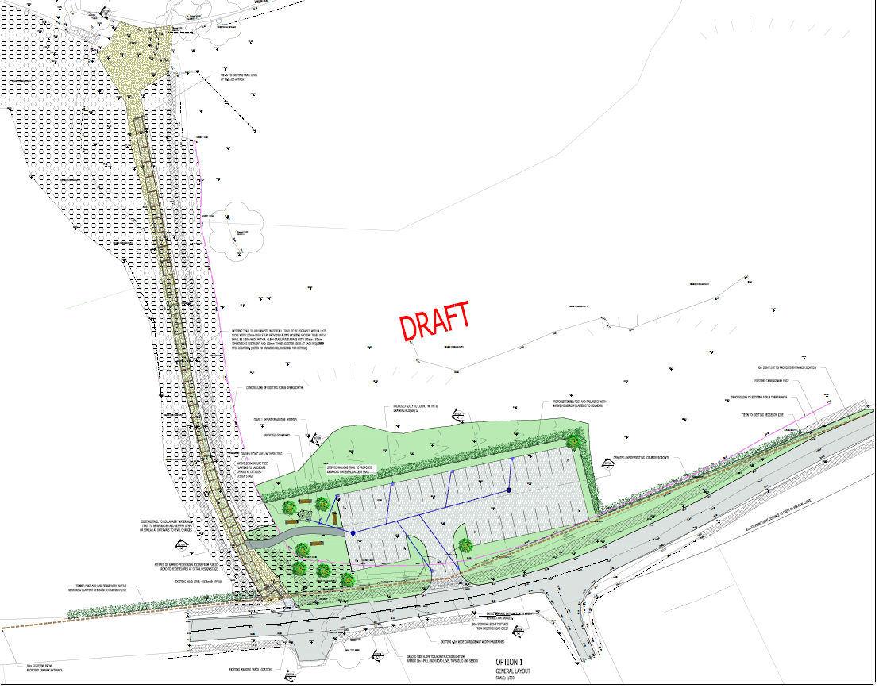
2019 Application
Poulanassy Waterfall
Car Parking and Trail rehabilitation
Subject to Part 8

Slide 12
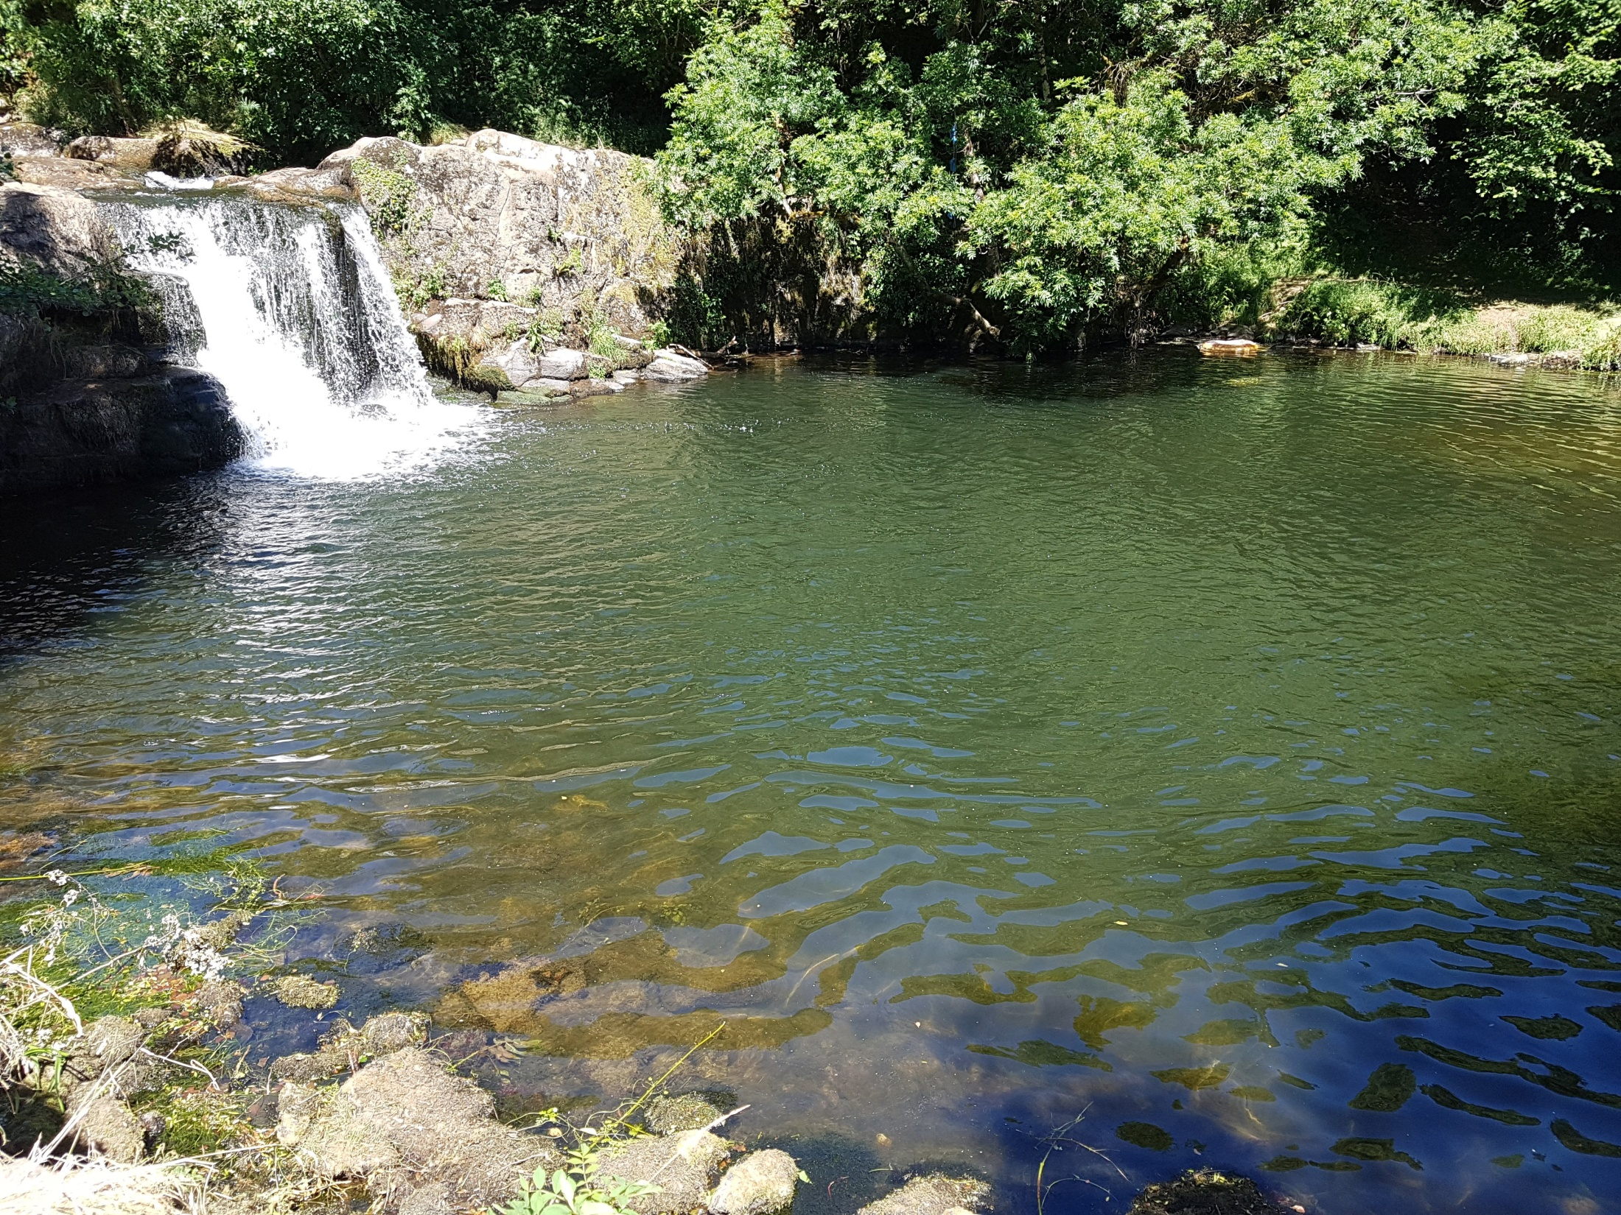

Slide 13
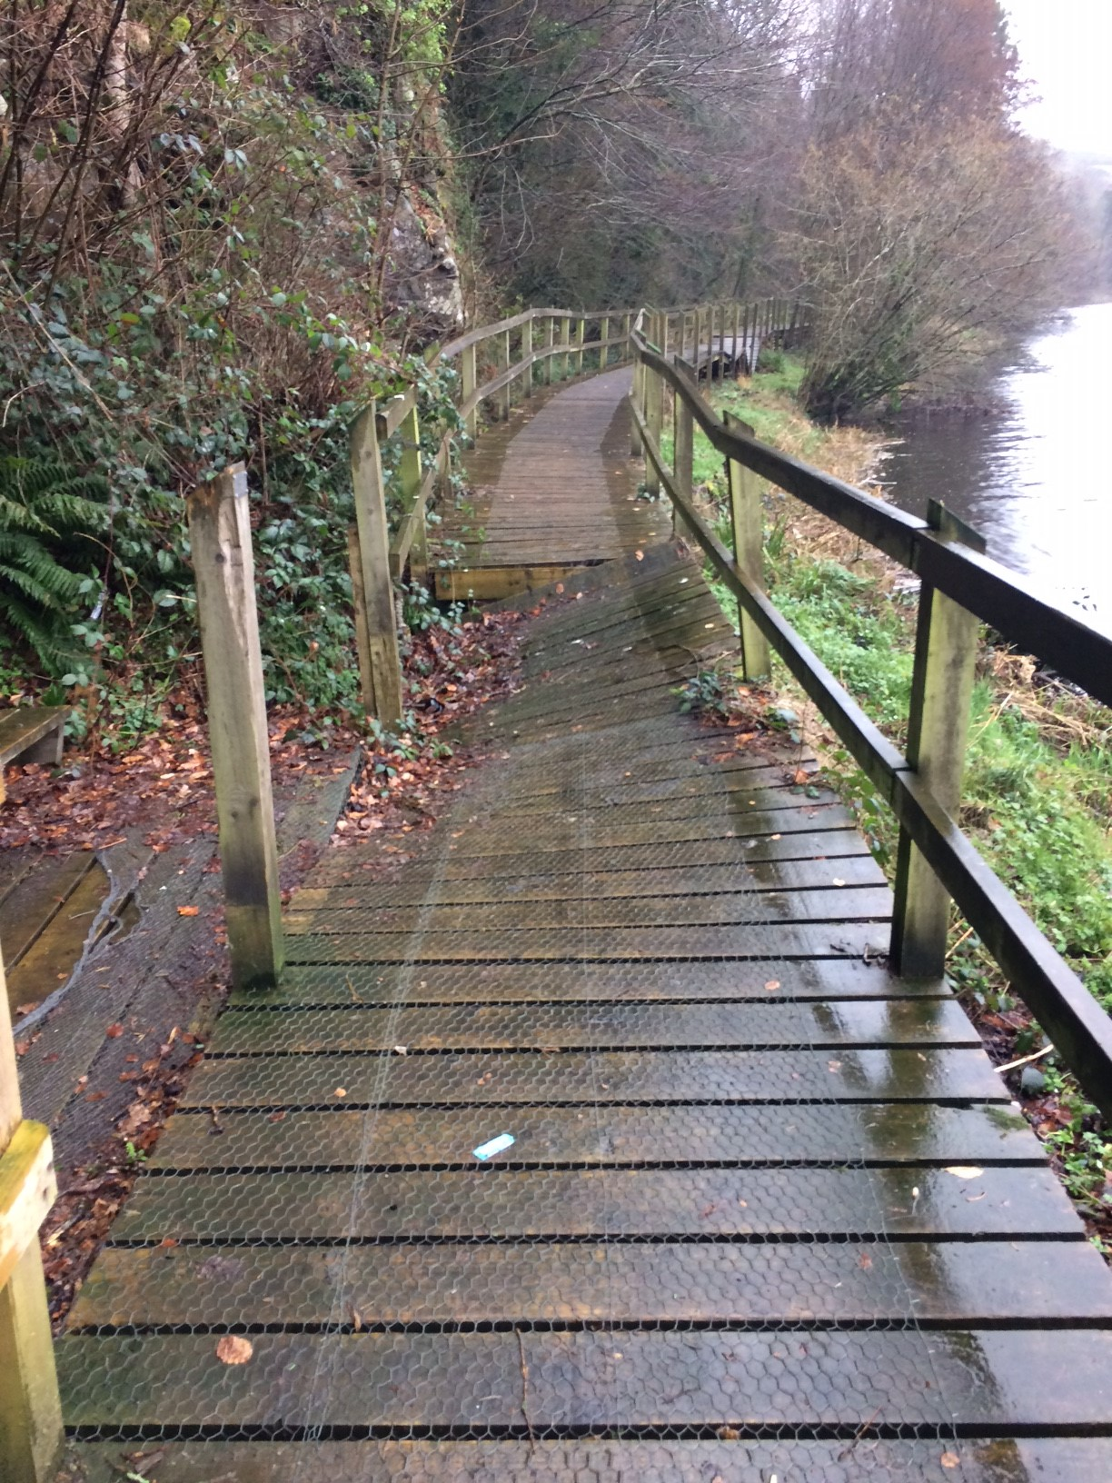
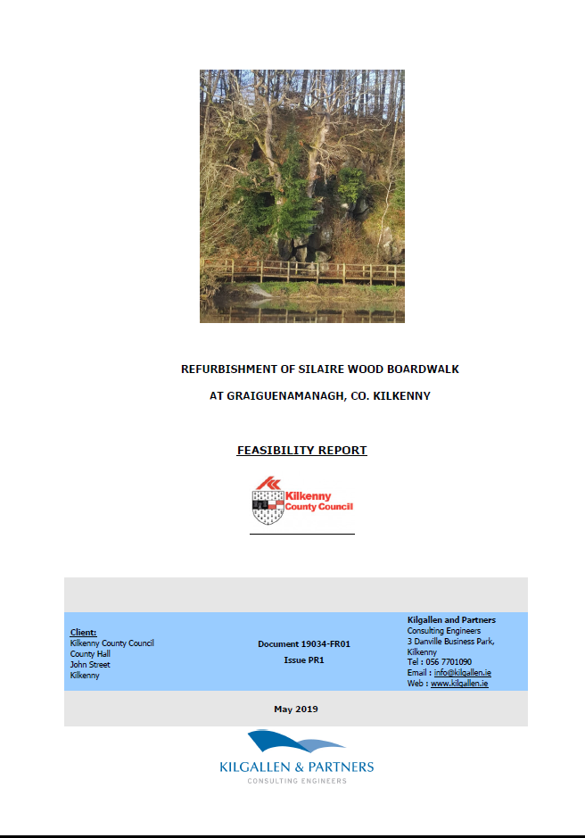

Slide 14
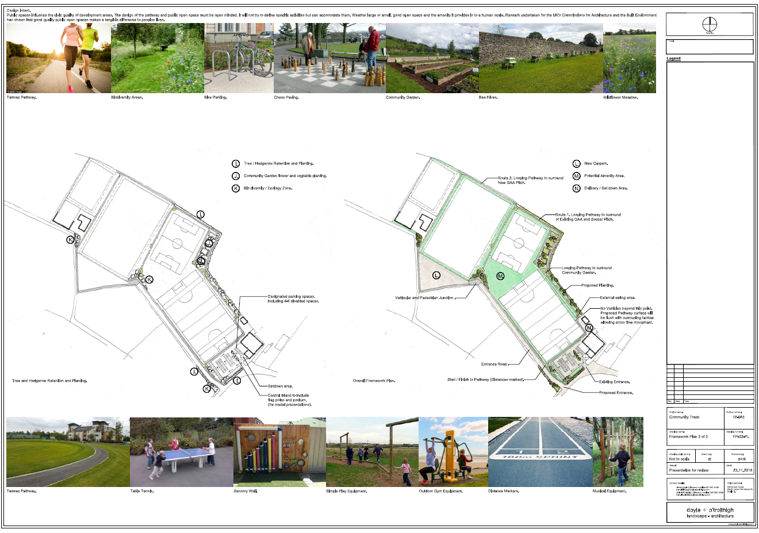

Slide 15
Smaller schemes €20K
Castlecomer Discovery Park
Woodstock Communications Plan
Kilkenny Outdoor Activity Communications Plan
Tory Hill Walk
Freshford Loop Walk
Lingaun Valley
Thomastown Cycling Loop
Activity Counters
Graiguenamanagh Hub

Slide 16
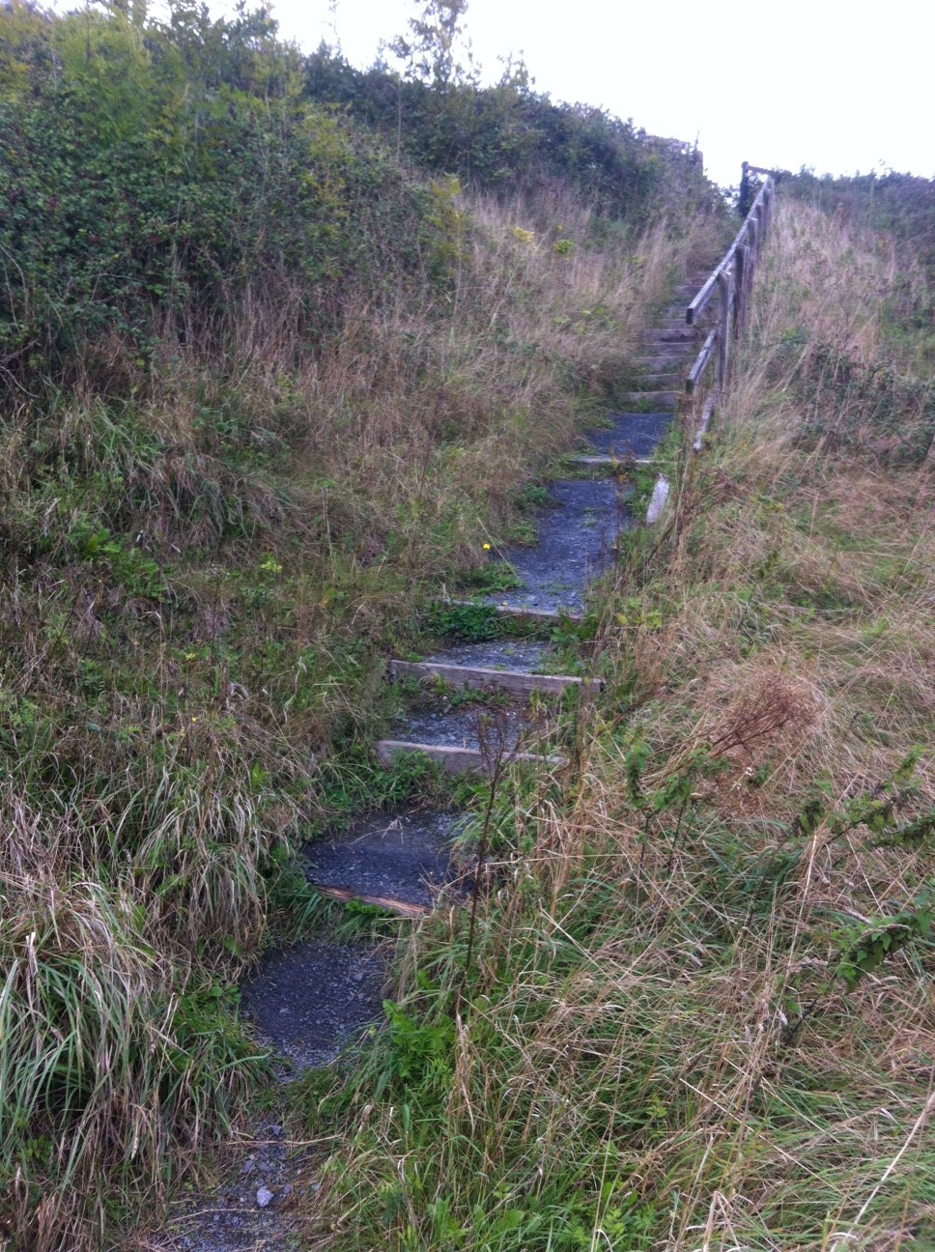
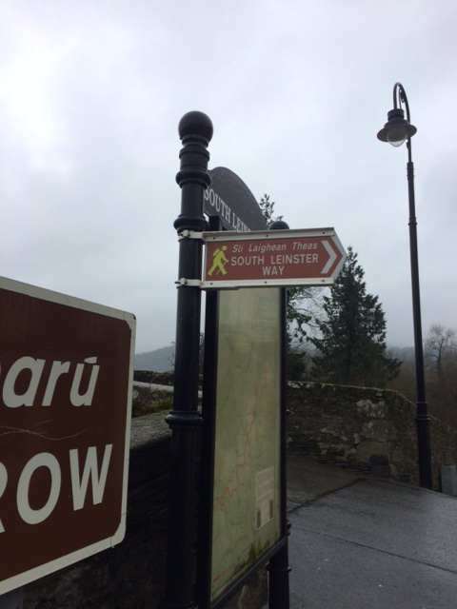
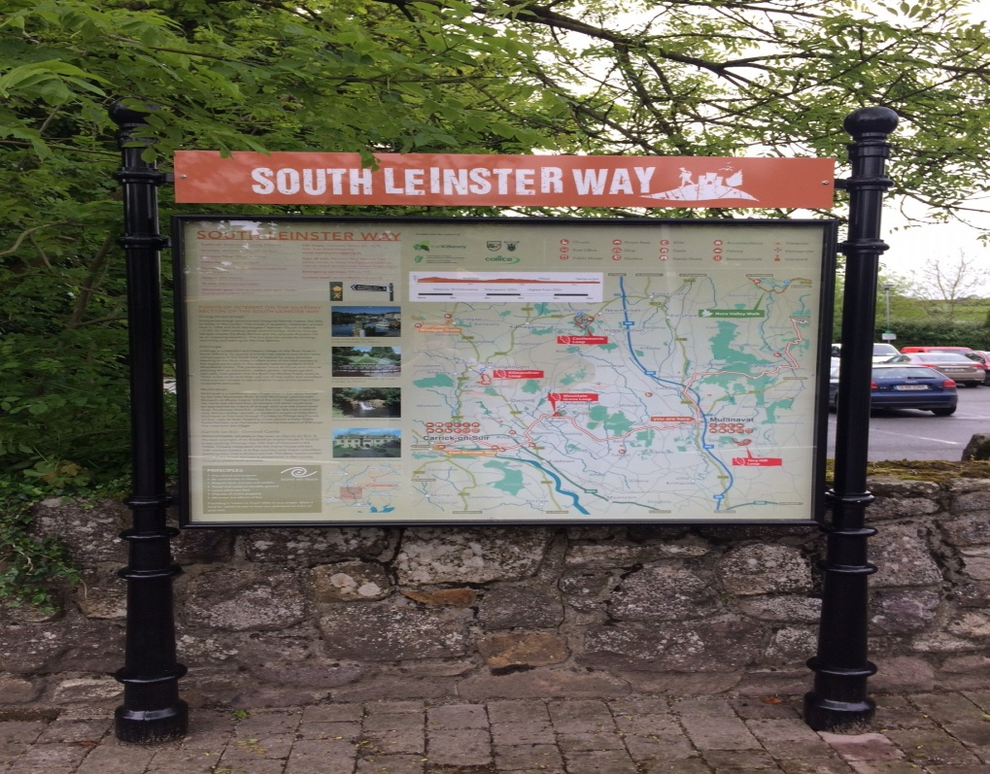
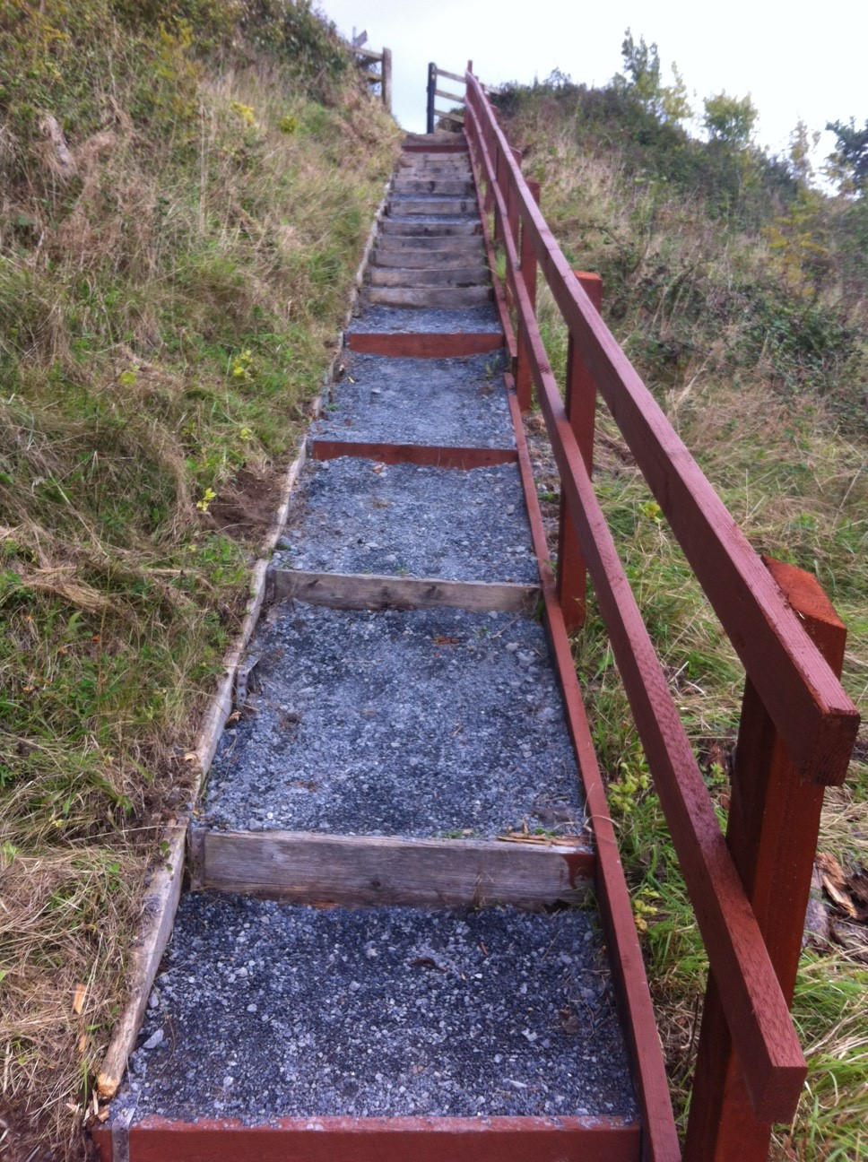
2018 Smaller Schemes..

Slide 17
Rural Funding Presentation
Overview
Main Schemes-CLÁR, Town and Village Renewal, Rural Regeneration and Development, Outdoor Recreation Infrastructure Scheme.
2016/17/18 applications and approvals.
2019 applications.

Slide 19
CLÁR Projects 2017
31 designated DED’s on the basis of population decline
A range of qualifying works which has changed since 2017.
2017
The Council submitted 14 applications (13 under Measure 1 and 1 application under Measure 2 and 1 under Measure 3 (Community Halls)) in 2017 –4 of which were approved as follows:
Galmoy Community Hall €46,772.
Crosspatrick Village / Crosspatrick Tidy Towns -Safety improvement by way of a) public lighting upgrade and b) provision of footpaths. €50,000
Skeoughvosteen GAA Sports Grounds & Community Centre- Provision of a) public lighting and b) the provision of a safe pedestrian area along the public road in front of the facility. €36,000
Clontubrid -Sand based all weather playing surface to be constructed on the pitch / playing area adjacent to school buildings on school grounds at Clontubrid Mixed National School €29,160
Total €161,932

Slide 20
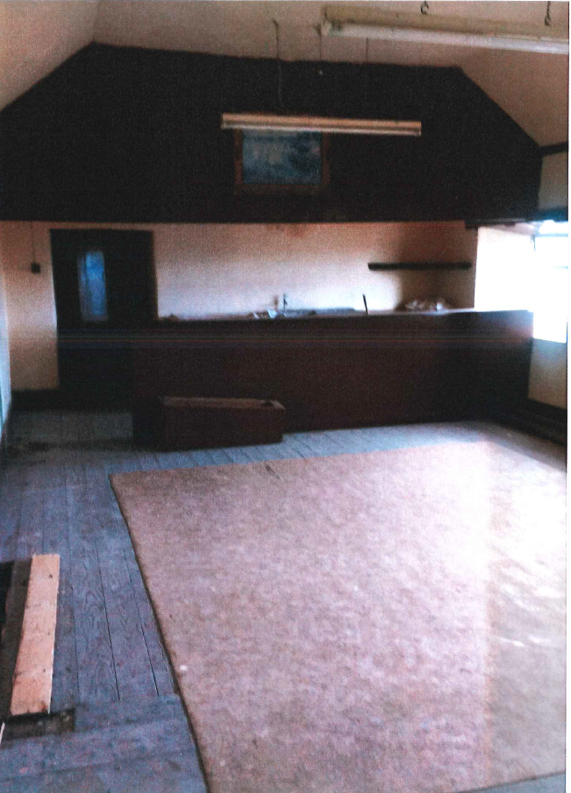
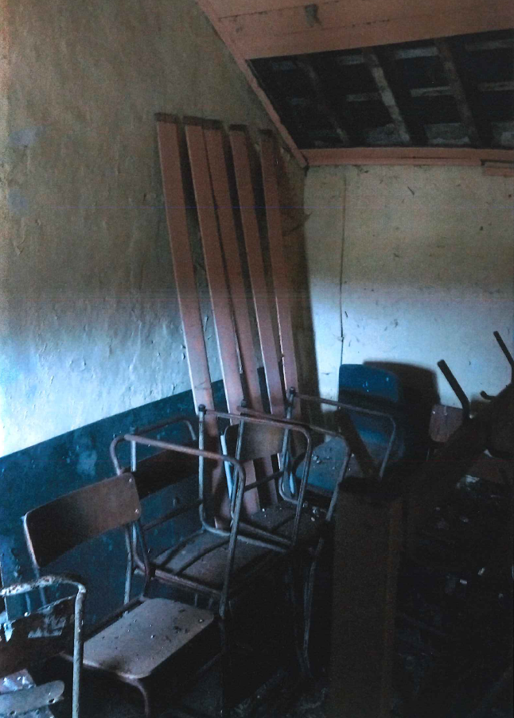
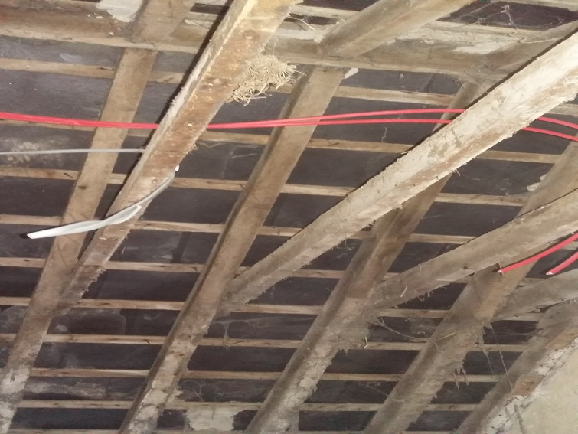
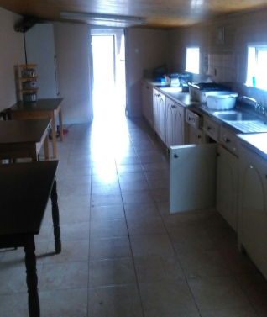
Galmoy Community Hall (Before)
Notes:
Upstairs Room:
At the moment the upstairs room is completely unused, It is a general purpose room that was used for Ferogie clubs and community meetings in the past but it has been derelict for over two decades. Our aim is to refurbish this room so that it could be used for multiple purposes. Currently the community is lacking such a space that could be used for as a general purpose meeting area. There are many clubs and groups established in Galmoy that have expressed as interest in having such a facility available. The local GAA club, Badminton club, Choir group, Handball\Racket Ball and Squash clubs are just some examples. Many members of the community have also expressed an interest in setting up supervised study for secondary level students in the community. This room would be perfect for such an activity if it was fit for purpose. The upstairs room is 11.25mtrs long and 4.8mtrs wide. The ceiling needs to be replaced and all the walls need to be insulated and plastered. Two new doors need to be installed (the head height of one to be increased) and three broken windows need to be replaced. There is currently no heating upstairs so we intend to install two new radiators. All the electrical wiring also needs to be redone in order to meet the current safety standards
Kitchen Area:
The current kitchen is extremely cold and damp, the ceiling is too low, the roof is leaking and there is little natural light. The kitchen units are old and broken and not fitted correctly. The hall is frequently used for big functions like birthday parties, GAA gala events and celebrations or funerals. The kitchen is fundamental for the hosting of such events but it’s just not fit for purpose. If the kitchen area was not available and functioning the hall would simply never be used. Our proposal includes replacing the current flat roof and also raising the ceiling height by roughly 8 inches. We also propose installing 2 new Velux ceiling windows and increasing the size of the existing windows in order to maximise the amount of natural light in the kitchen. An inner leaf wall will be constructed against the current exterior wall, this will allow us to appropriately insulate and damp proof an existing area that is causing extreme damp. All the interior walls of the kitchen will be insulated and plastered (including the new roof\ceiling). The old Kitchen units will also be replaced with a new fitted kitchen including a dishwasher.

Slide 21
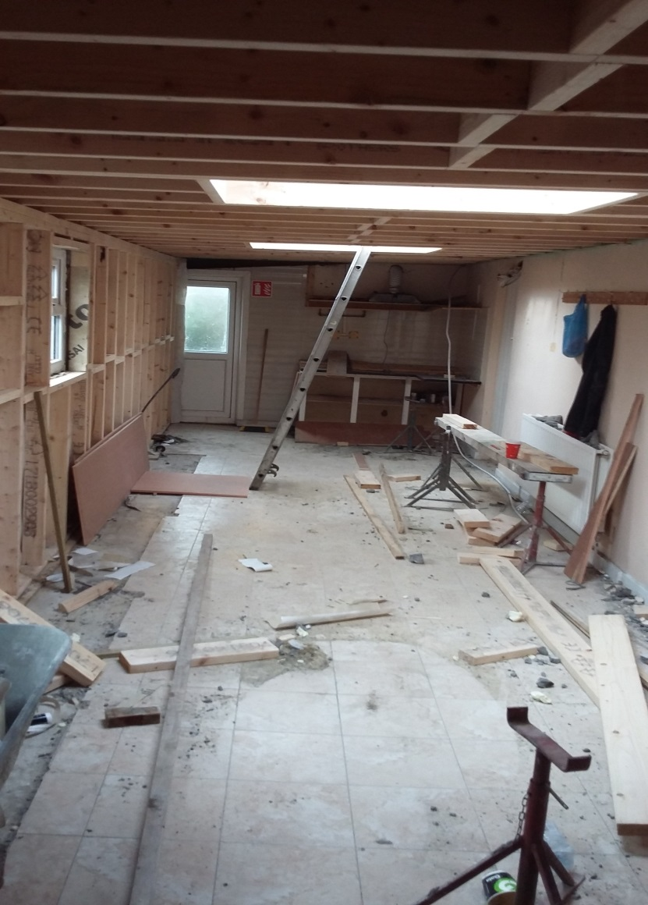
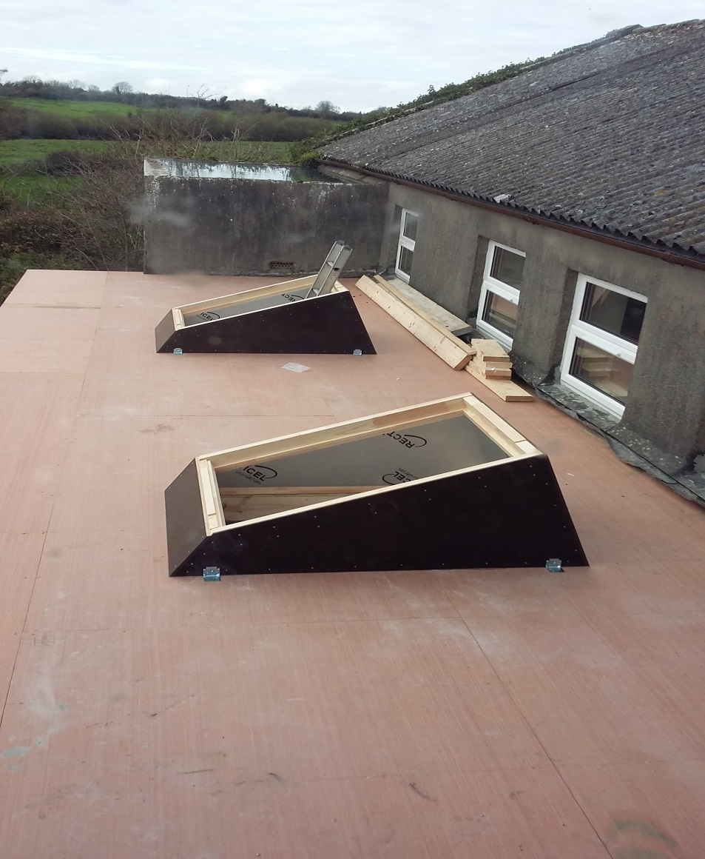
Galmoy Community Hall (During)

Slide 22
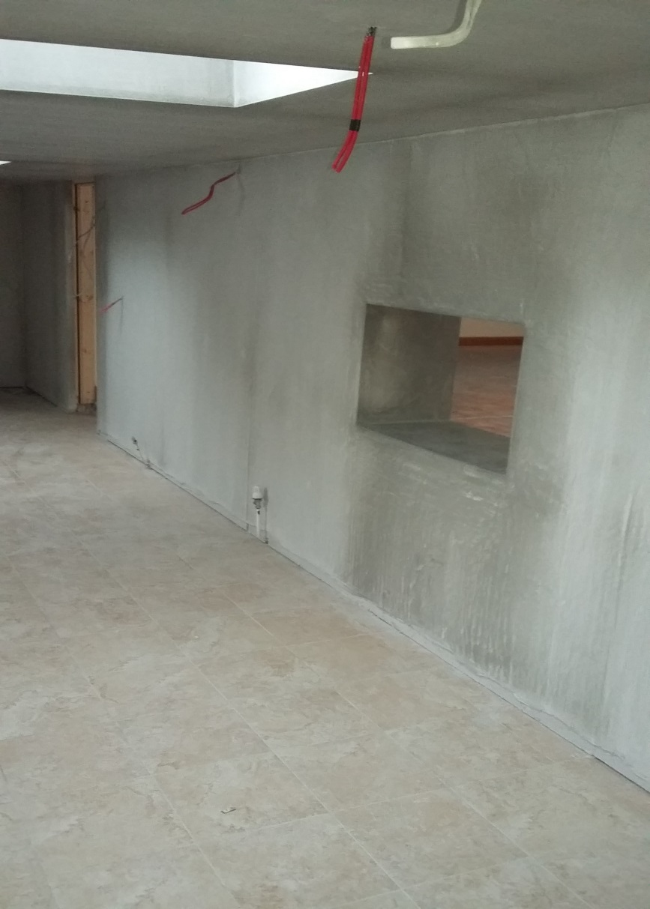
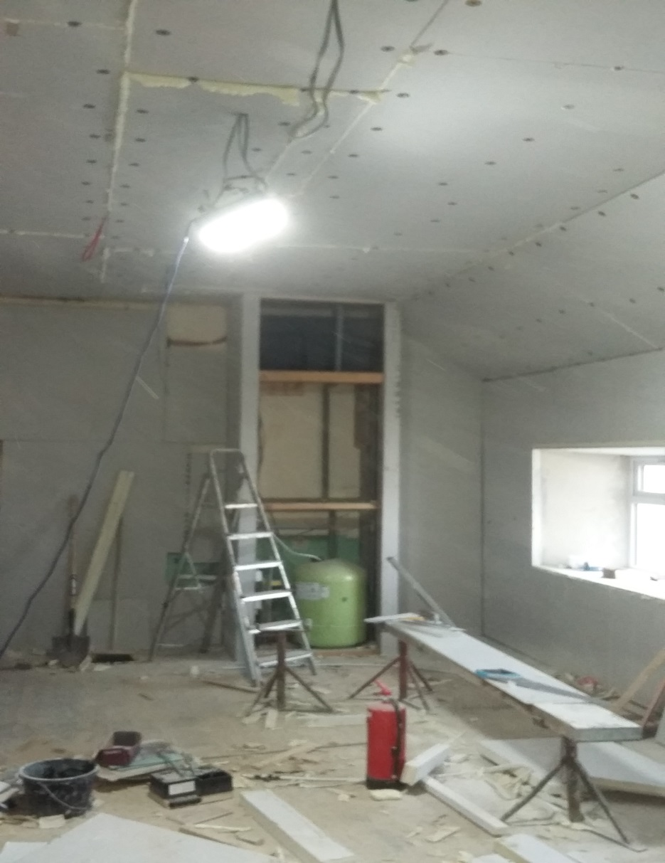
Galmoy Community Hall (During)

Slide 23
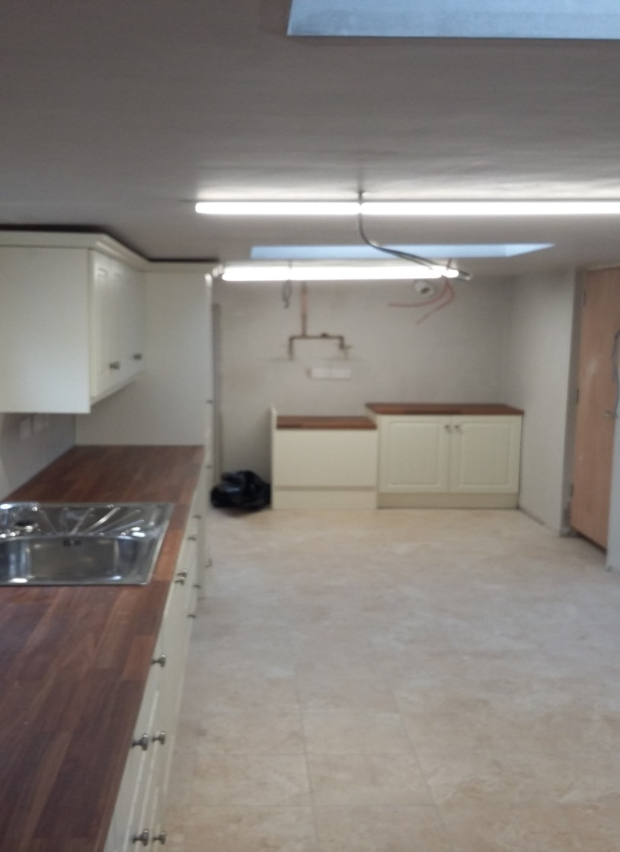
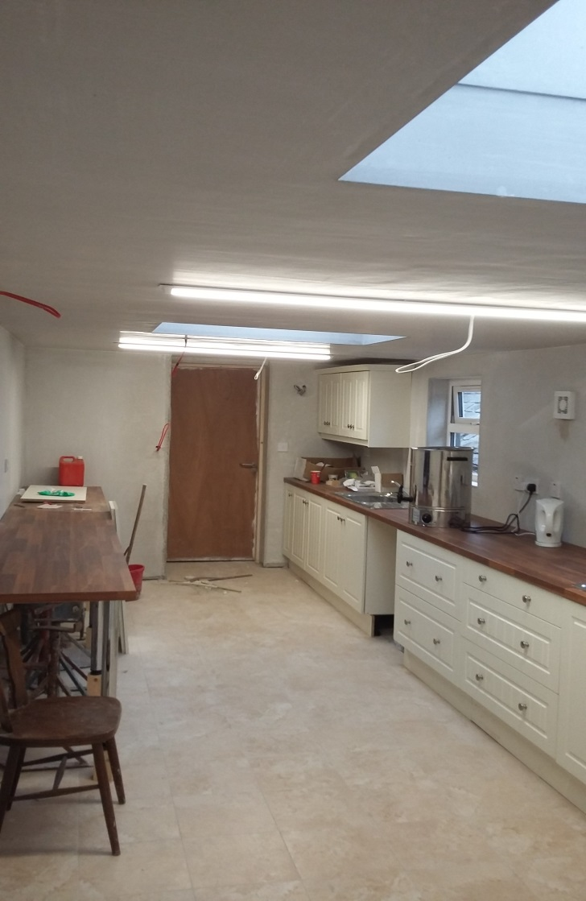
Galmoy Community Hall (After)

Slide 24
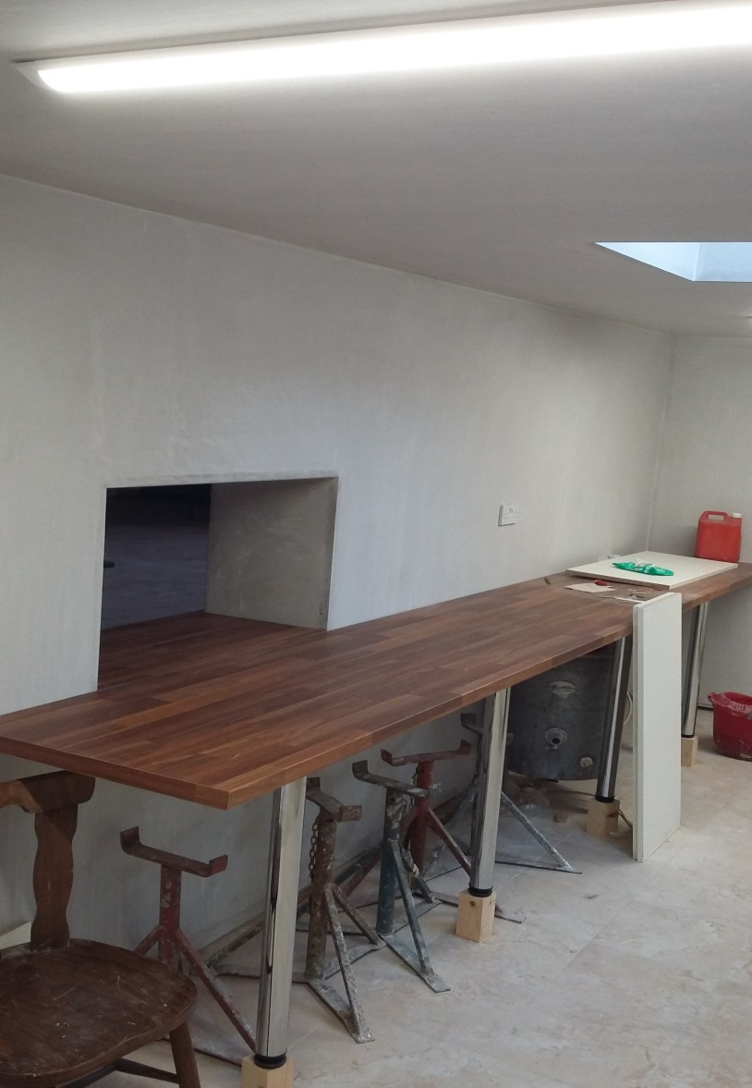
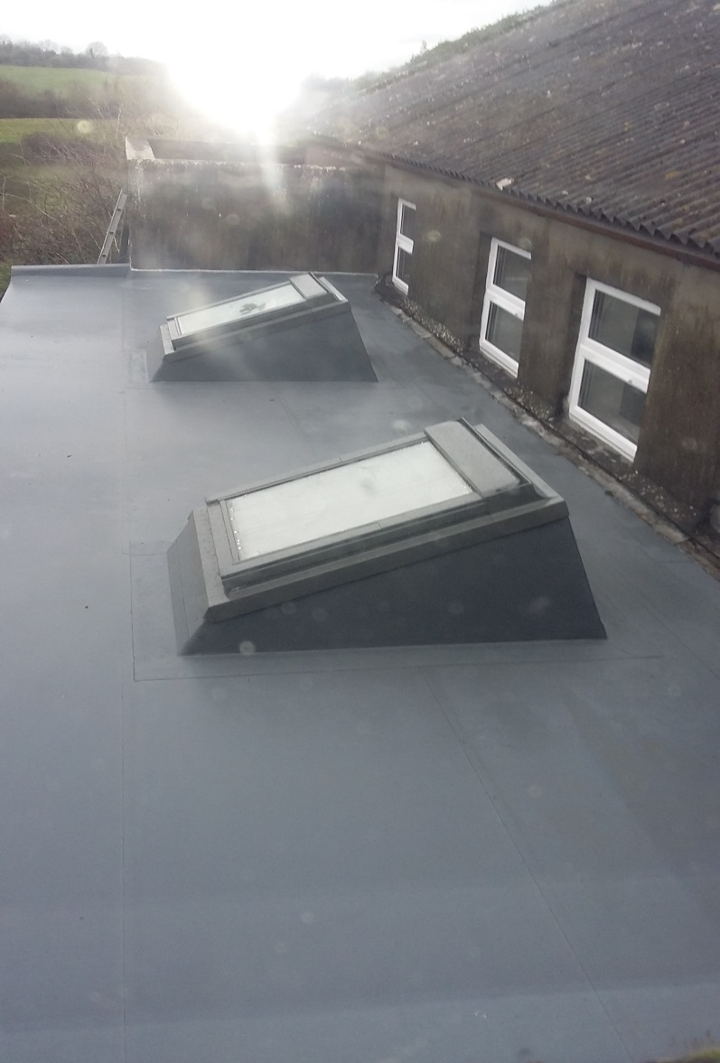
Galmoy Community Hall (After)

Slide 25
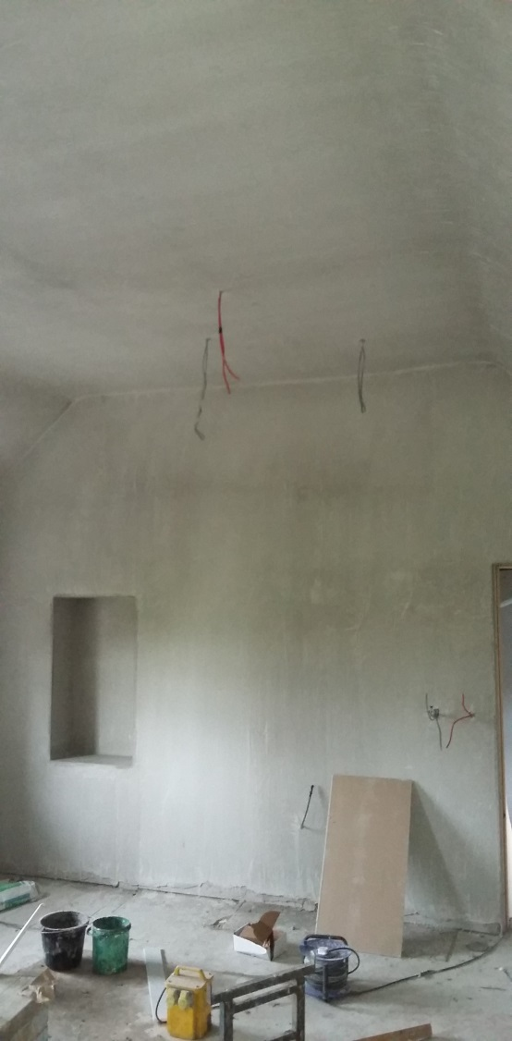
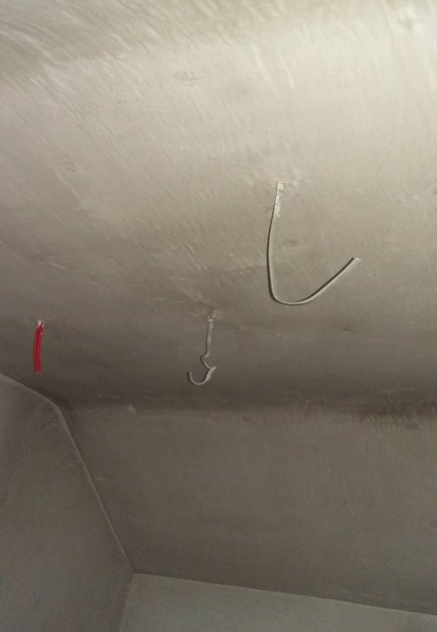
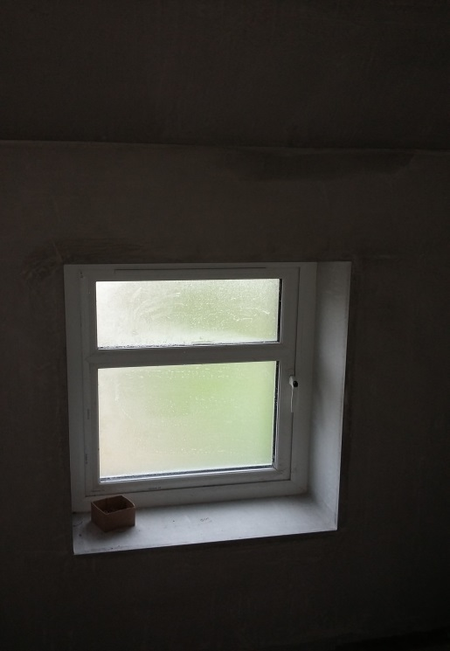
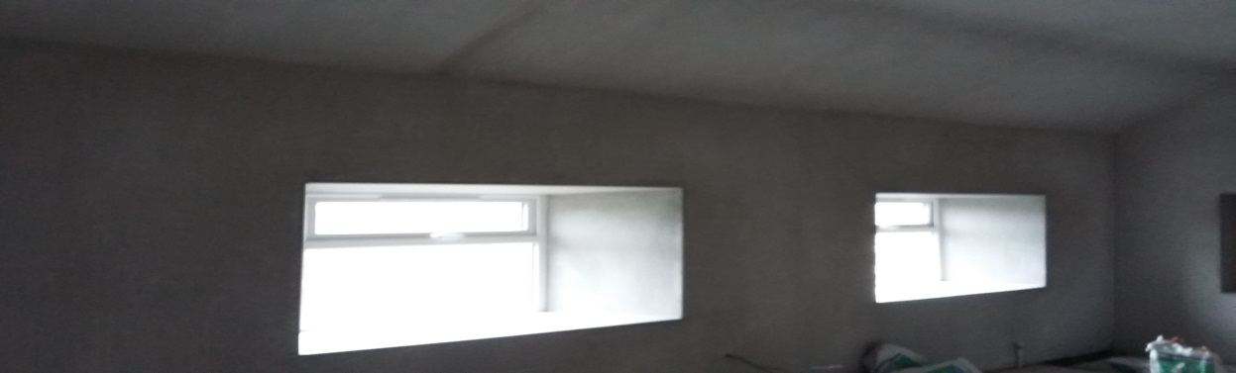
Galmoy Community Hall (After)

Slide 26
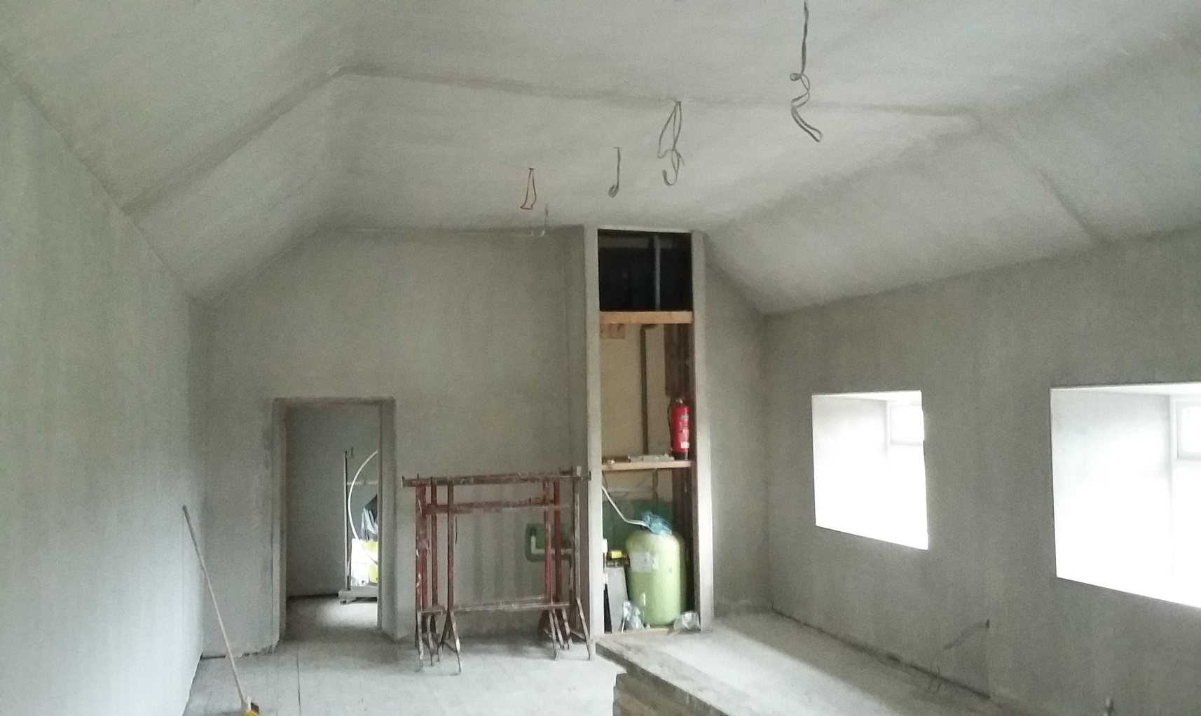
Galmoy Community Hall (After)

Slide 27
CLÁR Projects 2018
The Council submitted 11 applications (10 under Measure 1 and 1 application under Measure 2) in 2018 –all of which were approved as follows:
Muckalee Community Crèche - Parking, Safety Improvements/Connectivity €50,000.
Clontubrid – MUGA € 26,974.54
Kilmaganny - Public Lighting, Safety Improvement & Enhanced Connectivity €19,710
Kilmanagh National School & Church - Parking & Safety Improvements €27,000
Listerlin National School - - Safety Improvement & Enhanced Connectivity € 8,000
Crosspatrick Village - Safety Improvement Phase 2 € 20,000
Castlewarren Village & Sports Ground - Safety Improvements €1,980
Windgap -St. Nicholas National School, - Safety Improvement & Enhanced Connectivity €37,800
Conahy Community Car Park € 31,500
Lisdowney - Safety Improvement & Enhanced Connectivity €40,500
Knockroe - Improved access & parking € 30,000.
Total funding € 303,464.54

Slide 28
CLÁR Projects 2019
The measures available for Kilkenny County Council to apply for are:
Measure 1: Support for Schools/Community Safety Measure
Measure 2: Play Areas (including MUGAs)
Measure 3c: Community Wellbeing Support - Sensory Gardens.
Area Engineers and the Community Department work with local schools and communities to develop applications for identified small scale infrastructure projects.
Other Measures include First Response Measure and Cancer Care Mobility Measure-
-Applications made directly to the Department by appropriate voluntary groups involved in First Response and Cancer Care transport.
Kilkenny County Council has sought funding for 11 Projects totalling €304,300 as follows:

Slide 29
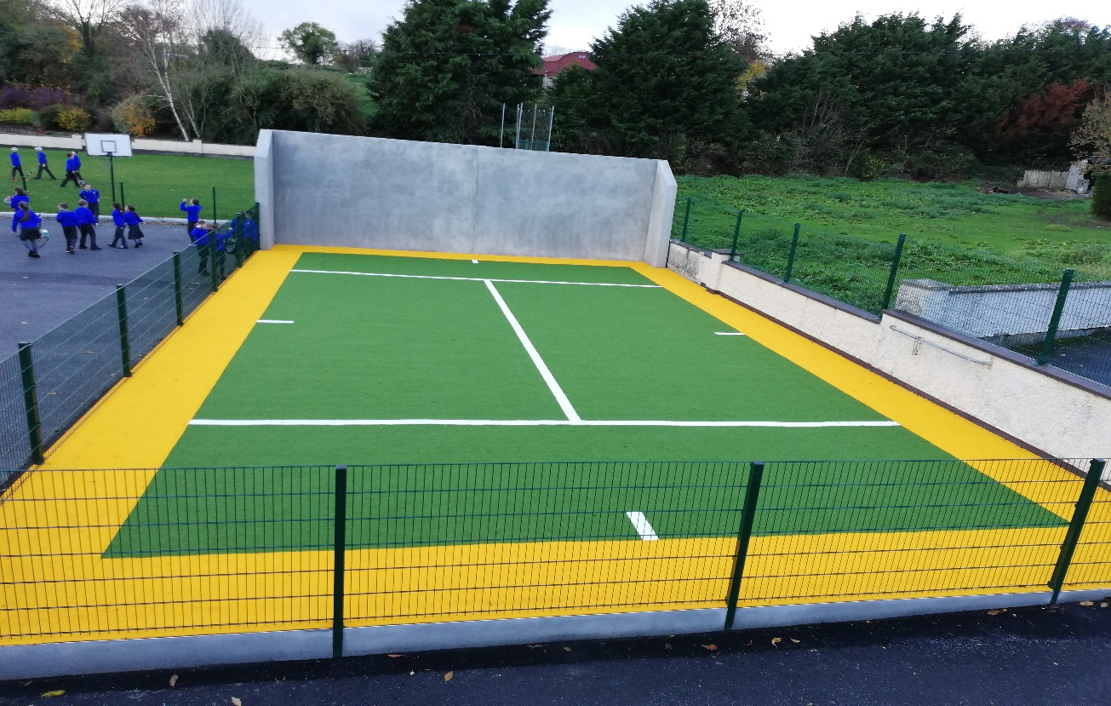
CLONTUBRID MUGA

Slide 30
Applications 2019
Community Group | Project Cost | Funding requested | Project Details
Windgap National School | € 55,000 | € 41,000 | Pedestrian Crossing.
Muckalee Community Creché, St. Brendan's National School, Muckalee Parish Committee | € 60,000 | € 50,000 | Car park surfacing Phase 2 of 2 phase project.
Black & Whites GAA & Community Centre | € 48,634 | € 43,770 | Multi-Use Games Area.
St.Colemans, Conahy | € 17,500 | € 15,000 | Speed safety signs.
Scoil Naisiunta Bhrighde, Coon | € 25,000 | € 22,500 | Pedestrian Crossing.
Lisnafunchion National School | € 17,500 | € 15,000 | Speed safety signs.
Tullogher Rosbercon GAA Club | € 55,000 | € 30,000 | Car park surfacing.
St. Aiden’s Kilmanagh | € 20,000 | € 15,000 | Speed safety signs.
Crosspatrick National School | € 50,000 | € 41,000 | Footpath & Speed safety signs.
Scoil Naomh Fiachra, Clontubrid | € 20,000 | € 15,000 | Speed safety signs.
St. Aiden’s Kilmanagh | € 17,814 | € 16,031 | Sensory Garden.

Slide 31
Town and Village Renewal Scheme
A scheme of capital funding to fund capital works in villages that have experienced economic decline and a loss of vibrancy.
Applications to be developed in collaboration with local communities on foot of expressions of interest.
Terms of Scheme extended and varied since 2016.
2016.
Kilkenny County Council was allocated €380,000 and it was invited to apply for up to 8 projects.
Kilkenny County Council prepared and implemented with local communities village renewal projects in
Ballyhale
Urlingford
Kells
Piltown

Slide 32
Town and Village Renewal Scheme 2017
Castlecomer- Provide a pedestrian cyclist bridge €200,000...€100,000 awarded
Piltown-Construction of a custom-built Enterprise Hub (2,563 sq feet) as an extension to an existing Incubation Enterprise Centre - €200,000
Thomastown- Provision of a Community and Incubation Hub in an existing premises.-Phase 1 works. €200,000-Not approved
Graiguenamanagh -Provision of Marquees, a Town of Books book store, Marketing and PR Campaign so as to amalgamate two existing into a month long festival of events .- €41,000
Callan -Undertake in-river and riverbank improvements to the Kings River in Callan.-€72,000
Ballyragget –Community Centre-Provision of a youth facility and an adult education facility €55,000
Goresbridge -Completion of access road to existing playground, and various Quayside works. €46,600
Windgap-Fitting out of Community Shop, Community Hub and Tea Rooms.- €79,960
Newmarket-Provision of an extension and upgrade to Gairdín an Ghorta Community and Visitor centre. €80,000
Hugginstown-Provision of Walkways, kerbing, drainage, and other public realm (phase1) €95,000
Kilmacow-Provision of walkways ,drainage and public lighting, car parking and landscaping in order to connect both parts of the village Phase 1).- €77,760
Inistioge-Stabilising works to an the ruins of a Medieval three storey Fortified Townhouse (a Protected Structure ). €26,000

Slide 33
2018 Town/Village | Proposal Overview | Amount applied for/ Approved
Inistioge | Inistioge Heritage Square Enhancement Programme | €200,000-Approved
Ballyhale - Knocktopher | Provision of Walkway between Ballyhale and Knocktopher | €100,000-Approved
Thomastown | Provision of Incubation and Hot Desks Facilities (alongside future branch library re-location in dis-used sports hall) at Marshes Street. | €200,000-Approved
Coon | Surfacing of car park and reconstruction of heritage wall | €100,000-Approved
Castlecomer | Castlecomer Destination Branding | €52,280-Approved
Stoneyford - Ennisnag | Walkway from Stoneyford to Ennisnag and a village signage scheme | €100,000 Not approved
Graiguenamanagh | Provision of public toilets and car park at Turf Market | €100,000 Not approved
 | Total | €652,280 approved

Slide 34
2019 Town and Village -Applications being finalised.
Location | Proposed Project | Amount being requested
Stoneyford | Provision of pedestrian walkway from Stoneyford to Ennisnag | €100,000
Graiguenamanagh | Provision of public toilets and car parking including disabled and age friendly car parking at Turfmarket, Graiguenamanagh | €100,000
Kilmanagh | Refurbishment of old school house into Community Centre | €100,000
The Rower | The provision of public realm and safety improvement works | €91,600
Kilmacow | The provision of public realm and safety improvement works (Phase 2) | €100,000
Hugginstown | The provision of public realm and safety improvement works (Phase2 ) | €100,000
Slieverue | The provision of public realm and safety improvement works | €200,000
Urlingford-Johnstown | To undertake a Health Check for both villages. | €20,000
Mullinavat | To undertake a Health Check | €20,000
Goresbridge | To undertake a Health Check. | €20,000
Castlecomer | To undertake a Health Check. | €20,000
Thomastown | To undertake a Health Check. | €20,000

Slide 35
Rural Regeneration and Development Fund
10 Year Fund-Minimum draw from fund is €0.5m (75%)
Projects of Scale
2018-Call for Category 1-(Ready to Commence) and Category 2 (requiring further development)
Kilkenny County Council submitted Projects for
Callan, Thomastown, Piltown, Graiguenamanagh and Castlecomer.
Callan
Callan Fair Green Amenity-Category 1- € 291,750 and Motte Field walking heritage track -€270,000. Both approved -€561,750.
Category 2’s- Bridge Street/Mill Street Regeneration and Mobility Management Plan and The Friary Conservation Plan-Not approved

Slide 36
Thomastown
Category 1 - Community Centre Redevelopment including library relocation ,
Phase 2 Public realm improvement Lowe St & Logan St,
Sessions House Refurbishment,
Quayside Car Park Redevelopment
Category 2 Project -Maudlin St Regeneration
€ 2.019m allocated

Slide 37
RRDF applications not successful.
Piltown-Category 1-Pavement reconstruction, standardisation of carriageway width, Traffic calming, defined parking, footpath improvements.
Graiguenamanagh-Category 1-Access to the HUB Complex and Essential Maintenance to Library.
Castlecomer- Category 2-Enhancement to Castlecomer Discovery Park, Feasibility Study old Barracks Site .
Piltown- Pavement reconstruction, standardisation of carriageway width, Traffic calming, defined parking, footpath improvements.

Slide 38
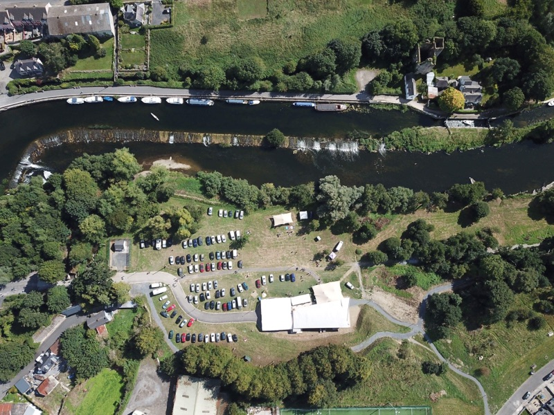
HUB SITE, GRAIGUENAMANAGH

Slide 39
2019 RRDF applications
Call for Category 1-”Ready to Commence” projects
Graiguenamanagh-The Hub Access Road, Turf market Car park and public toilets, Library refurbishment , provision of MUGA and conversion of old public toilets to Men’s Shed.
Piltown- Pavement reconstruction, standardisation of carriageway width, traffic calming, defined parking, footpath improvements and Community playground and park.

