Slide 1
Presentation to Members of Kilkenny County Council
Tina Dowling, Chief Executive
The Watershed
16th September 2019
Billy Murphy, Chairman
Bernie Manning, Finance Manager

Slide 2
The Watershed
The development of The Watershed is a result, of the Vision and Leadership, of Kilkenny County Council
Many Community Groups and Sporting Organisations benefit from the facilities
The ethos of The Watershed is sport and leisure for all. This is represented in the large and varied number of relationships we have developed with local and national sporting organisations

Slide 3
The Watershed
Sub Aqua
Water Safety
KCH
25 to 30 Schools p/w
and many more...
Special Olympics
KRSP
Tri-Club
Swim Club
Notes:
To name but a few:
The Swim Club who are our 5.15am users 7 days per week
Sub-Aqua club
The Triathlon club
Kilkenny Water Safety, again a vital service to the community,
Kilkenny Masters Club
We facilitate 25 to 30 schools per week, under our school lessons program
KCH and the County Board with Athletics
KRSP: Kilkenny Recreation and Sports Partnership
Minority Groups: Fr McGrath Centre
Special Olympics
And many more
We host many competitions and galas for different clubs or groups too

Slide 4
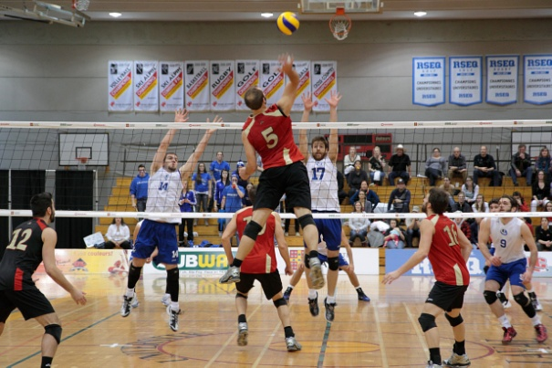
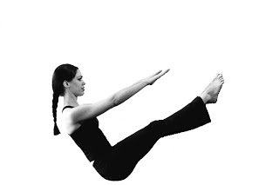
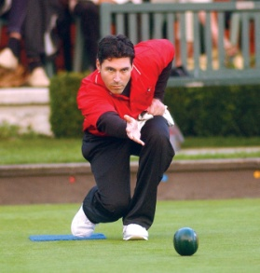
The Watershed
Notes:
The Range of Activities include:
Badminton
Basketball
Volleyball
Soccer
Tae wan doo
Karate
Gymnastics
Indoor Hockey
Pilates
Yoga
Bowls
We have Activities for all ages

Slide 5
The Watershed
Notes:
All revenue lines are extremely important
Outline the Top 3

Slide 6
The Watershed
2018 and 2019 to date:
As you are aware 2018 saw extreme weather events including the beast from the east snow storm and a prolonged heat wave both of which impacted negatively on the leisure industry, consequently The Watershed did not achieve operational budget.
2019: YTD is strong and exceeding operational budget
Expansion of the swim program
Duckling’s (swimming lessons for pre-school) Introduced
Shark’s program (Teen Lessons) additional lessons
Les Mills classes Live and Virtual
All Fitness Classes free to Members (86 Classes p/w)
Notes:
Each year relies heavily on footfall to achieve budget.
the very cold weather in Feb/March forced a closure and many cancelled bookings and the exceptionally good weather from May to Aug last year, was not good for the leisure industry.
People were enjoying the beaches and outdoor activities all summer.
Although we are heavily reliant on footfall, mitigating factors have helped turnaround 2019:

Slide 7
The Watershed
Costs, as a % of YTD Total Income:
Staff Costs.............................. 53% (49 Staff)
Other:
Energy.....................................9%
Rates & Water Rates.................5%
Insurance.................................5%
Repair and Maintenance...........4%
That is €0.76 of every €1 of Income is paid on the above costs before any other costs are considered. It is a very ‘tight’ business.

Slide 8
The Watershed
With 600K+ visits and total income a little less than €2m, the average value per visit is only €3 approx!
The day to day operational challenge is to facilitate the large numbers, efficiently, safely and our customer service is paramount both face to face and online

Slide 9
The Watershed
What’s New?
The Watershed Mobile App
Booking Online for Lessons, Astro, Fitness Classes and Membership
Age Friendly Initiative
Universal Membership (Fitness Classes)
Sensory Hour in the Pool Complex
Ducklings / Sharks /Additional Lessons
Laura Langton Sports Therapist
CPN, Conscious Performance Nutrition
School Tours (host in-house)

Slide 10
The Watershed
Capital Projects completed this year:
Buffer Tank installed for the Biomass
Pool Cover (energy efficient)
Athletics Track
Energy Audit: LED retrofit and Pumps
After 10 years in Business inevitably equipment will need replacement and updating
Pool Defender Filters and Moveable Floor RAM

Slide 11
The Watershed
Grant Projects require matching funding from the council, along with continued capital re-investment support for the upkeep of The Watershed’s facilities
CKEA: Energy Grant received: Buffer Tank and Pool Cover
Grant Applications Sought:
Large Scale infrastructure Grant: All inclusive Facility, Track Hoists in changing rooms, Disability Gym equipment and Pool
Sports Capital Grant: Sports Hall Floor and Astro Pitches resurfacing
Exceed Energy Grant: To repair the solar panels
Notes:
St. Patrick’s closing

Slide 12
The Watershed
Plan for the Future:
Medex/Exwell Program
Age Friendly Initiative
Expand All Inclusive offering with grant aid and working closely with groups like KRSP
Born to Move, Kids Classes 8 – 12, Helping children shape positive physical habits
Additional Nutrition Talks
Get Ireland Active, Run Club, Youth Fit4Life
Swim for a Mile (expand to Teens)
The ethos of The Watershed is sport and leisure for all in the community.
Notes:
Keeping up to date and keeping the facilities to a high standard is paramount
The focus for the year ahead will be to continue to deliver on our strategic objectives, build upon the work already completed, and take advantage of new opportunities as they arise. The next few years will be challenging and exciting, especially with the growth and awareness of Health in society.
We have an Aging Population and Health Conscious society The Watershed needs to provide for the needs of the community with this in mind

Slide 13
The Watershed
Thank you

