Slide 1


Notes:
The purpose of this promotional video is to reflect the range of services that our library spaces provides. Communicating about new services is as important as providing them and our challenge is to be relevant to community needs and transform our spaces and services accordingly.

Slide 2
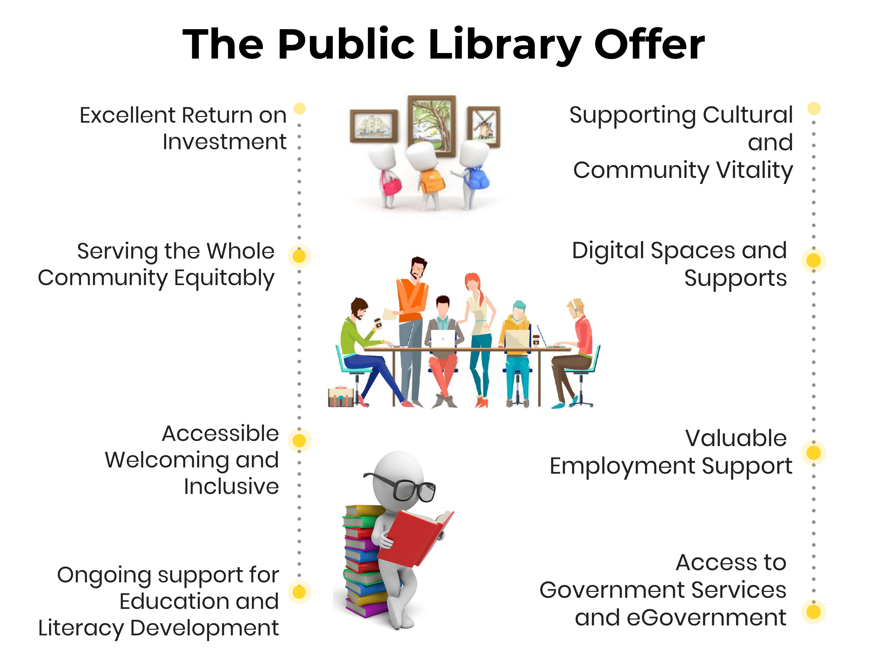
Notes:
We have expanded the offer and contribution the library makes to our communities and citizens.

Slide 3
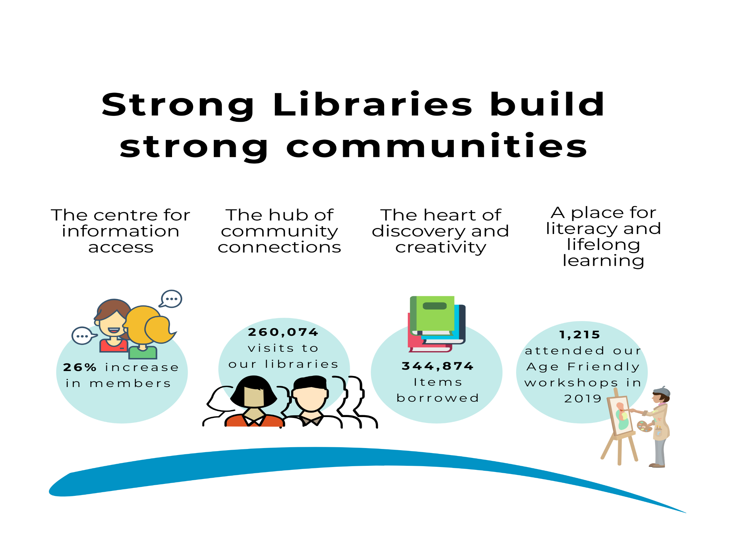
Notes:
We believe that strong libraries build strong communities . If we look at some of our performance figures for 2019 we see an increase in membership by 26% to 17,579. Over 260,000 visits to the library with over 340,000 items borrowed. If we look at 1 of our programming inititaives such as our Age Friendly programme we see that 1,215 older people attended a range of events/workshops.

Slide 4
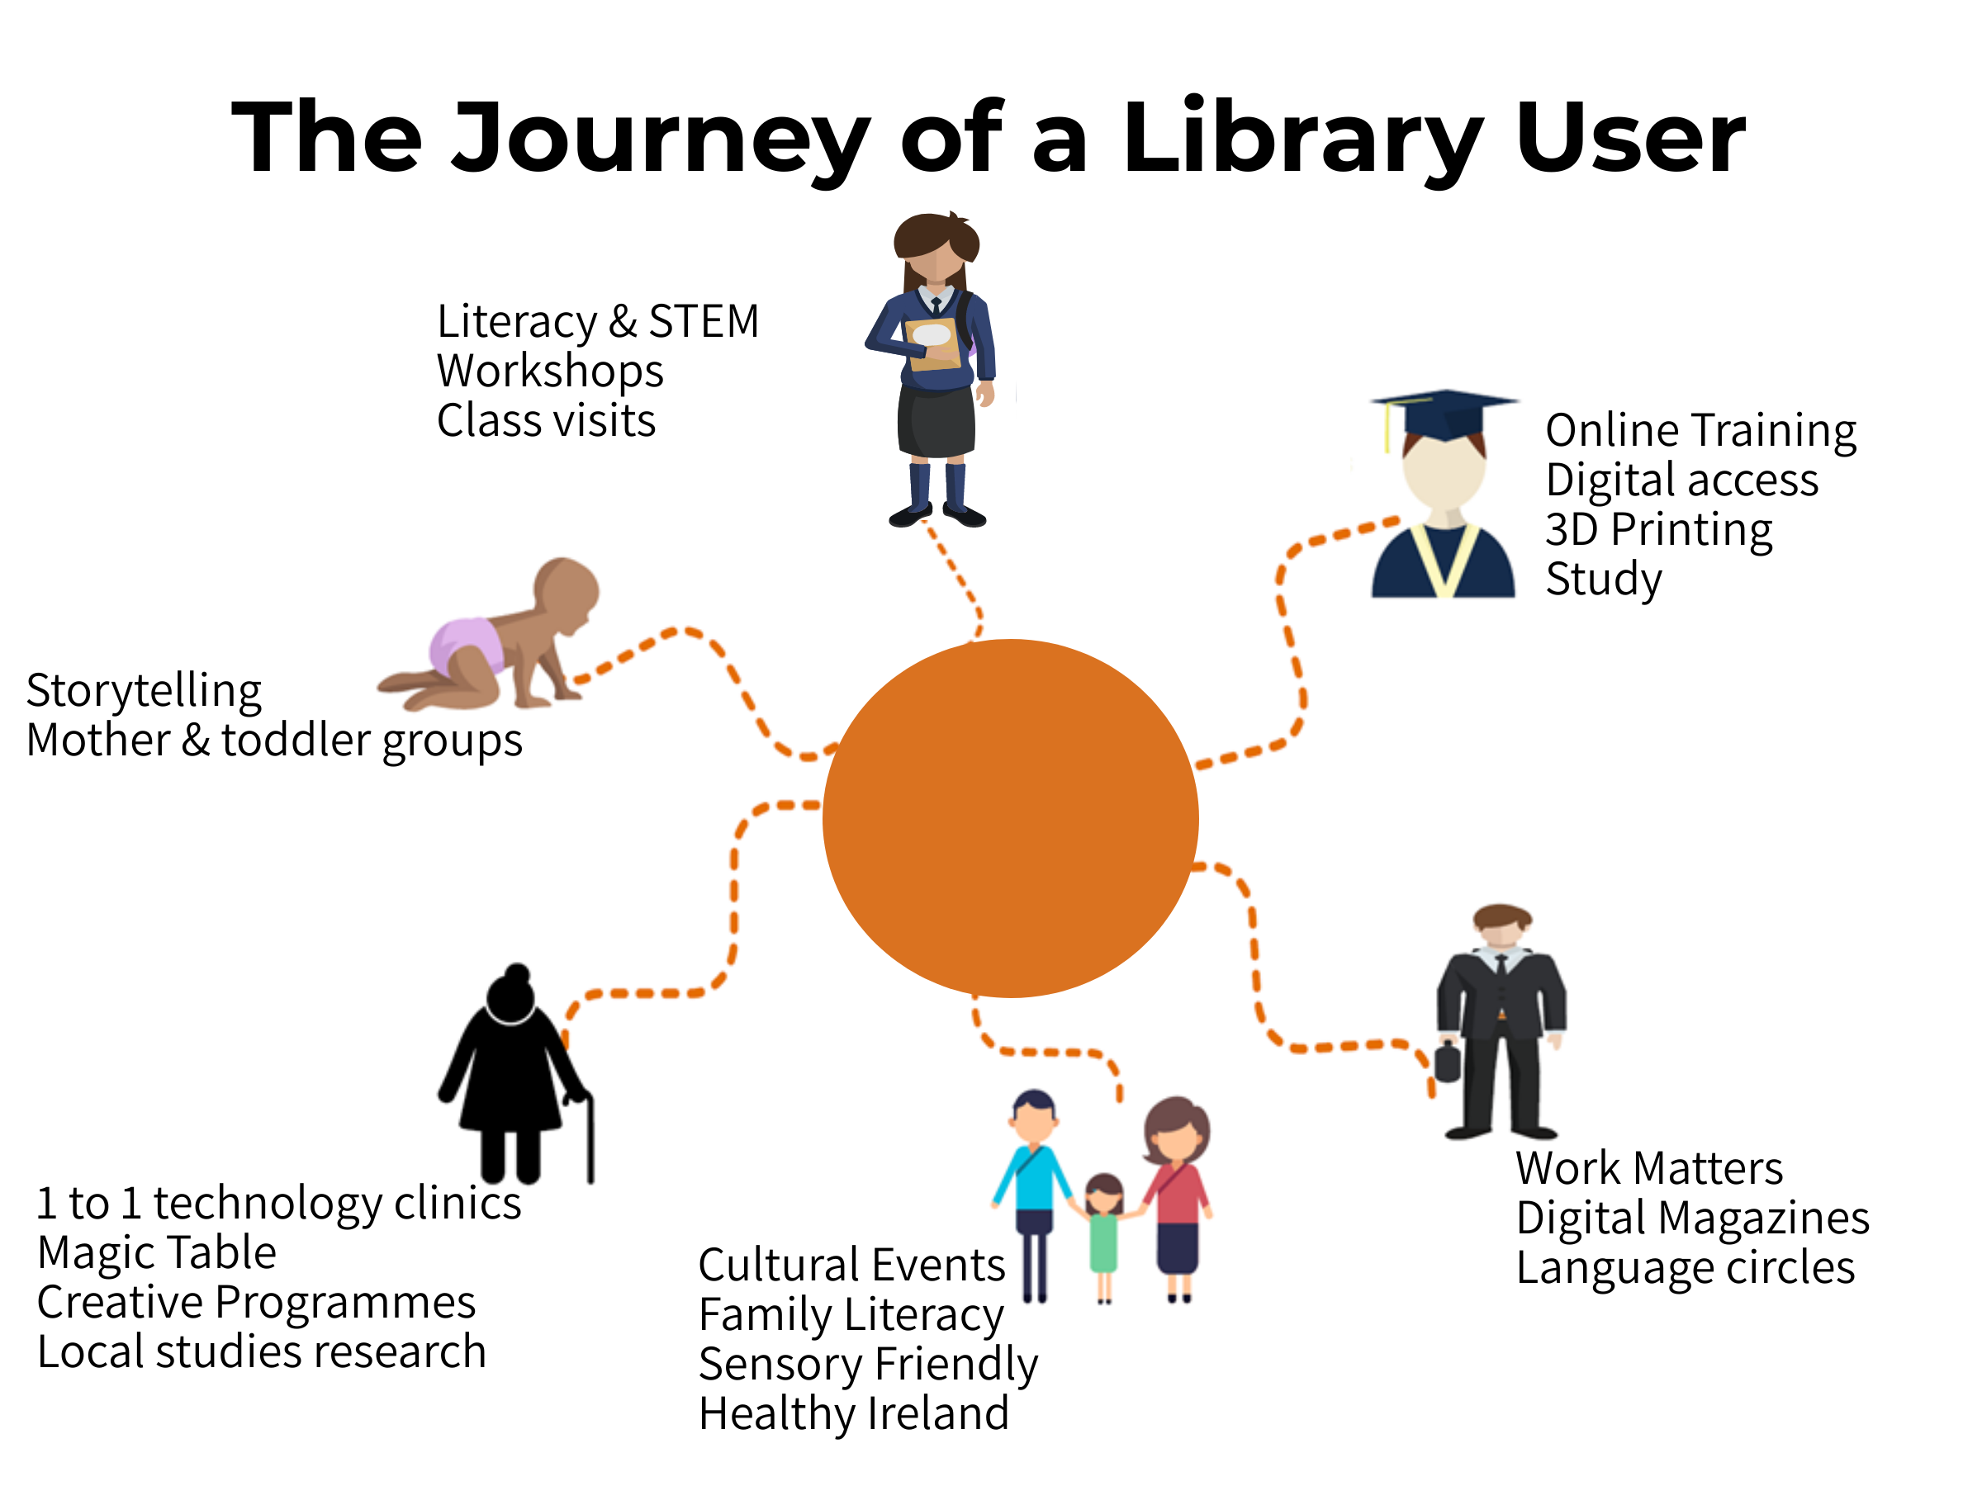
Notes:
We know that a broad and diverse range of people use our services and access our programmes at all life stages.
This slide reflects the fact that no matter what age you are the library provides something for you. So a small child attending a storytelling session, a school goer attending a science week workshop, a student using the 3D printing facilities, a worker learning a language online , a family attending a cultural event or an older person learning to use technology or learn a new craft. Consequently our resources are invested efficiently and effectively to allow the service to fulfil many multiple roles due to the diverse nature and constantly expanded set of user needs.

Slide 5
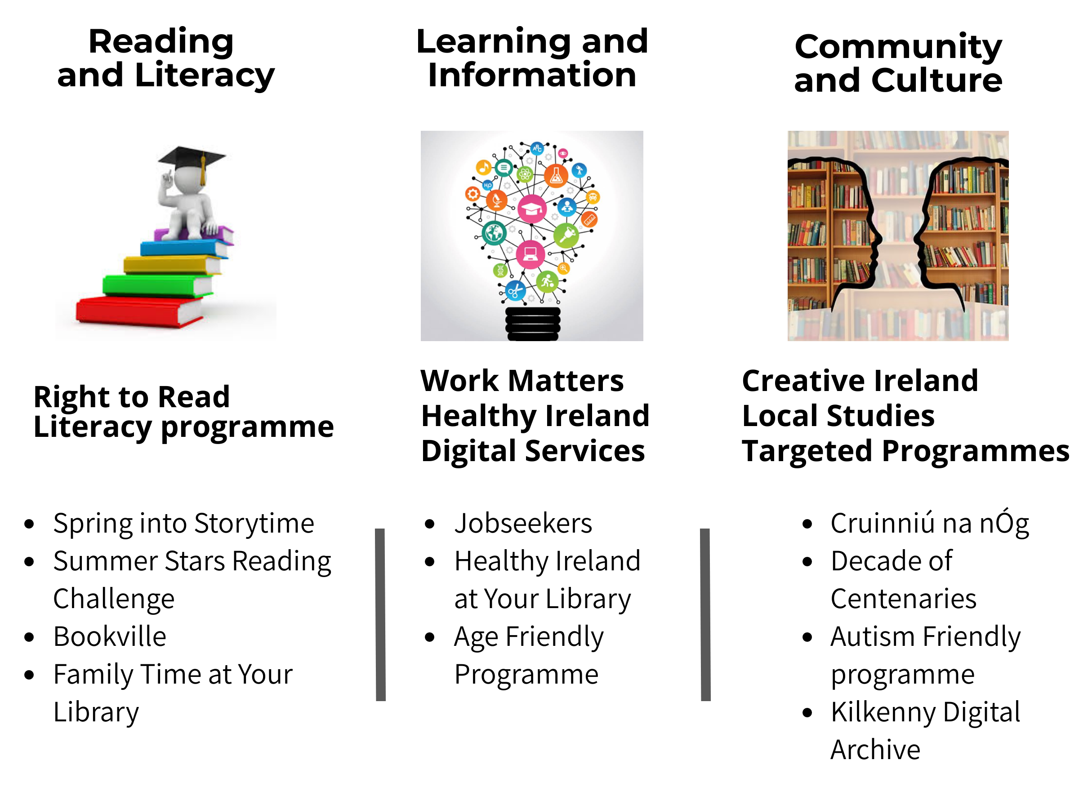
Notes:
This slide reflects the 3 strategic programmes identified in the national strategy that we focus on.
Reading and Literacy which is the core of what the public library stands for. We run a range of initiatives to encourage reading for enjoyment, nture learning for all users of all ages and support and develop literacy levels to help people make informed decisions and choices about their lives.
Learning and Information and Community and Culture – again we are involved in many initiatives and programmes. We recognise that we do not operate independently but are part of a bigger picture both within the local authority and outseoide of it so we work closely with a range of agencies and partners to deliver these programmes such as ETB, Kilkenny Education centre, HSE, Intro, Science Foundation of Ireland.

Slide 6
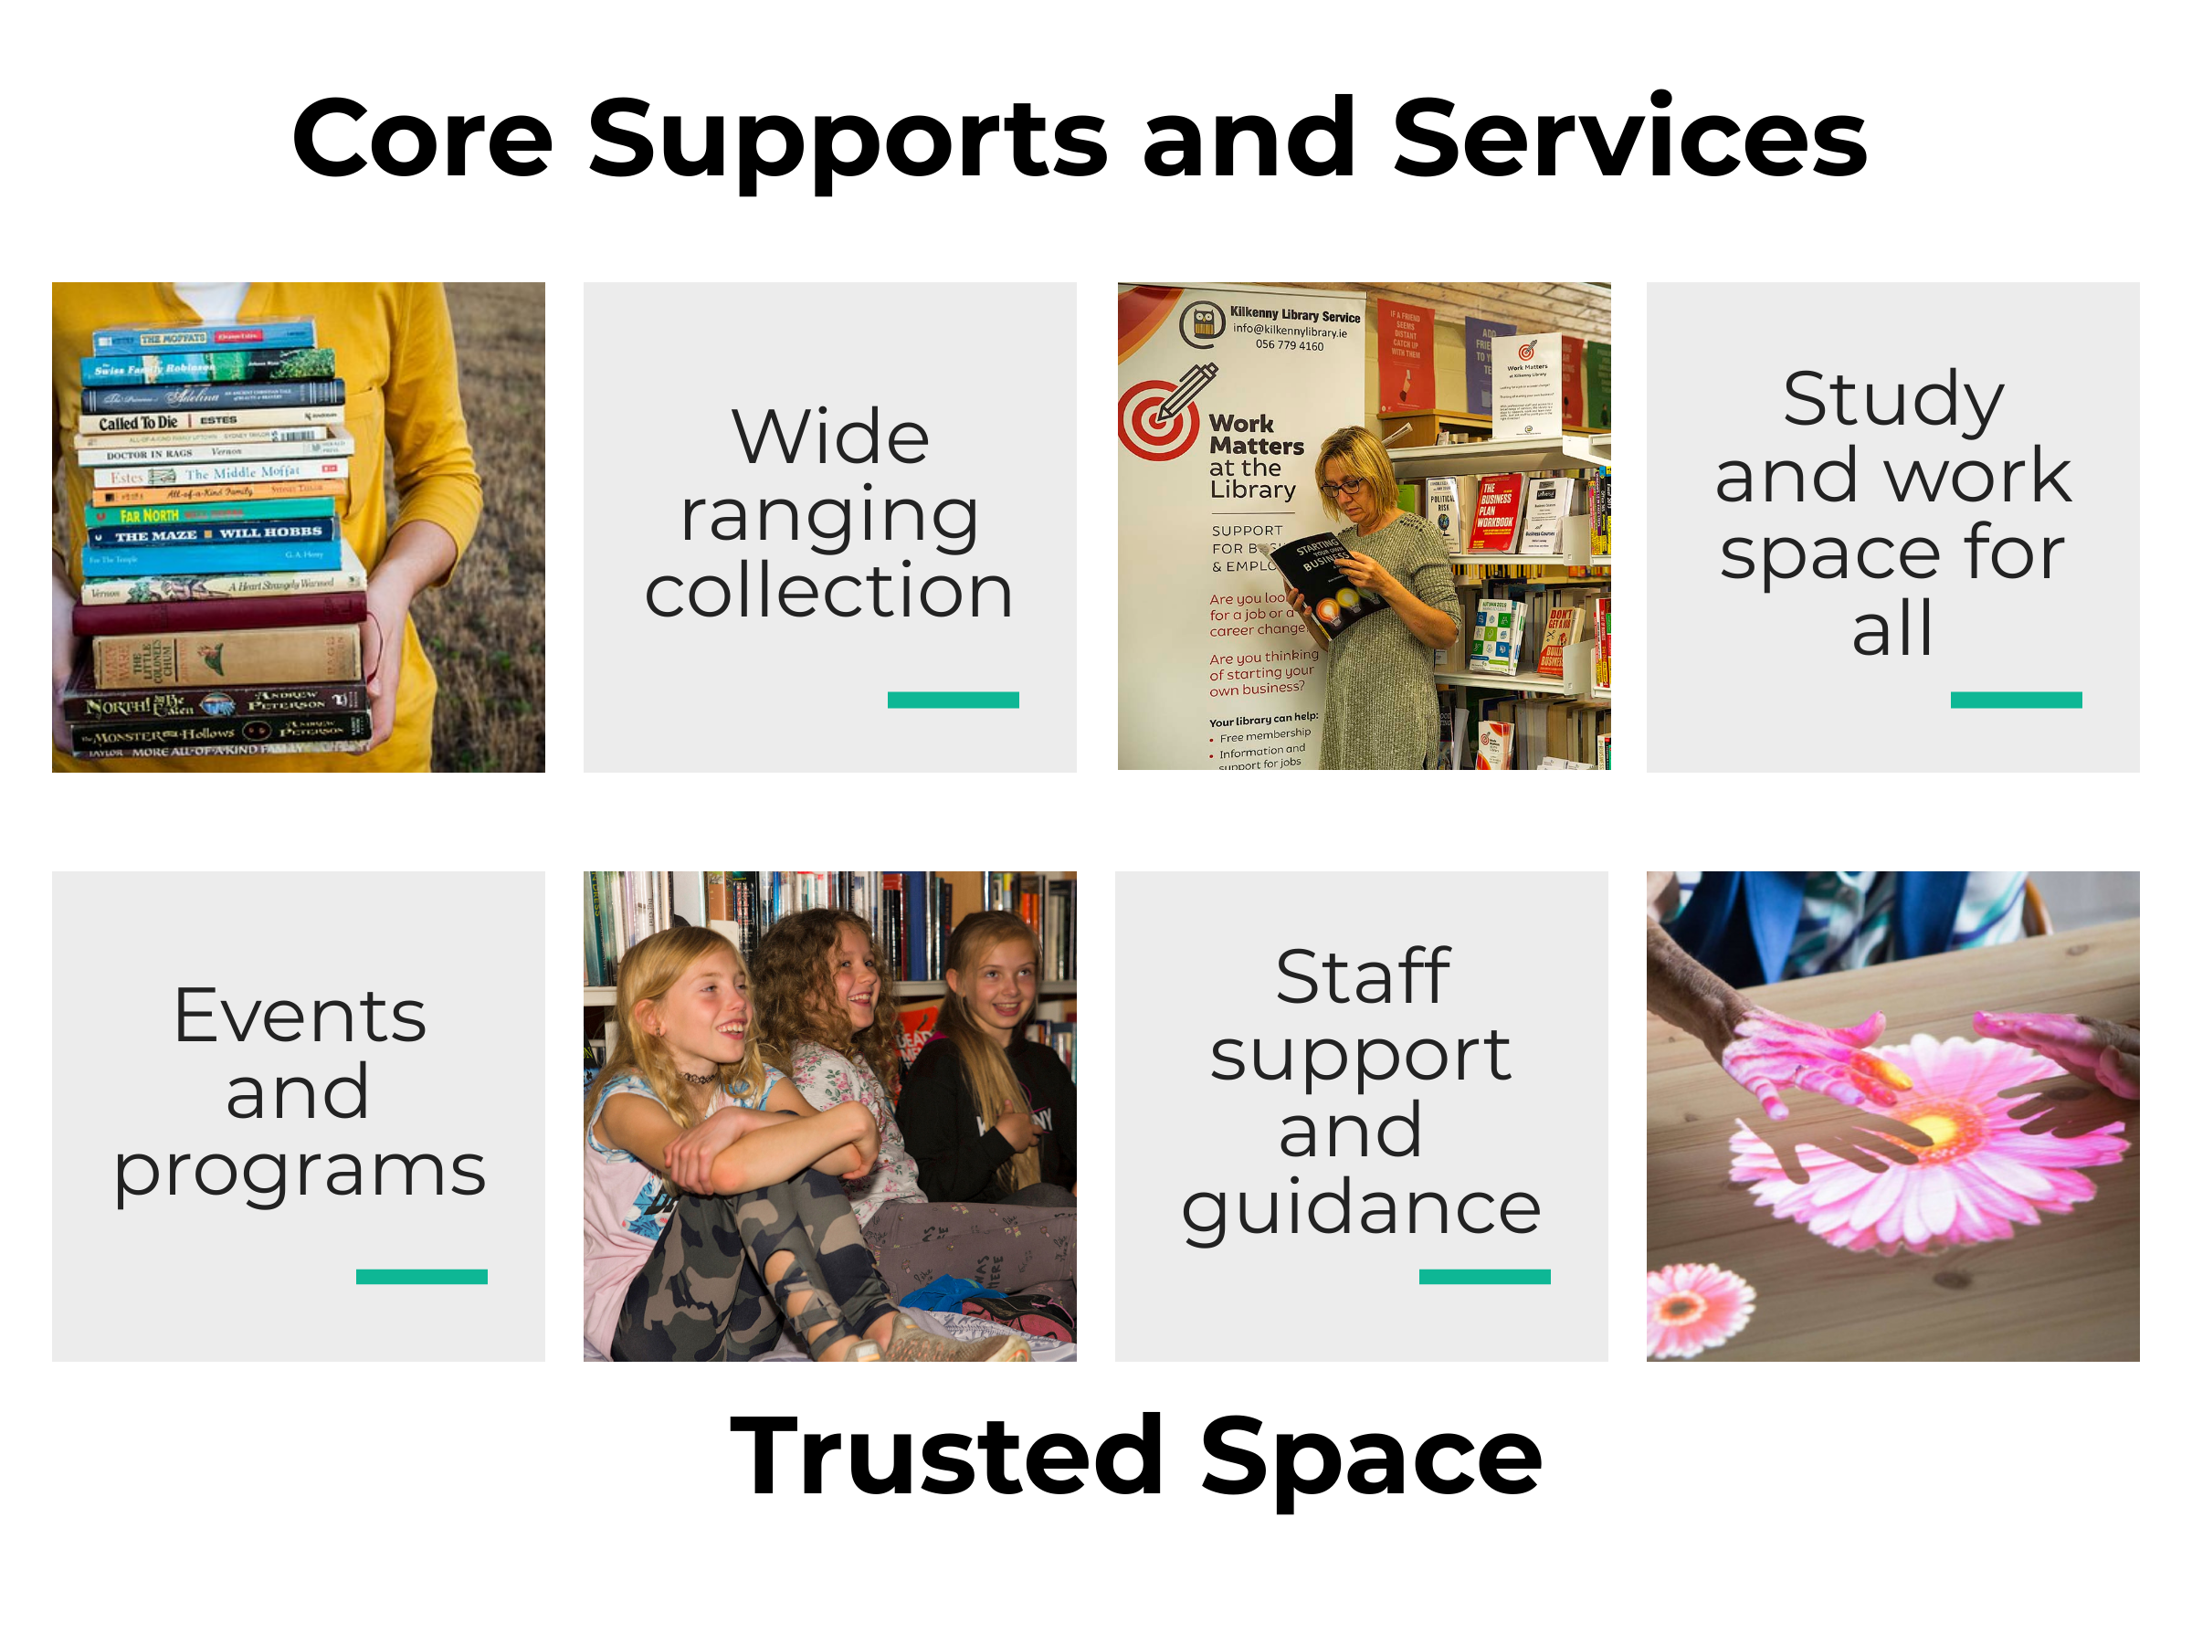
Notes:
Underpinning these strategic programmes are our core supports and services where we are developing our spaces and services to be accessible, welcoming and inclusive so people can come together in a safe environment.

Slide 7
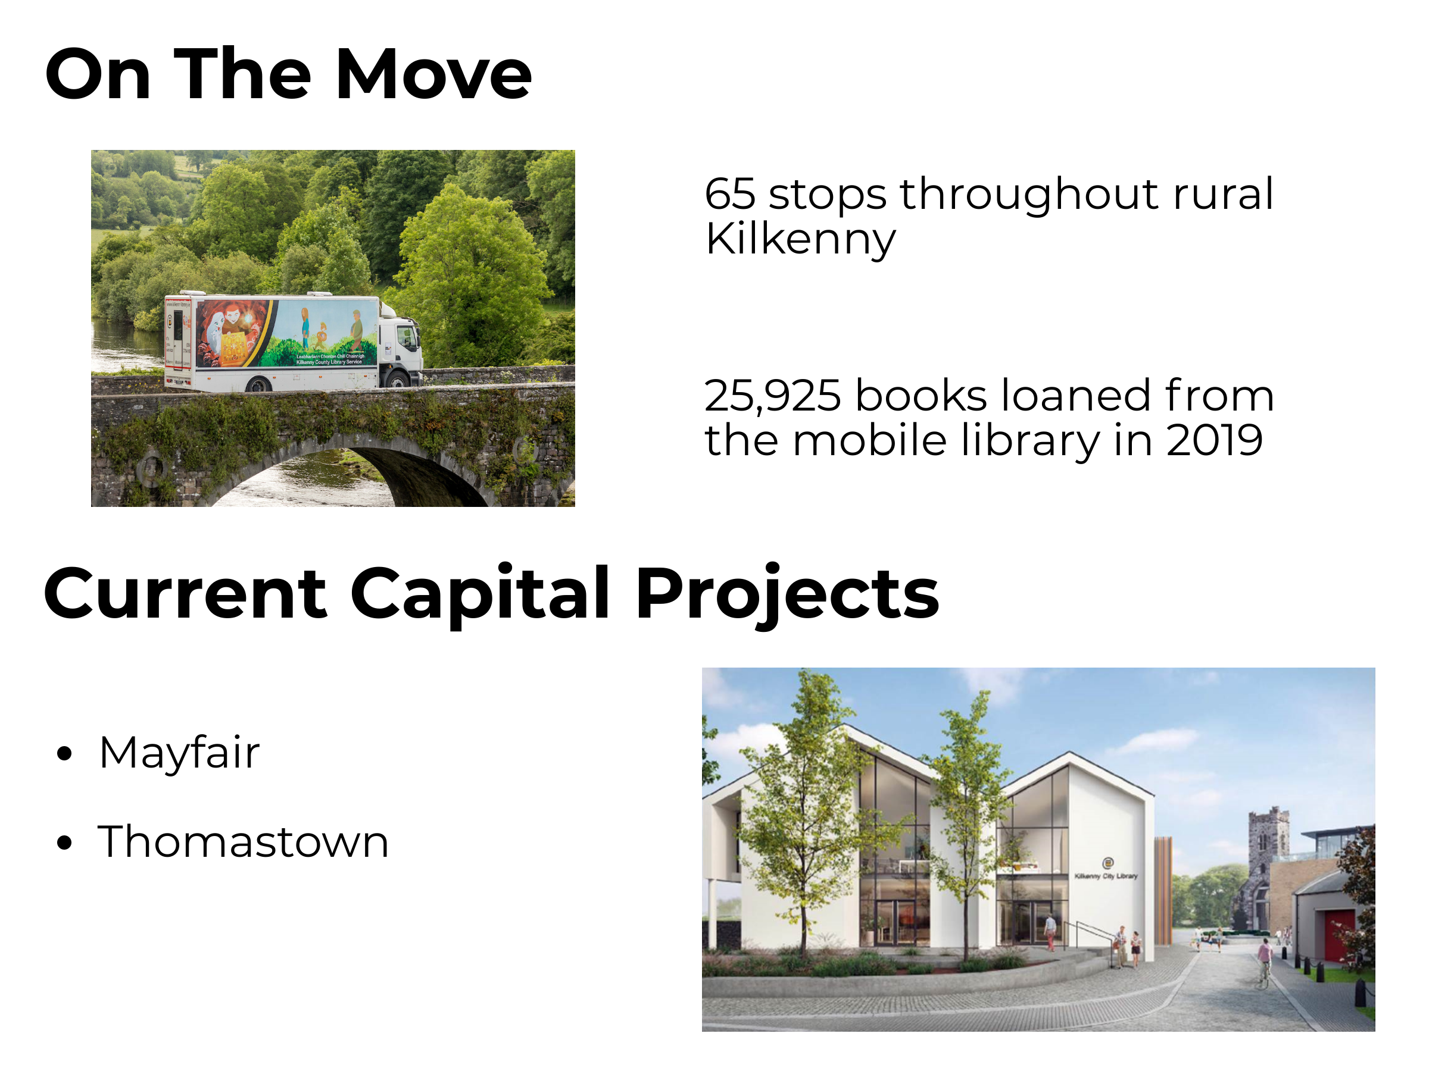
Notes:
Alongside our network of 8 libraries across the county we also have our mobile library service which provides an essential service to rural communities and schools who cannot access fixed libraries. We also have 2 capital projects being developed - Mayfair City library and Thomastown Library

Slide 8
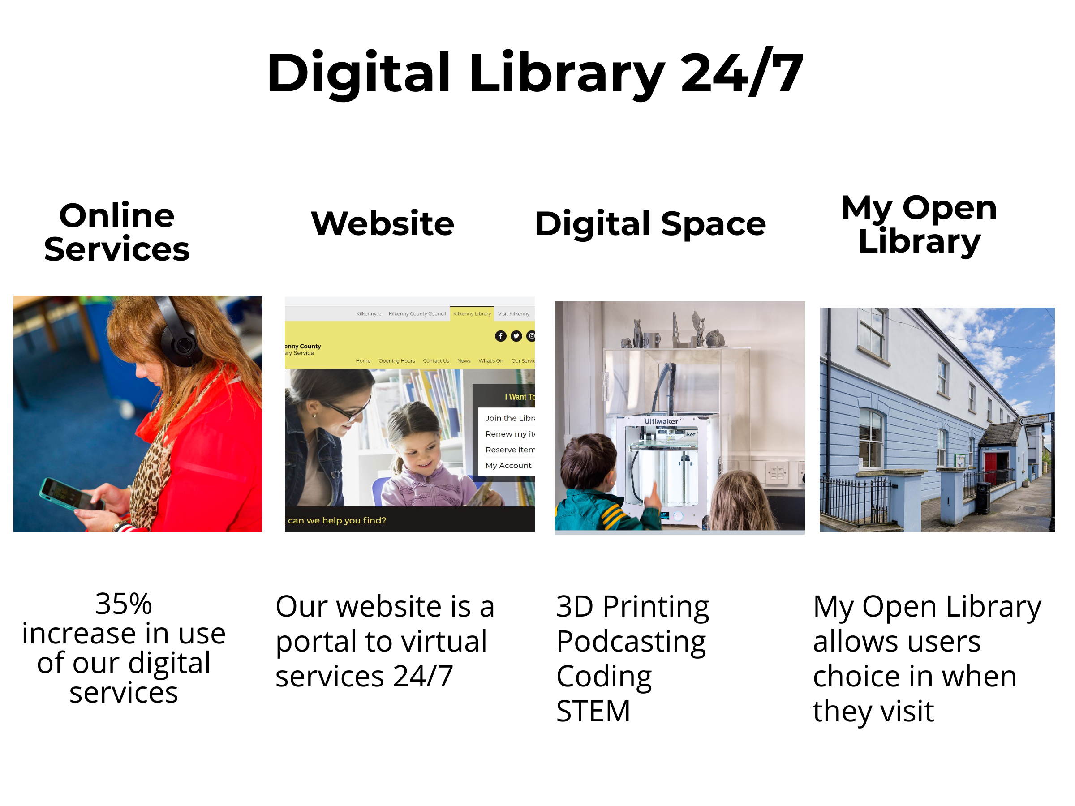
Notes:
The role of the library as a digital hub is increasingly becoming very important.
We are proactive in this area providing access to public computers and free WIFI but also the library is regarded as an important resource particularly for those who may be left behind by technology developments either because of access or skills.
We have become providers of digital literacy training from providing workshops on how to use tablets/mobile phones to providing access to innovative technologies such as 3D printing.
We have seen an increase of 35% in the use of digital services.
New approaches to service delivery such as the pilot My Open Library in Castlecomer has seen 280 users register for this service. Main activities are for studying and returning or getting books/stock. It has increased opening hours from 30.5 to 84 hours.
Finally our website and social media platforms are used to connect and engage with users who may not have used libraries in the past. It has proven an excellent way to communicate and promote what we do.

Slide 9

Notes:
National Open Day on February 29th is a national campaign by Libraries Ireland to get more people to visit and use their libraries across Ireland. The tagline is “take a closer look” . While we recognise that the people who use our services know how valuable a service it is, but there are people who haven’t been to the library or visit occasionally and do not realise all that is an offer.
The aim is to increase library membership nationally to 30% while it currently stands at 16%

Slide 10
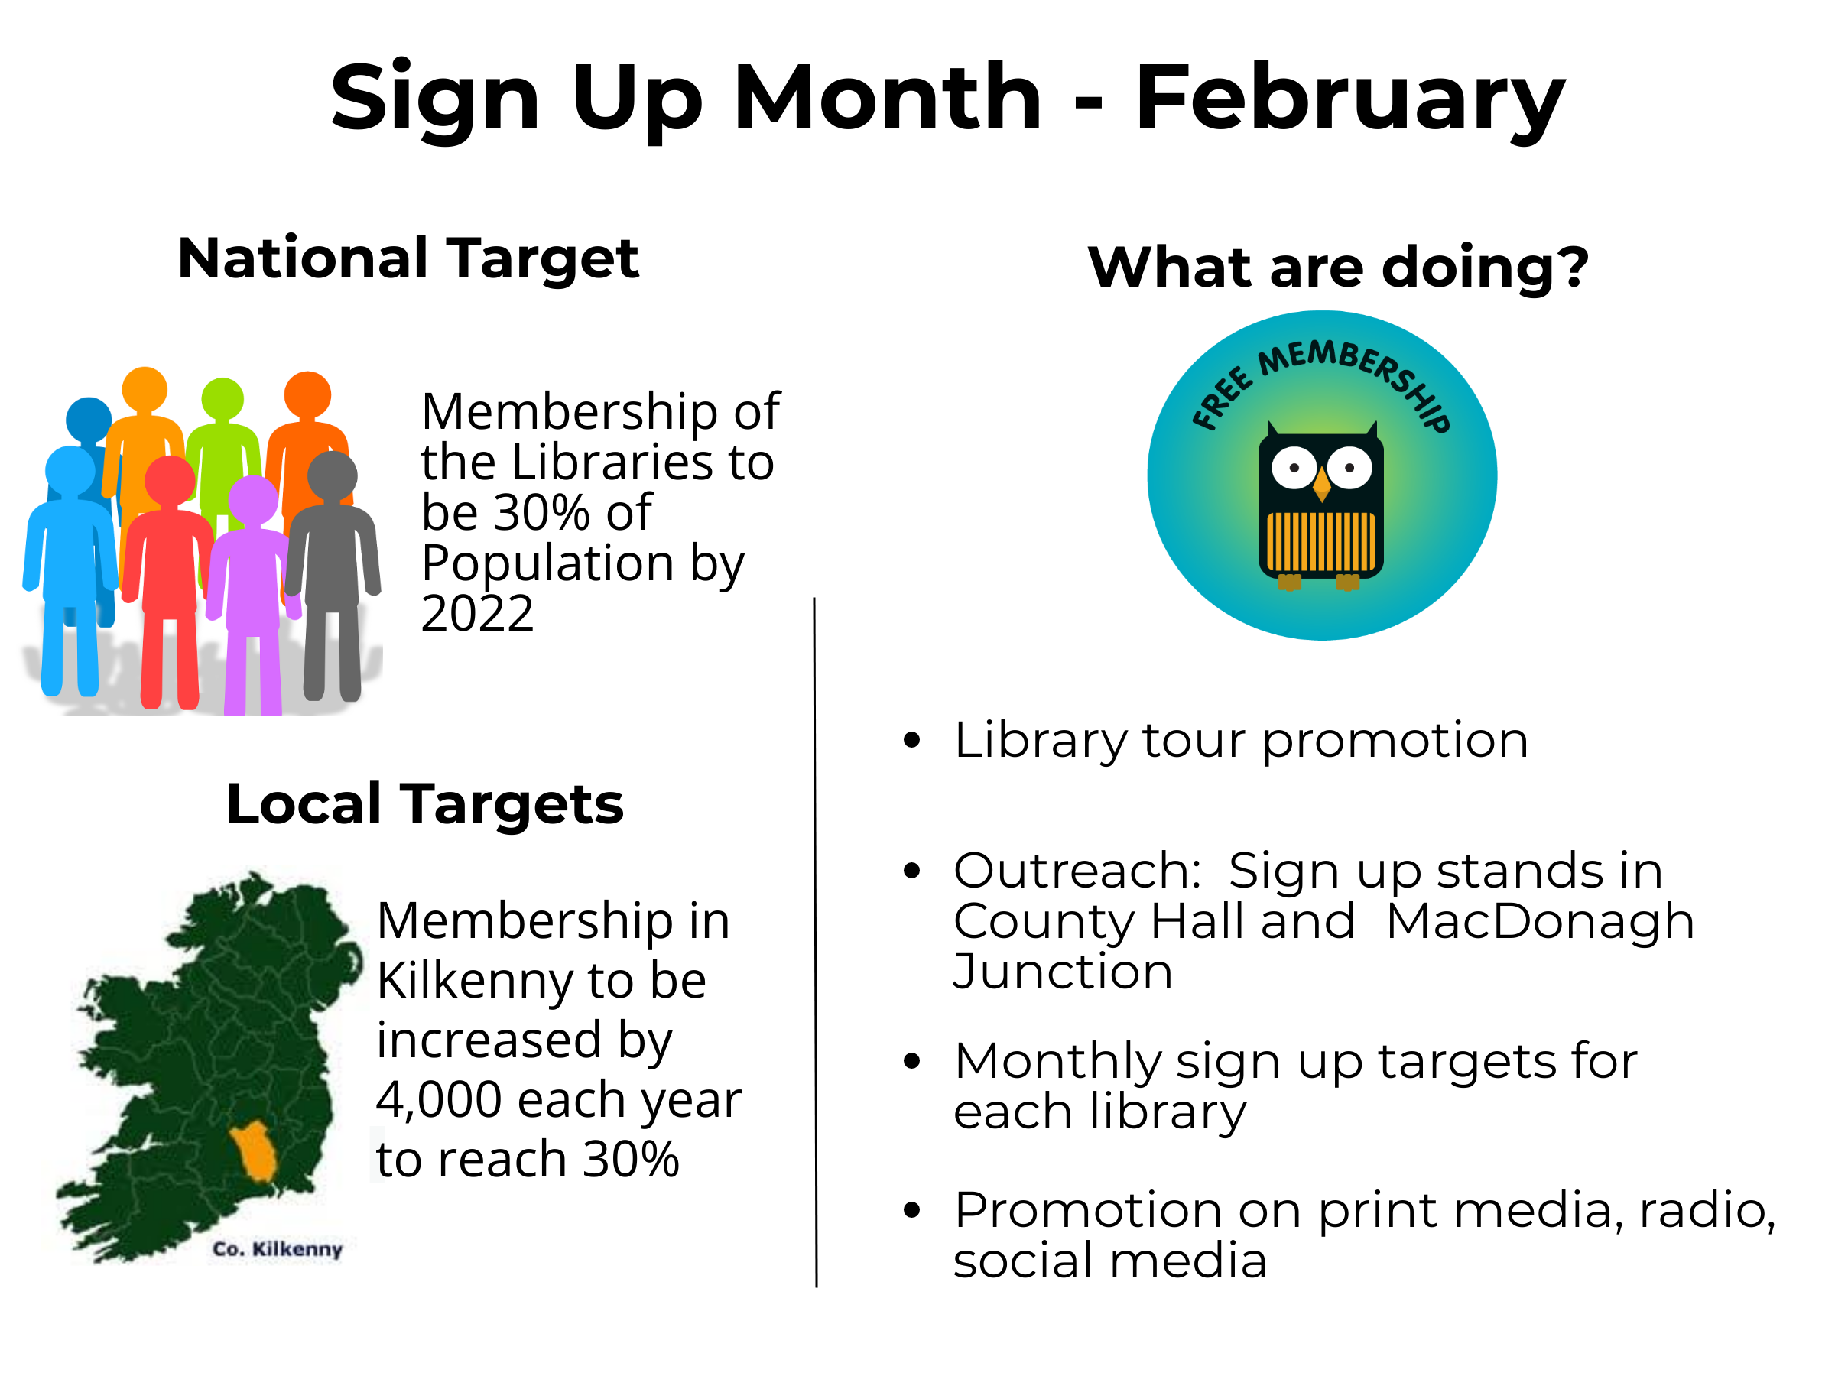
Notes:
Here in Kilkenny we have already set ourselves targets around membership and we would need to increase our membership by 4000 per annum to reach a 30% rate by 2022.
Our current membership(over 17% ) is 17,759 which is a 26% increase on last year and we have we would hope to build on this again this year. The 30% target in Kilkenny would be to have 29,769 members.
Our libraries will provide tours to promote services, have being doing outreach work and general promotion across all media.

Slide 11
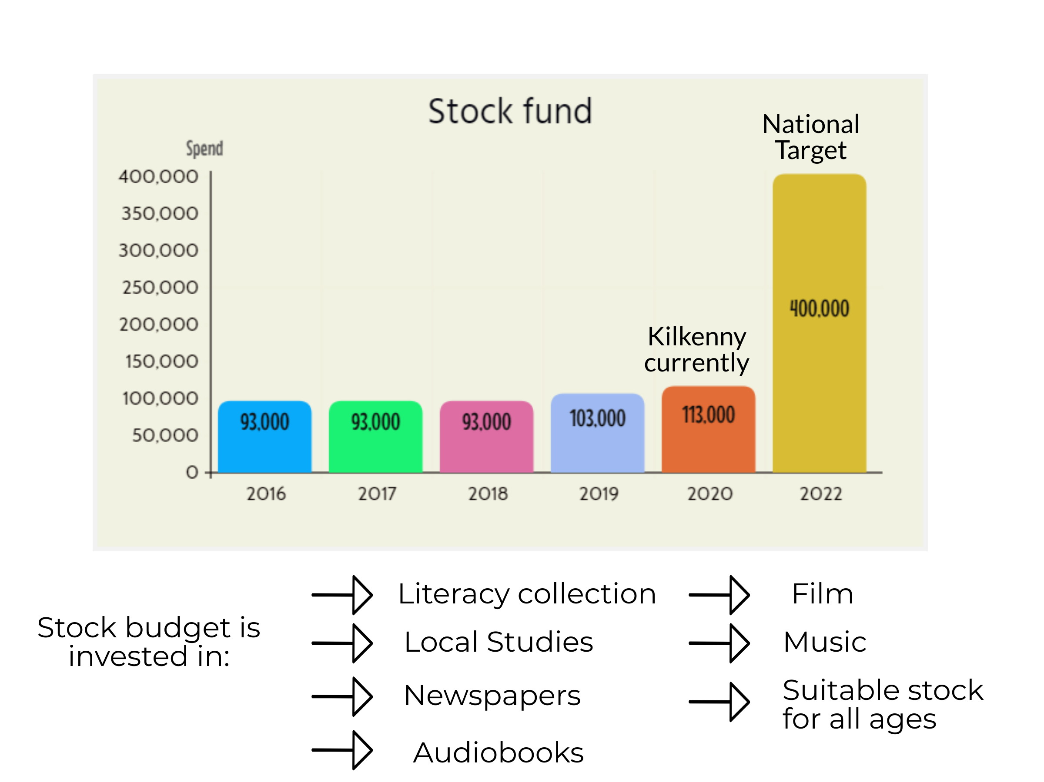
Notes:
Other Targets – Aligned to increasing membership and ensuring these members return and utilise the library is the national stock fund target of €4.00 per head of population. Kilkenny is currently at €1.13 per head of population and this graph reflects the investment over the past 4 years - €93,000 in 2016 to €113,000 in 2020 so we have someway to go to ensure we are investing in this vital area. We are currently the lowest in the South East – Carlow €1.76, Waterford €1.85, Offally €1.80 and Wexford €2.07. The stock budget is invested across a wide range of formats and areas and we try to do this as equitably as possible across 8 branches, the mobile library and Local Studies. We can only spread it so far.

Slide 12
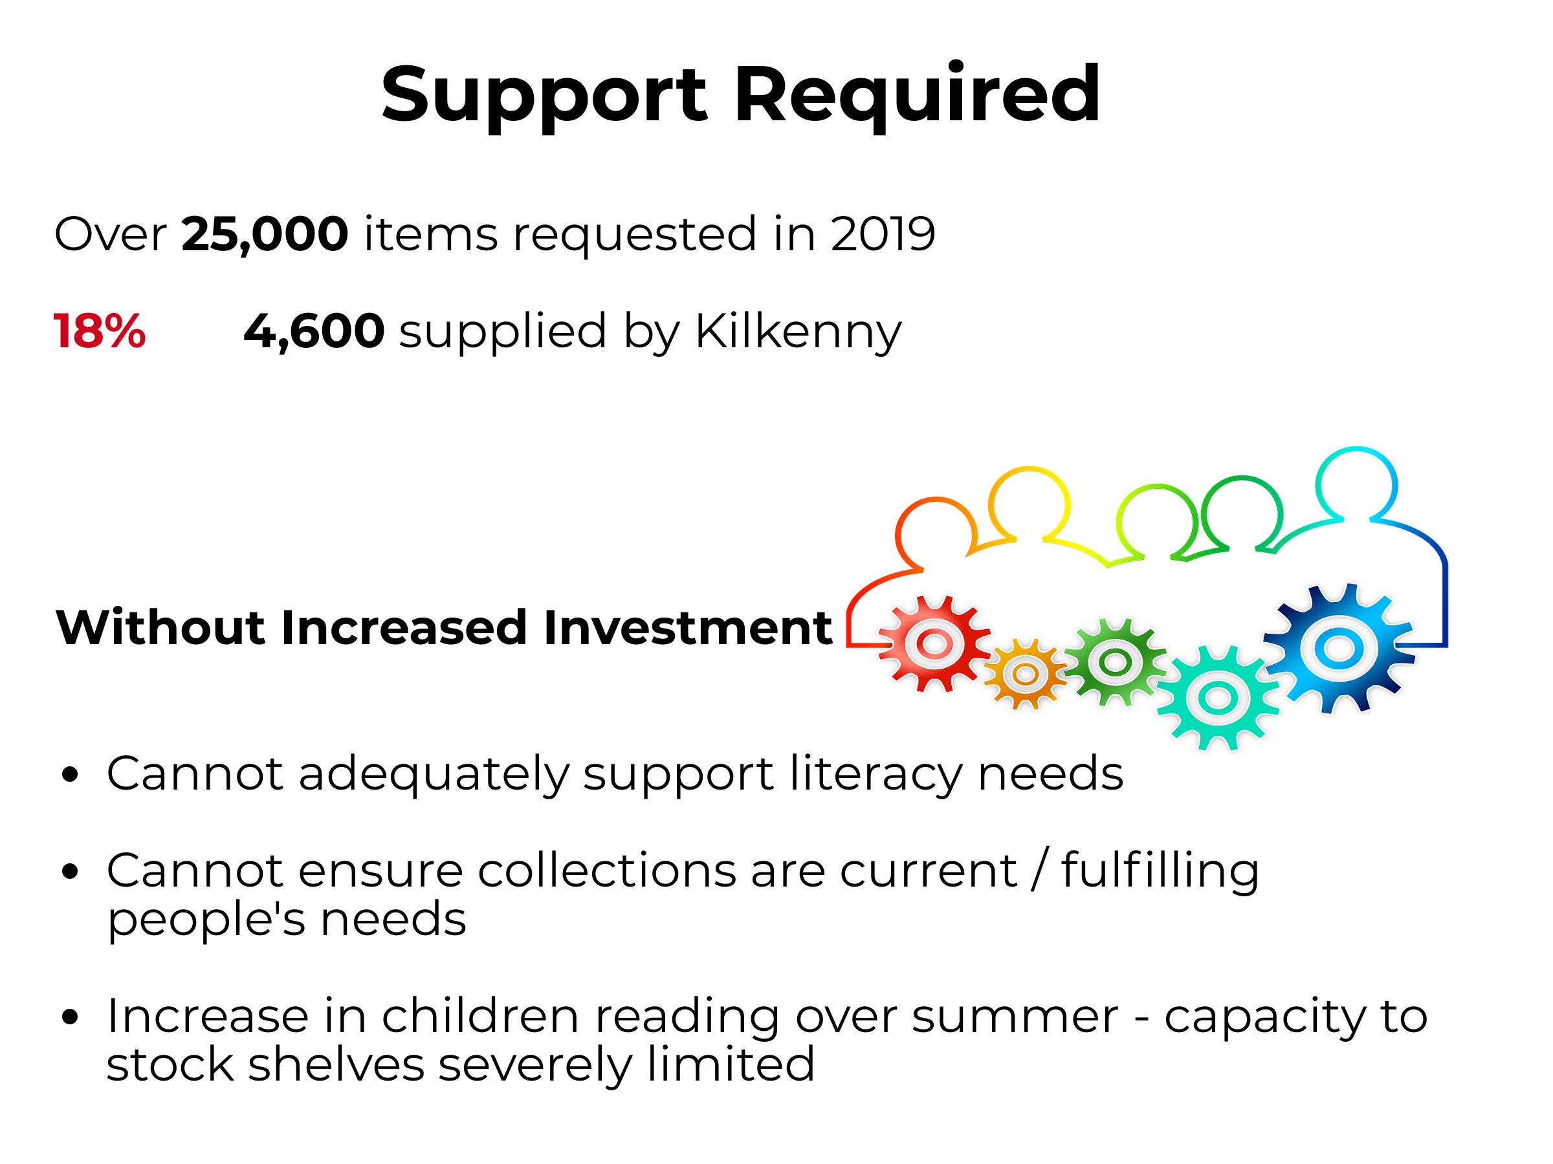
Notes:
While we have tried to invest as effectively as possible and ensure we have collections that are dynamic and current we face challenges . In 2019 we had over 25,000 items requested by Kilkenny borrowers and our stock was only able to satisfy 18% of those requests – we had to go to other local authority library services to fulfil 82% of these requests.
During July and August 16,000 children's books were read as part of the Summer Reading Challenge – this is a great success story however the shelves were practically emptied and we do not have capacity to replenish these so we have to wait until they are returned to us.
The lack of investment assumes that people who need the stock most have other ways of accessing stock – often they do not and we run the risk of losing members
In summary while we are doing fantastic work in engaging with people and promoting the library our worry is that we will lose their interest as our collections are not as current and comprehensive as they should be . By growing the demand and interest for library services you increase people’s expectations and this requires increased investment to ensure we can provide for this. By applying an incremental increase of €50,000 per annum we would have reached €2.65 per head of population by 2023.

Slide 13
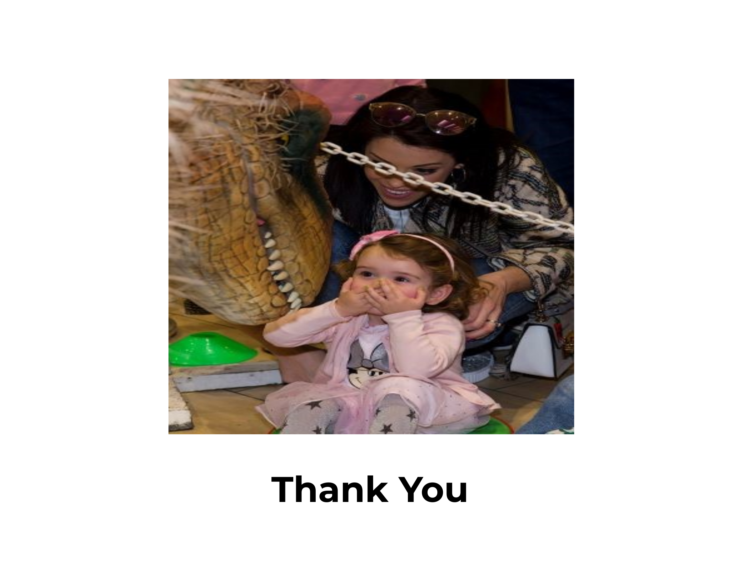
Notes:
Libraries are solid tangible evidence of public money returned directly to a community as public value . I would like to take this opportunity to thank you for your support and commitment towards the library service which as resulted in a service that is customer driven .

