Slide 1
Abbey Quarter – Conservation Plan

Slide 2
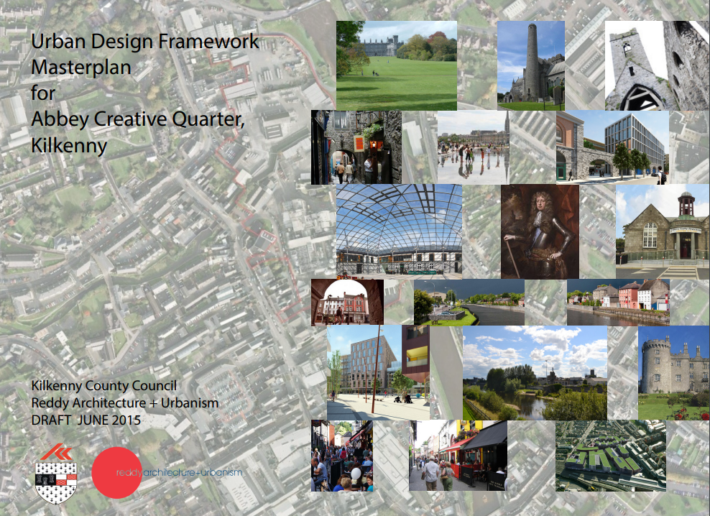
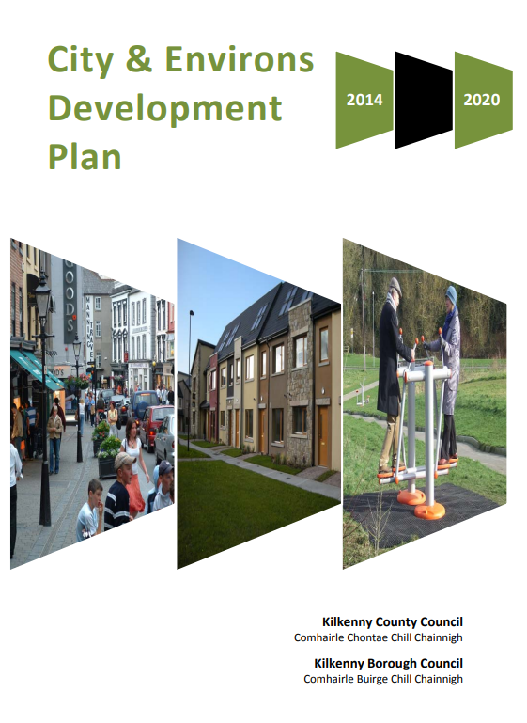
Abbey Quarter – Masterplan
Commitment to prepare a Conservation Plan for heritage structures on the Abbey Quarter site
Kilkenny city & Environs Development Plan 2014 – 2020
Variation no. 1
Objective 3J
To prepare a Heritage Conservation Plan for St. Francis Abbey, Evans’ Turret and St. Francis’ Well in the context of the existing City Wall conservation plan in conjunction with the Heritage Council, the Office of Public Works, the National Monuments Service, the Department of Arts, Heritage and the Gaeltacht and other relevant stakeholders.

Slide 3
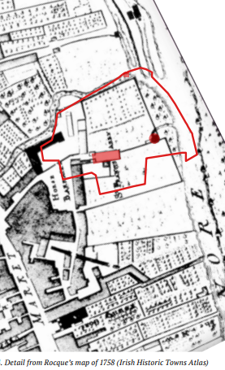
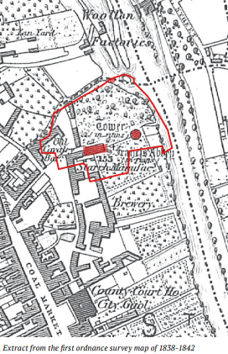

Slide 4
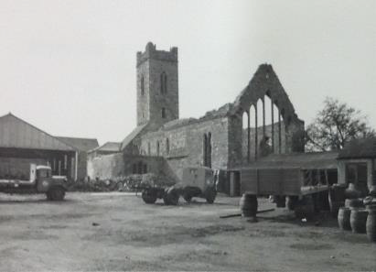
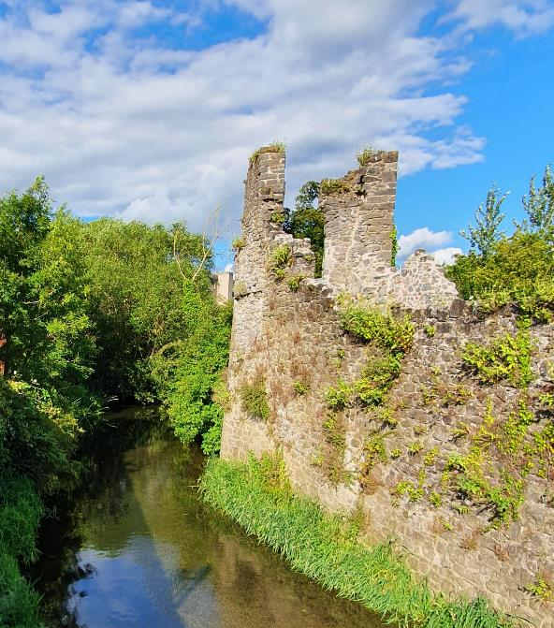
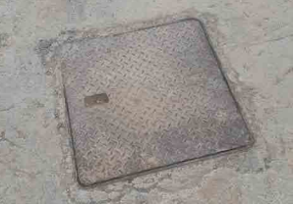
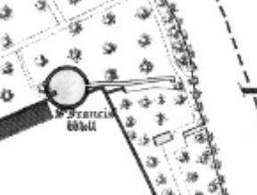
Conservation
Plan

Slide 5
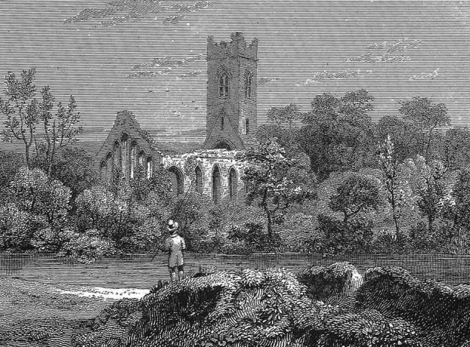
Conservation Team
Architects – Howley Hayes Cooney
Engineers – CORA Consulting Engineers
Archaeologist - AMS Archaeology
Ecologist - Scott Cawley Ecologists
Steering Group
Kilkenny County Council
  Conservation Officer
  Heritage officer
  Project Manager
Office of Public Works
National Monuments Service

Slide 6
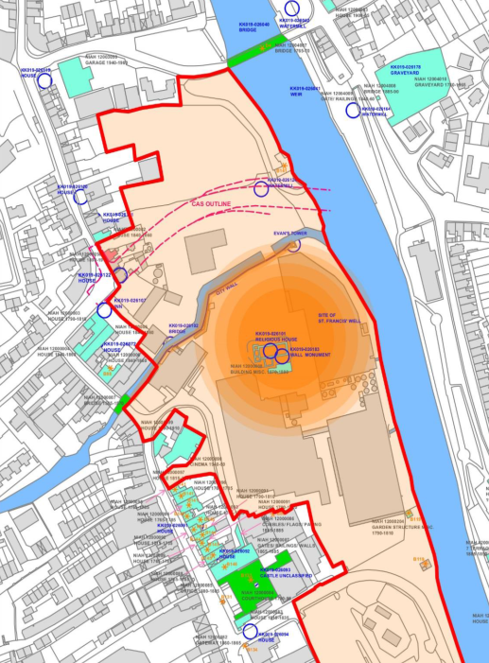
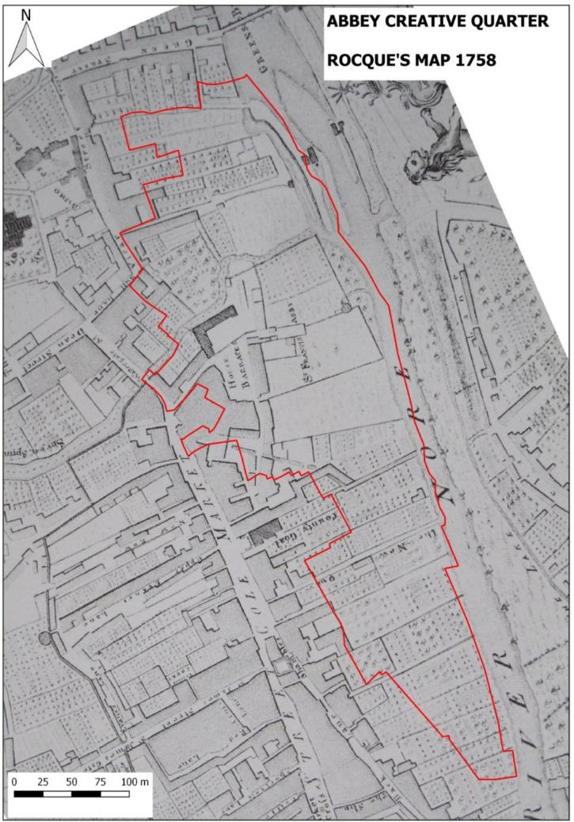

Slide 7
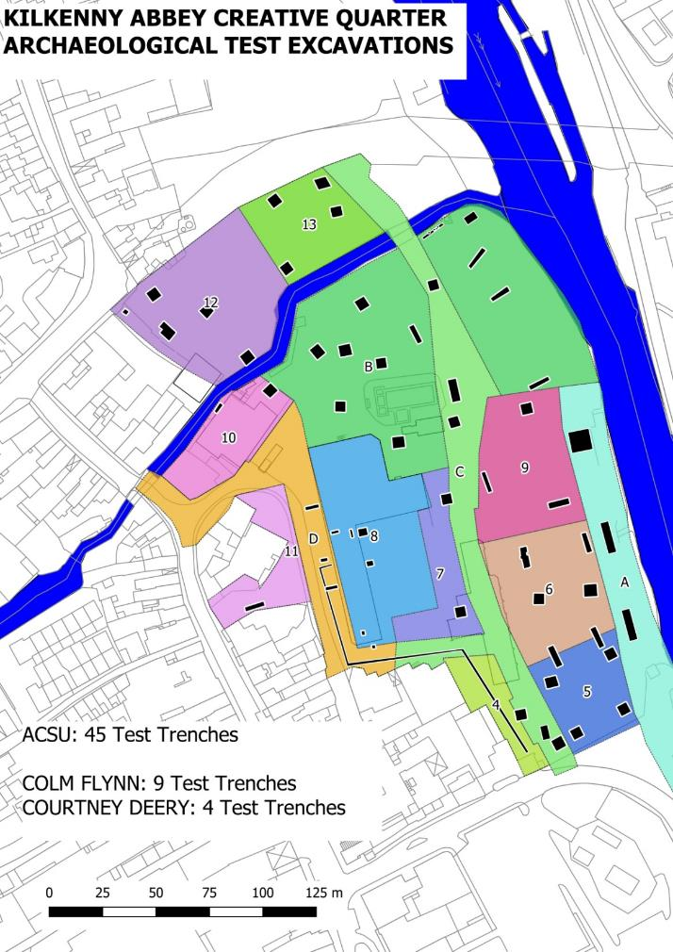
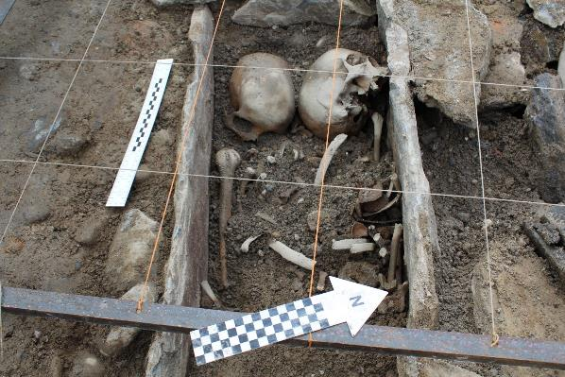
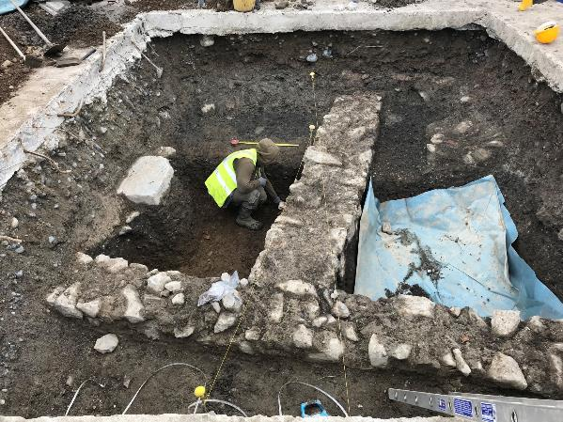
Archaeology

Slide 8
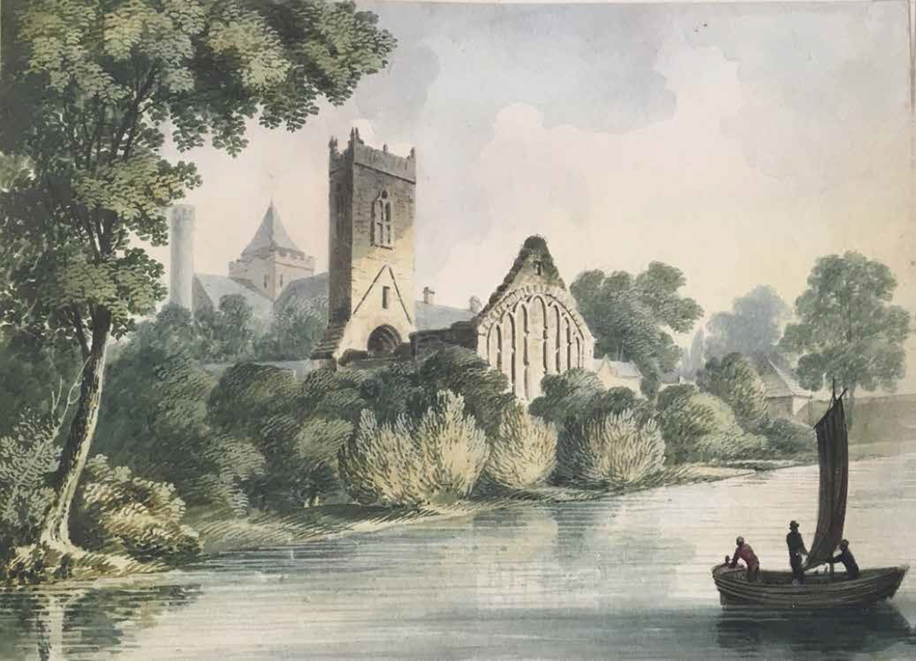
Structure of Conservation Plan
Understanding the Place
Physical Evidence
Statement of Significance
Condition Survey
Ecology
Defining Issues & Threats
Conservation Strategies
Development Strategies

Slide 9
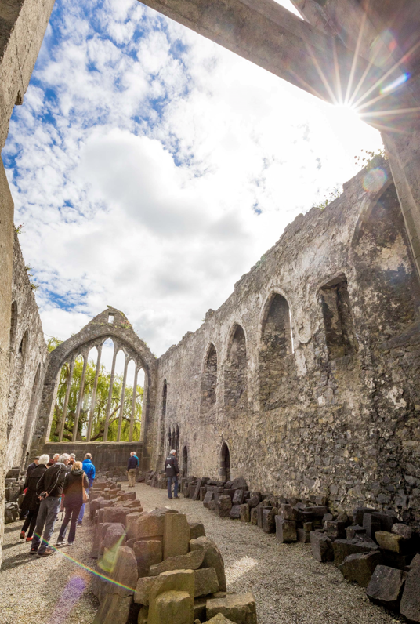
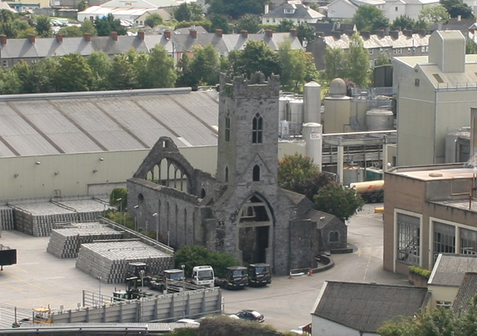
Defining Issues & Threats
Redundancy & Neglect
Greatest single threat
Requires a planned programme of maintenance and conservation
Interpretation
Presentation of below ground archaeology
Condition & Use
Brewery use was not sympathetic to the structures
Access & Settings
Improved access to the structures
Proposed park improves the setting of the abbey – removing the
former industrial yard

Slide 10
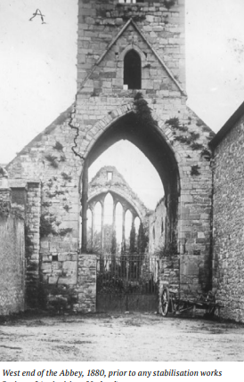
Conservation Strategies
International Charters & Conventions
  UNESCO ‘International Charter for the Conservation of Monuments and sites (Venice Charter)
  UNESCO ‘Convention Concerning the Protection of World Cultural and Natural Heritage’
  Convention for the Protecion of Architectural Heritage of Europe’ 1985 (Granada convention)
  ICOMOS ‘Charter for the Conservation of Places of Cultural Significance’ (Burra Charter)
  ICOMOS ‘Charter for the Protection and Management of Archaeological Heritage’
  ‘European Convention for the Protection of Archaeological Heritage’ 1992 Valetta Treaty
National Monuments Legislation - National Monument
  Ministerial Consent
Planning & Development Act
  Development Plans to include objectives for ‘the conservation and protection of the environment incl. in particular the archaeological and natural heritage’
Kilkenny City & County Development Plans
Burra Charter - “…as little as possible but as much as necessary…”

Slide 11
Conservation Strategies
Conservation Plan sets out conservation work for each structure.
  Urgent, Short term, Medium Term, Long term
Policies
  Protection of Archaeological Heritage (Buried)
  Protection of Archaeological Heritage (Standing)
  Repair & maintenance
  Intervention
  Reversibility
  Visitor Facilities
  Expert Advice & Skills
  Continued Liaison
  Settings & Key Views
  Inspections
  Monitoring
  Ecology
Notes:
Structures are in a fair condition following conservation works over the years
Structures were previously inaccessible – improved access needs to be balanced with ensuring their preservation

Slide 12
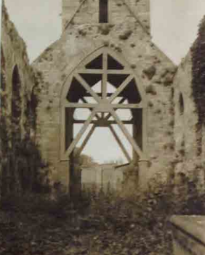
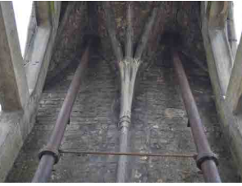
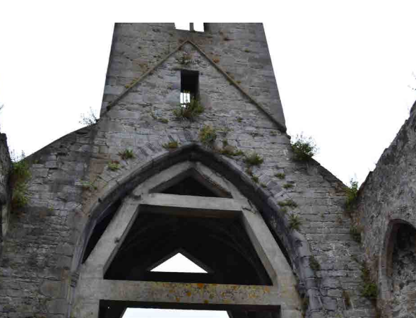
1880
Notes:
Structures are in a fair condition following conservation works over the years
Structures were previously inaccessible – improved access needs to be balanced with ensuring their preservation

Slide 13
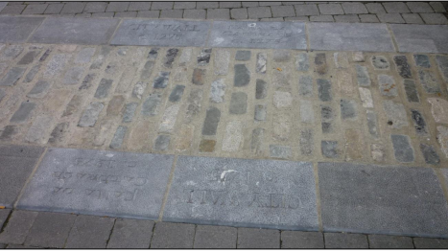
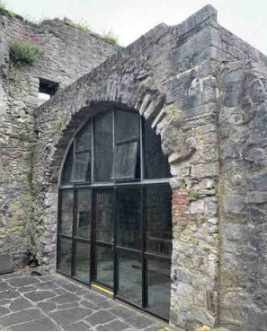
Development Strategies
Proposed park very significantly improves the setting of the Abbey, City Walls, Evans Turrett
Park includes proposals to interpret the below ground archaeology.
New use to be sought for the former sacristy area
Clear need for KCC & OPW to work together on proposals for the park & Abbey.
Design concept prepared for the interface between the park and the Abbey.
Proposed to reflect the location of St Francis well with a water feature.
Consider Options for access to Evans turret, possibly as a viewing platform.
In the long term, consideration should be given to the removal or modification of the Tasting Room
New buildings to give consideration to opening up views of the Abbey.

Slide 14
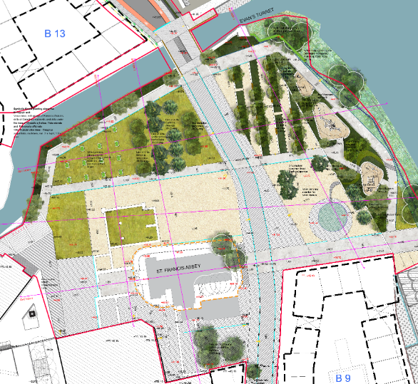
Transept
Nave
Ranges

Slide 15
Public Consultation
4 week public consultation from Monday 27th June 2022
to Monday 25th June inclusive.
Responses to Public Consultation to be considered by the Conservation Team and the Steering group.
Report on Consultations to return to Council in September 2022
DRAFT Conservation Plan to be updated as appropriate to take into consideration to responses to the Public Consultation.

