Slide 1
Irish Water Leakage Reduction Plan for Kilkenny 2023
Outline Plan to Reduce Leakage & Facilitate Growth in Kilkenny County Council

Slide 2
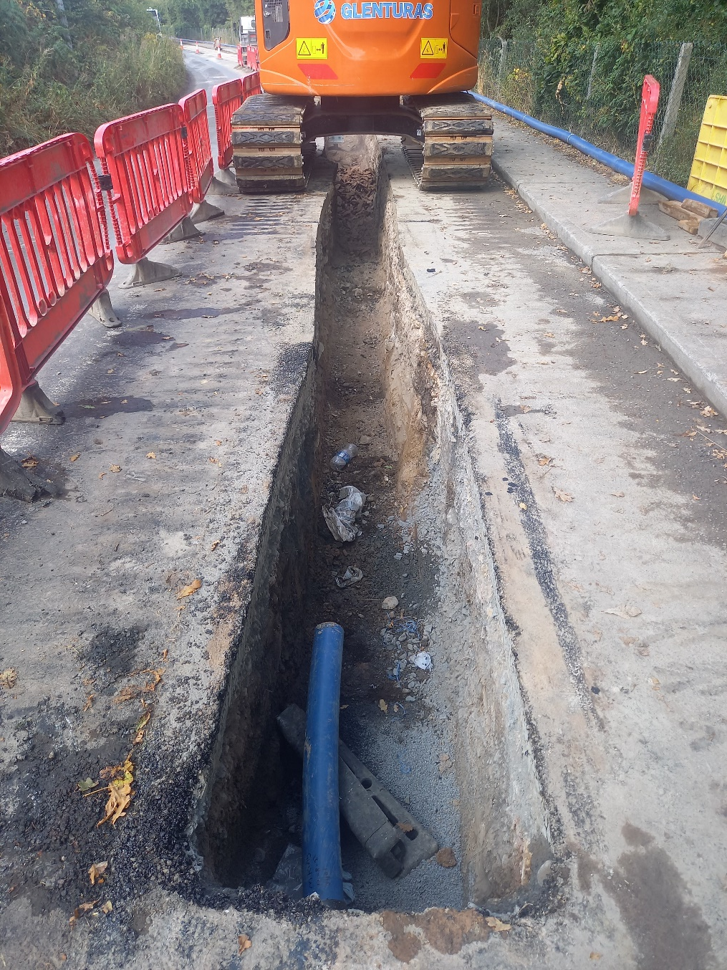
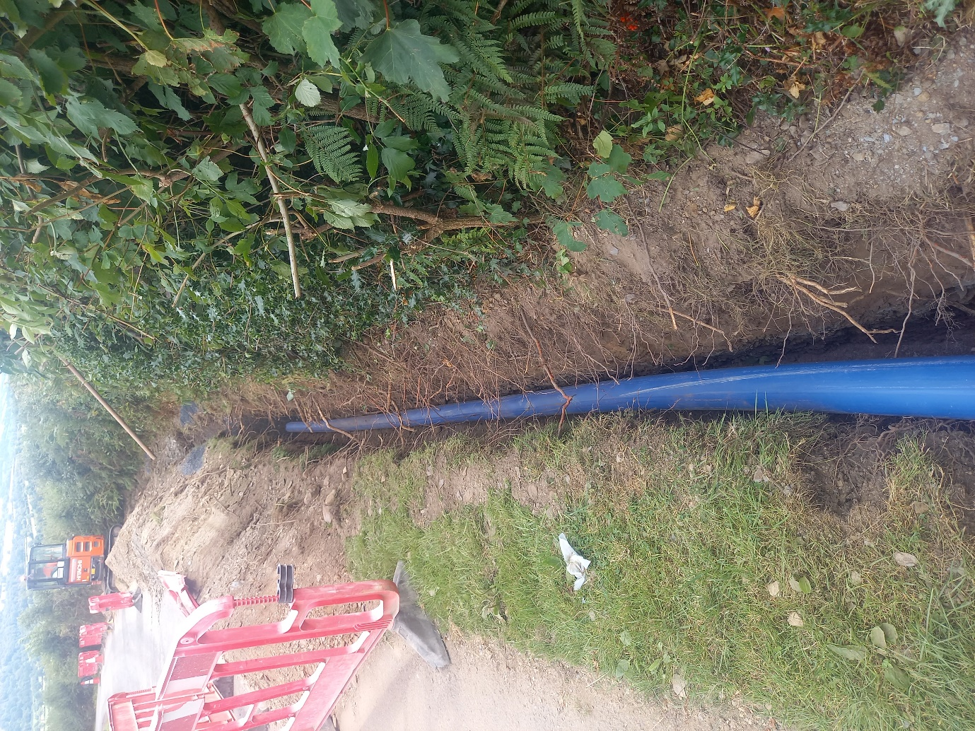
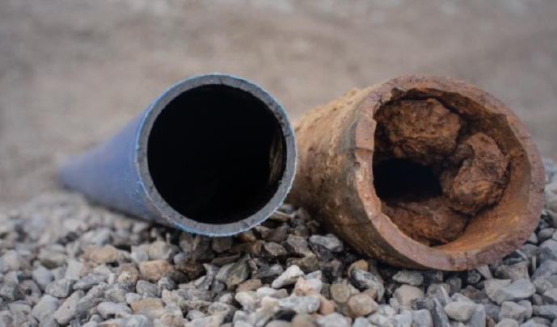
Water Main Rehab Program 2022-Present
Fatima Place BYS – 400m + 85 services (complete Q1 2021)
Jerpoint, Thomastown – 450m (complete Q3 2021)
Knocktopher Village – 1,250m (complete Q2 2022)
Michael St, Kilkenny BYS 250m + 25 services (complete Q2 2022)
Carrickmourne, Thomastown – 3,250m (complete Q4 2022)
Slieverue Village – 1,200m (complete Q3 2022)
Knockanore Cross to Norelands WTP – 5,270m (in-progress)
Dublin Rd, Thomastown – 1400m (in-progress)
St. Fiacres Place BYS – 600m + 99 services (in-progress)
Construction of new HDPE water-main at Slieverue Village
Construction of new HDPE water-main at Carrickmourne, Thomastown
Typical existing Cast Iron Main condition versus new HDPE Main

Slide 3
Kilkenny - Mains Replacement Priority List 2023
Priority Rating | Title | Main | Main Length (m) | Diameter | Material
1 | Bennettsbridge Regional WS – Rathduff – Ballyreddin South R700 | Main | 4,000 | 100 | uPVC
2 | Radestown WS - Radestown - Ring Rd | Trunk Main | 1,400 | 375 | AC
3 | Mooncoin WS - Clogga Cross - Tubrid Res & Tubrid Res Downstream Main | Main | 2000 & 400 | 125 & 150 | AC
4 | Goresbridge/Paulstown/Gowran WSZ - Duninga | Main | 3,300 | 100 | CI
5 | Bennettsbridge Regional WS Bennettsbridge - Annamult | Main | 4,000 | 100 | uPVC
6 | Mooncoin WS - Grannagh - Lickettstown Res | Main | 3,300 | 150 | uPVC
7 | Radestown WS - Bonnettsrath Rd - Rath Ullord | Main | 1,900 | 100 | AC
8 | Ballyragget WSZ - Rathduff | Main | 720 | 75 | HDPE
9 | Bennetsbridge WSZ - Bishopslough | Main | 1,300 | 100 | uPVC
10 | Bennetsbridge WSZ - Tullaherin | Main | 1,700 | 100 | uPVC

Slide 4
Kilkenny - Mains Replacement Priority List 2023
Priority Rating | Title | Main | Main Length (m) | Diameter | Material
11 | Clonassy WSZ - Grange | Main | 1,200 | 100 | AC
12 | Clonassy WSZ - Silversprings | Main | 500 | 150 | AC
13 | Clonassy WSZ - Clonmore | Main | 1,400 | 100 | AC
14 | Clonassy WSZ - Mooncoin Village | Main | 1,000 | 100 | AC
15 | Gowran WSZ - WTP - Gowran Reservoir | Main | 1,400 | 200 | AC
16 | Bennettsbridge WSZ - Tullaherin - Dungarvan | Main | 1,700 | 100 | uPVC
17 | Callan WSZ - Collins Park | Main | 440 | 75 | CI
18 | Thomastown WSZ - Oldcourt - Kilcross | Main | 550 | 75 | uPVC
19 | Bennetsbridge WSZ - Stoneyford to Kells | Main | 1,300 | 100 | uPVC

Slide 6
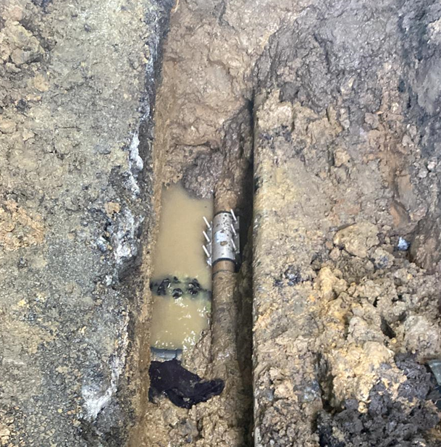
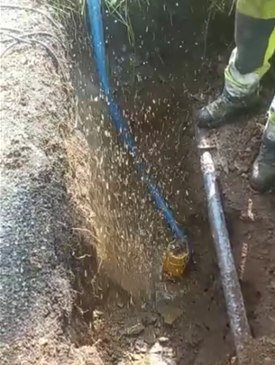
Find and Fix Program
The Find and Fix process continued through 2021
Planned and structured program where find crews use network information to streamline efficiencies with finding leakage
Improved network visibility from 50% in March of 2021 to 85% in December of 2022, resulting in improved information on high leakage areas
In Q3 2022, rollout of a trial leak acoustic listening system. This entailed the installation of 500 smart listening devices into the water network in the Kilkenny City and Callan Town areas. The smart listening system has assisted in the locating of 22 leaks
Reduced leakage within the Bennettsbridge, Goresbridge, Castlecomer, Thomastown, Inistioge, South Kilkenny, Piltown and Kilkenny City water supply zones.
Leak Repair in Annamult,
Bennetsbridge
Burst Main in Kilcross,
Inistioge

Slide 7
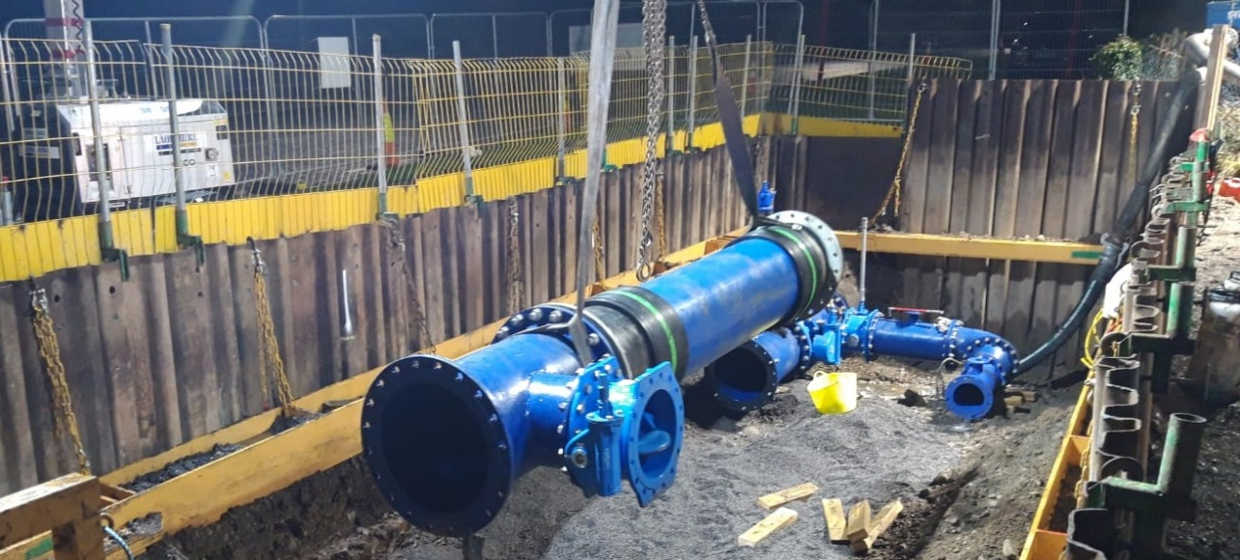
Pressure Management Program
Two new pressure reducing valves (PRV’s) were installed in Kilkenny City in 2021
PRV’s work by reducing pressures on an automatic basis, reducing network pressures at various times of the day
PRV’s have instant impacts on leakage rates and long term impacts on network burst frequencies
Estimated 15% reduction in burst frequency
Smaller scale PRV’s installed at Kiltown Cross, Inistioge & Fiodh Mor, Ferrybank 2022

Slide 8
First Fix Program
Cold calling resumed in 2022 after Covid-19 restrictions lifted
New regional contractor commenced FF works in Q2 2022 on Customer-Side-Leaks
Each Customer is entitled to one initial fix on the private side once consent is provided to Irish Water (IW)/Regional Contractor (RC) to undertake the repair, repair must be outside the footprint of the house
Kilkenny County Council find, quantify and report Customer Side Leaks over to IW and the RC for action

