Slide 1
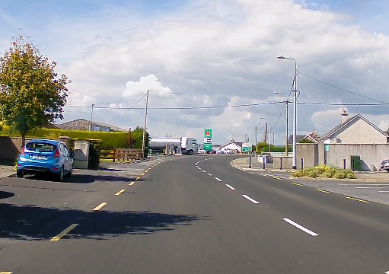
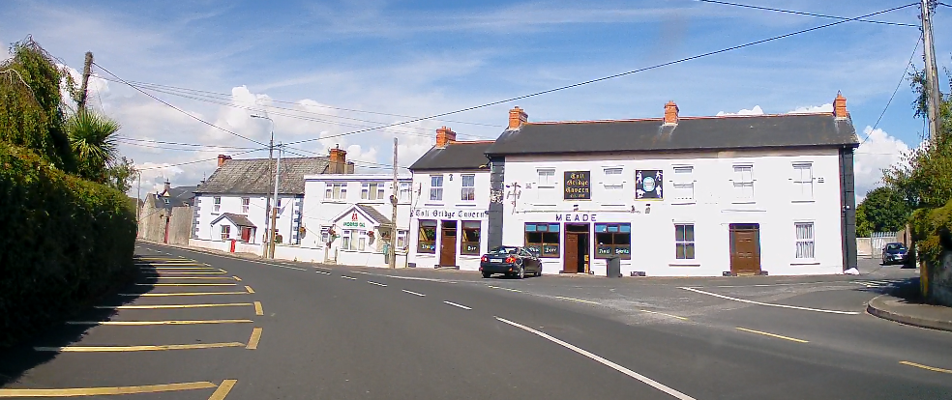
Fiddown Village Improvement Works Scheme Update 16th October 2023

Slide 2
CONTENTS
Existing Conditions
Proposed Improvements
Scheme Benefits
Bus Stops
Raised Table Crossings
Junction Tightening
Public Consultation
Overview
Submissions
Informal Input
Changes between Section 38 Design and Updated Design

Slide 3
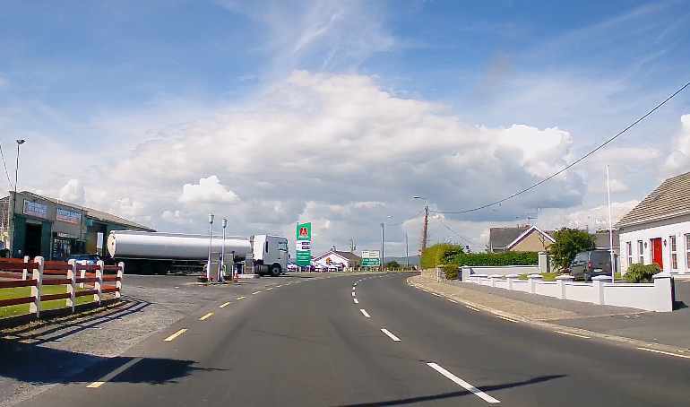
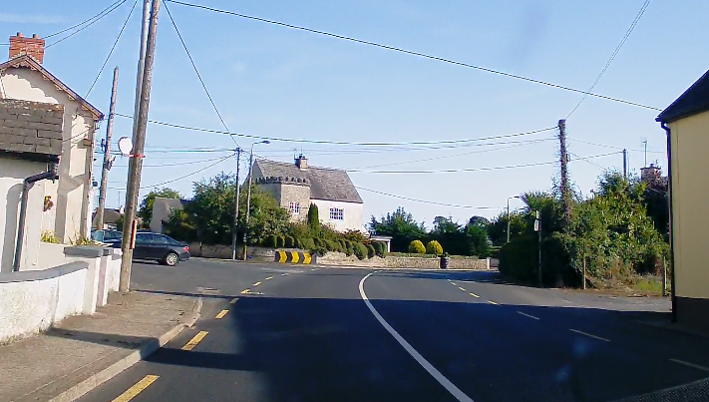
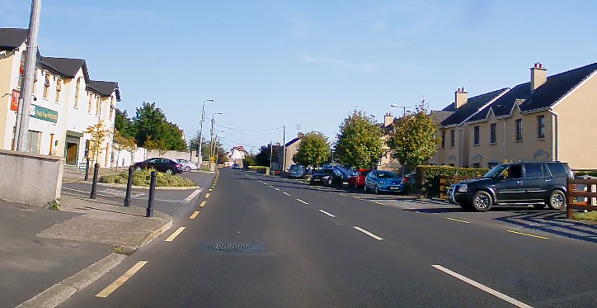
1. Existing Conditions
Village is defined by the R698 regional road along which the core village has developed.
The regional road has priority throughout, with multiple local and direct access forming priority junctions.
The primary commercial properties in the village are Merry’s Garage, the building accommodating the Montessori and Chinese takeaway, and Meade’s pub.
There are footpaths at various locations, with some uncontrolled crossings across the local roads.
The current bus stop location is along a bend in the R698 adjacent to Meade’s Pub.
The issues are:
Pedestrian facilities are not continuous through the village and there are no crossings provided across the R698.
Bus stop locations are unsafe in terms of advance visibility for vehicles and pedestrian facilities and connectivity.
These features inhibit and discourage journeys by foot and by public transport for residents and visitors to Fiddown.

Slide 4
2. Proposed Improvements
Proposed junction tightening with road crossings and footpaths
Proposed Bus Stops with Shelters
Proposed Raised Table Crossing
Proposed Raised Table Crossings with associated footpath connections
Principal characteristics:
Bus Stops Relocated and shelters provided
3 no. raised table pedestrian crossings provided
Junction at Meade’s Pub tightened. Raised table provided across junction with pedestrian facilities

Slide 5
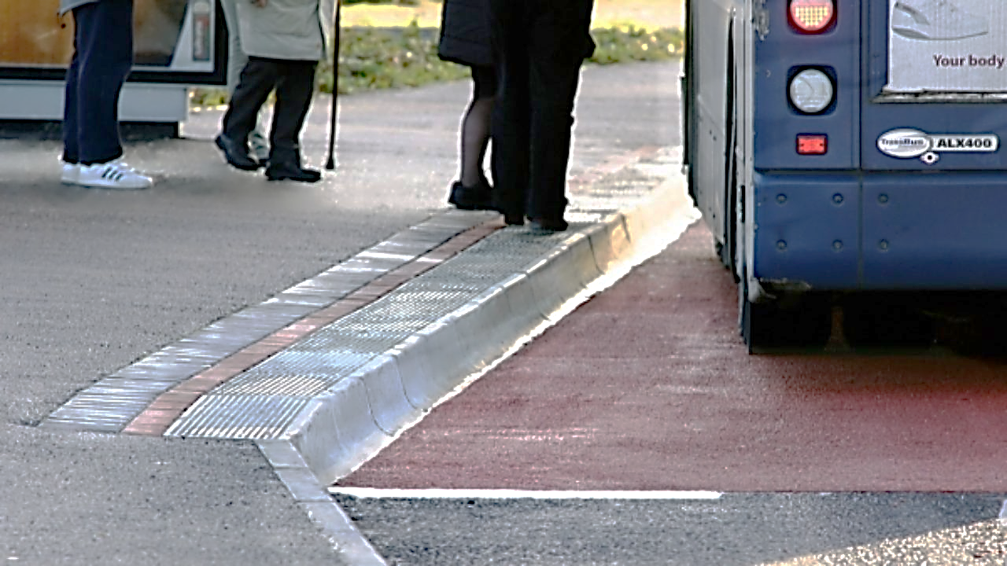
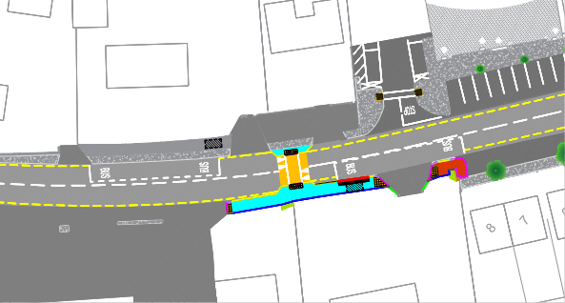
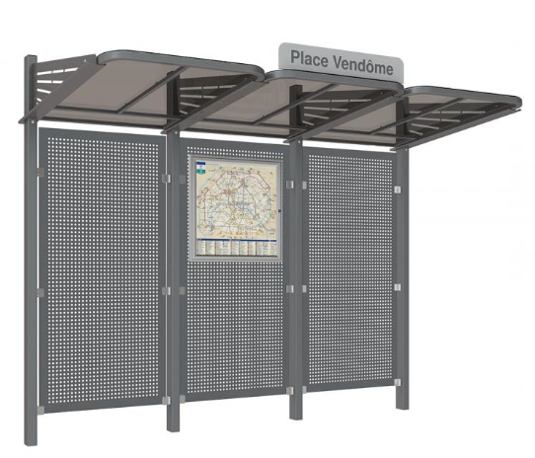
Bus Stops
Bus Stops to be relocated from their current positions along the bend adjacent to Meade’s Pub to locations along the straight east of Merry’s Garage
Bus stop facilities to be provided including kassel kerbs and shelters with seating
Raised table uncontrolled pedestrian crossing to be provided between bus stops to improve connectivity to the bus stops
INSERT IMAGE OF BUS STOP WITH KASSEL KERBS

Slide 6
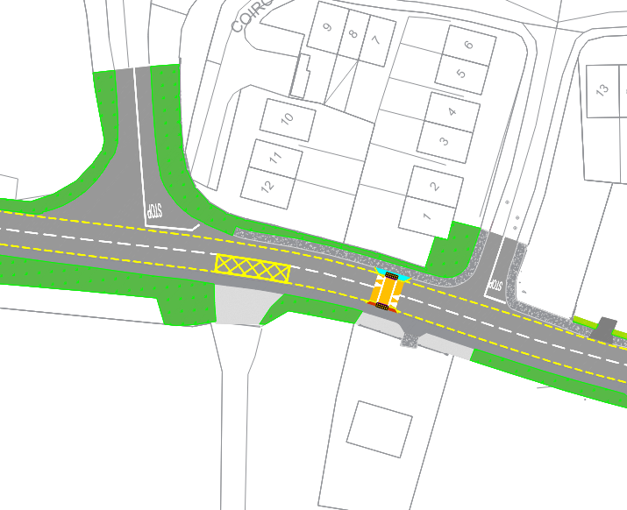
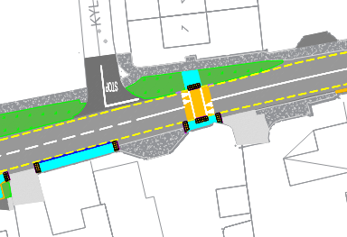
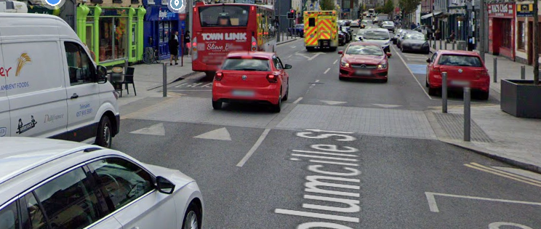
Raised Table Crossings
3 No. crossings to be provided
Western Crossing provides access to the footpath along the R698, linking Fiddown to Piltown.
Central Crossing provides access across the commercial area, the service station and the proposed bus stops.
Eastern Crossing links residents to the North and South, providing access to the inner facilities of Fiddown (the Pub and postbox)

Slide 7
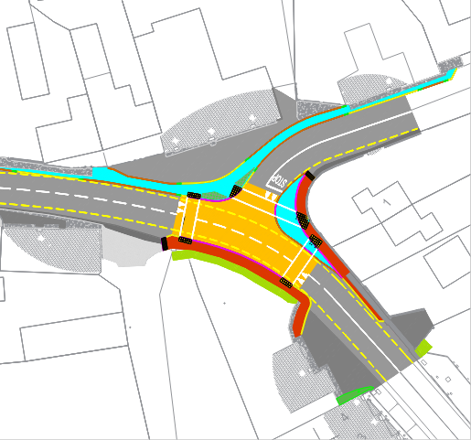
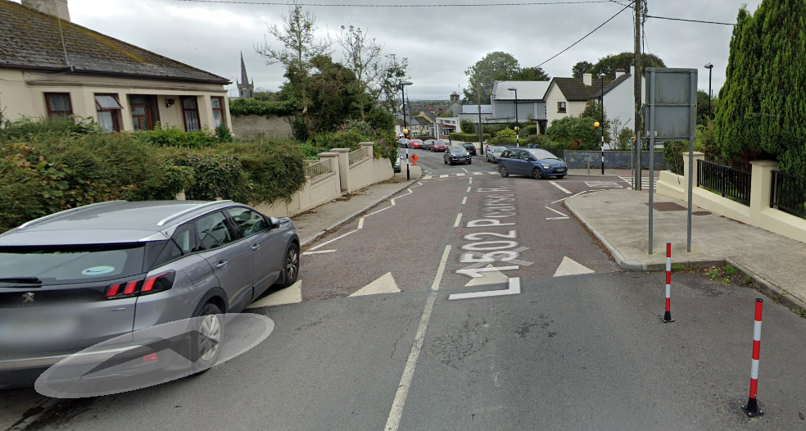
Junction Tightening
Tightening of junction to reduce vehicular speeds through the junction and to improve pedestrian facility by reduction of crossing distances.
Provides full pedestrian connectivity through the junction, linking in with existing footpaths, where present.
Comprehensive informal crossing provision including tactile paving at designated crossing locations
Promotes biodiversity via incorporation of SuDS elements while accommodating public realm drainage
Facilitates HGV turning and access to / from the local road

Slide 8
3. Scheme Benefits
Access – Improved permeability and connectivity both within the village and externally via access to bus stops and existing footpath link to Piltown
Safety – Improved safety for all road users via:
traffic calming effects of raised table junction and crossing locations,
provision of continuous pedestrian route through the village including improved and additional pedestrian facilities,
junction modification reducing turning speeds and pedestrian crossing distances
formalised and accessible bus stop facilities
Public Realm – raises profile of VRU’s via traffic calming measures and improved pedestrian facilities, thereby enhancing the public realm through the village. Incorporation of SuDS measures adds to improved aesthetic at key location

Slide 9
4. Public Consultation - Overview
Section 38 Public Consultation held from 23-Aug-2023 to 20-Sept-2023
Scheme particulars made available:
Online,
At the Piltown Community Centre, Ardclone, Piltown from 9am to 10pm, Monday to Saturday, and
At the area office of Municipal District of Piltown, Ferrybank Shopping Centre, Ferrybank, Waterford from 9am to 1pm & 2pm to 5pm Monday to Friday (excluding weekends and Bank Holidays)
Due date for submissions was 20-Sept-2023
2 No. formal submissions received.
Additional input received informally and considered.

Slide 10
Public Consultation - Submissions
Ref. | 1
Received on / by | 15-Sept-2023 via email
Issues Identified | Concern regarding proposed location of the westbound bus stop citing a potential issue with sightlines for westbound traffic and relating to the traffic movements accessing Merry’s Garage.
Response | The proposed bus stops are intended to include bus shelters and kassel kerbing and are to be connected to key destinations in the village by accessible footpaths and road crossings. To accommodate these elements, and to ensure the bus stop locations best serve the passengers wishing to use them, a range of issues and potential locations were considered. The issues included the available width of the road, adjacent verges and footpaths to accommodate the bus stops; sight distance along the regional road to and from the bus stop locations; potential for incorporation of a pedestrian crossing in close proximity to the bus stops; proximity to main residential areas in Fiddown; convenience of the location in terms of how the bus stops would be accessed by passengers both on foot and in cars and proximity to Merry’s Shop. The proposed location adjacent to Merry’s Garage was identified as the preferred location as it addresses the issues identified while limiting both modifications to the existing conditions and disruption to adjacent properties. Sight lines to and from the proposed bus stop locations meet the requirements of the applicable design standards. In addition, the provision of pedestrian crossings with raised tables at regular intervals through the village will serve to calm traffic and shall ensure speeds on approach to the bus stopping locations are appropriate.
Associated Design Modifications | None

Slide 11
Public Consultation - Submissions
Ref. | 2
Received on / by | 18-Sept-2023 via email
Issues Identified | Request for clarification relating to construction of footpath in the vicinity of Meade’s Pub and any connection between the footpaths and the existing pub structure. Concern raised relating to impact of proposed scheme on building structure where the footpath is connected or where road levels are raised in front of the building.
Response | The proposed arrangement in the vicinity of Meade’s Pub will not involve any buttressing against the building structure at that location, and the pavement immediately in front of the property will not be modified. Footpaths will be provided as part of the junction tightening with level differences limited in places to facilitate short duration vehicular access to the property as well as access for pedestrians at crossing locations. New gullies will be provided at low points in the area where existing surface water flow lines are modified by the introduction of footpaths. In addition, where paving is to be modified, a channel will be formed between the paving and the building, at the edge of the paving, to collect runoff from the pavement and footpath where necessary. This channel will outfall into gullies which will connect with the closed drainage network.
Associated Design Modifications | None

Slide 12
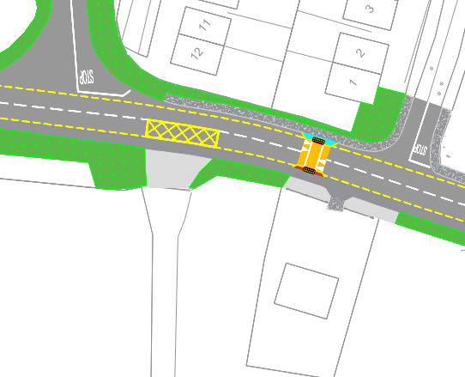
Public Consultation – Informal Input
Issue Identified | Planning Permission 17/295 (extended by 22/458) for Piltown Engineering relating to land access adjacent to proposed pedestrian crossing location.
Associated Design Modifications | Proposed pedestrian crossing relocated to the east to avoid conflict with future development.
Issue Identified | Requirement for junction to accommodate HGV access to Morris’ Oil Depot to rear of Meade’s Pub
Associated Design Modifications | Junction modified to incorporate overrun area in reinforced concrete, with pedestrian dwell area set back.

Slide 13
5. Changes between Section 38 Design and Updated Design
Relocation of western pedestrian crossing
Modification of junction arrangement

Slide 14
Fiddown Village Improvement Works Scheme Update 16th October 2023

